Slide 1
Application of New Achievements in the Development of 5G
Igor Bojadjiev igor.bojadjiev@aec.mk
Skopje, 20/05/2025

Slide 2
Application of New Achievements in the Development of 5G
Igor Bojadjiev igor.bojadjiev@aec.mk
Skopje, 20/05/2025

Slide 3
Application of New Achievements in the Development of 5G
Igor Bojadjiev igor.bojadjiev@aec.mk
Skopje, 20/05/2025

Slide 4
Introduction
Regulatory part
Technical part

Slide 5
1. Regulatory Part

Slide 6
Introduction of 5G in Macedonia
11/07/2022 Successfully end the tender procedure for implementing 5G
3 Licenses were issued
2 Licenses for mobile services
1 License for FWA

Slide 7
Frequency Bands

Slide 8
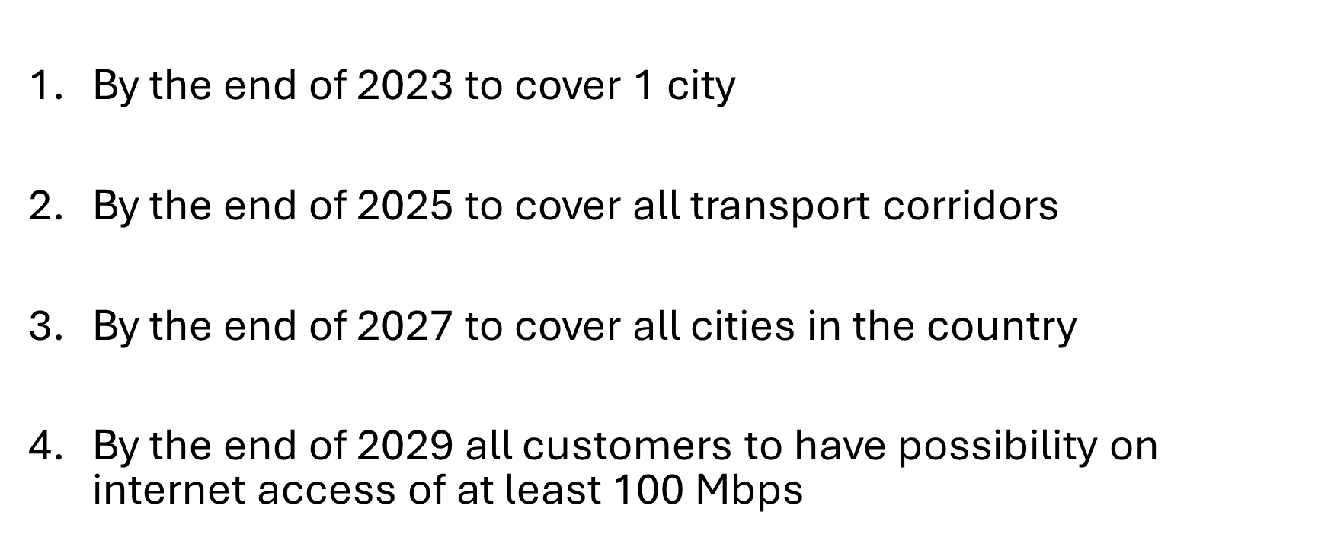
5G Conditions

Slide 9
Technology Neutral

Slide 10
3 Years Later

Slide 11
Carrier Aggregation (5G/5G and 5G/LTE)

Slide 12
Data Speed/CA
Max Data Speed-real conditions
CA-combination

Slide 13
Carrier Aggregation in Fixed Service (Links)

Slide 14
E-band (71-76/81-86 GHz)

Slide 15
Licenses and Aggregation
22-23.6 GHz
71-76/81-86 GHz

Slide 16
Terrain Profile and Overview

Slide 17
Terrain Profile and Overview

Slide 18
Terrain Profile and Overview

