Slide 1
Overview of the EKIP's obligations under NEWLY ADOPTED LAWS (Related to Spatial Planning and Construction of Structures)
Skopje, 20. – 21. MAY 2025.
Mirjana Smolović
Spatial Planning Documents Manager
in the Electronic Networks and Services Sector
Agency for Electronic Communications and Postal Services Montenegro
mirjana.smolovic@ekip.me

Slide 2
CONTENT
New Laws
Obligations under the Law on Electronic Communications ("Official Gazette of Montenegro", No. 100/24)
Obligations under the Law on Spatial Planning ("Official Gazette of Montenegro", No. 19/25)
Obligations under the Law on Construction of Structures ("Official Gazette of Montenegro", No. 19/25)
Proposals for improvements in the field of construction of facilities
Summary of the Agency's obligations

Slide 3
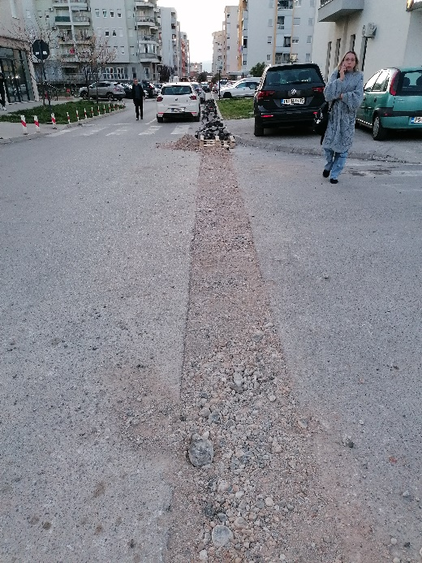
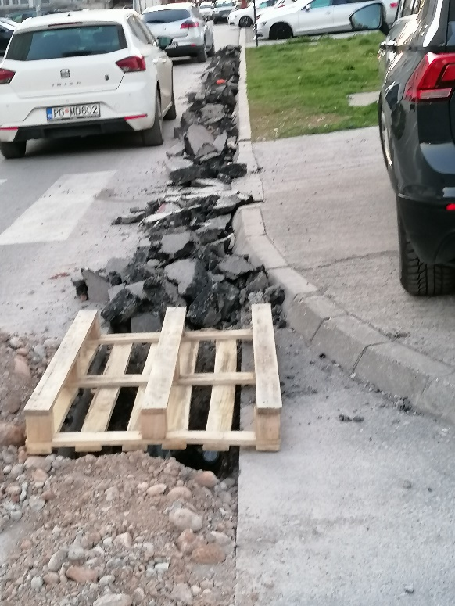
Does it have to be like this?
3 od 16

Slide 4
Does it have to be like this?

Slide 5
Does it have to be like this?
5 od 16

Slide 6
NEW LAWS
Law on Electronic Communications
working group on the law
the intention for the adoption of a new law is to transpose the provisions of the EECC into a new law
operator's comments and requests
adoption of the law October 2024

Slide 7
NEW LAWS
Law on Spatial Planning and Law on Construction of Structures
Agency's comments and requests
operator's comments and requests
adoption of the laws March 2025
the intention for the adoption of these separate laws in this field is focused primarily on decentralizing planning tasks and defining the authorities of the state and municipalities for adopting planning documents and issuing permits
one of the main novelties is the reintroduction of the building permit, which was not required by previous law
these laws are in line with European regulations and practices

Slide 8
Law on Electronic Communications ("Official Gazette of Montenegro", No. 100/24)
The Agency's new obligations are prescribed in Articles 17 and 20 of the Law on Electronic Communications
These obligations are related to granting approvals for the Final design for the construction of facilities and for the construction of transport infrastructure.
Article 17 prescribes the construction of an Electronic Communications Network in a building intended for residence and/or business activities
„The Agency shall approve the Final Design in the process of its revision for the electronic communications network, electronic communications infrastructure and related equipment in the building, for buildings with an area greater than 500m².”
Article 20 paragraph 4 prescribes construction in the transport infrastructure belt

Slide 9
Law on Spatial Planning ("Official Gazette of Montenegro", No. 19/25)
Article 36, paragraph 1, stipulates the obligation to submit data
body in charge of technical specifications and the operators shall submit the data within 10 days from the date of submission of the request
Article 37, paragraph 1, stipulates the obligation to submit an opinion
body in charge of technical specifications
within 15 days from the date of submission of the request
Article 45, paragraph 2, stipulates the obligation to submit planning document draft,, for the purpose of granting consent.
body in charge of technical specifications
this consent is granted within 15 days from the date of submission of the request

Slide 10
Law on Spatial Planning ("Official Gazette of Montenegro", No. 19/25)
Article 147 stipulates the obligation to issue the zoning and technical specifications for electronic communication infrastructure
body in charge of technical specifications
new obligation for EKIP
Contents of Zoning and Technical Specifications

Slide 11
Law on Spatial Planning ("Official Gazette of Montenegro", No. 19/25)
The zoning and technical specifications
The issuance of these conditions is foreseen until the adoption of planning documents in accordance with the Law on Spatial Planning ("Official Gazette of Montenegro", No. 19/25).
The deadline for the adoption of new planning documents from the date of entry into force of the Law on Spatial Planning
20 months for state planning documents,
22 months for local planning documents

Slide 12
Law on Construction of Structures ("Official Gazette of Montenegro", No. 19/25)
Article 5 prescribes the concept of objects of general interest
State objects of general interest are, among others, considered to be: electronic communication infrastructure and related equipment and/or electronic communication network; broadcasting facilities.
This Article 5, which defines, among other things, the traffic infrastructure, is significant from the aspect of the Agency's obligation to give consent to the Final design of the construction of this infrastructure.
Traffic infrastructure belongs to both local objects of general interest – municipal roads (local roads and streets in settlements) and state objects of general interest (all others).
Article 34 paragraph 1 prescribes the documentation on the basis of which a building permit is issued (except for family residential buildings):
6) consents, opinions and other evidence determined by special regulations
Paragraph 6 of Article 34 prescribes issuing this consent within 15 days from the date of submission of the request
new obligation for EKIP

Slide 13
Proposals for improvements in the field of Construction of Structures
In order to facilitate the introduction of very high-capacity networks, the European Union adopted The Broadband Cost Reduction Directive (2014/61/EU)(transposed into the Law on the Use of Physical Infrastructure for the Installation of High–Speed ​​Electronic Communication Networks ("Official Gazette of Montenegro", No. 1/22))
This Directive has not been applied consistently in the European Union. For this reason, the Commission proposed to replace this directive with the Gigabit Infrastructure Act. The Gigabit Infrastructure Act (GIA) entered into force on May 11, 2024, and will be fully implemented in November 2025. The GIA, which includes provisions regarding the physical infrastructure inside the building and obtaining the label "Prepared for broadband access", should be a guide for the future development and construction of networks in buildings for Montenegro as a country which strives to join the European Union,
Application of all valid Rulebooks, which will also be harmonized with the new Law on Electronic Communications.
SUMARNI PREGLED OBAVEZA AGENCIJE U SKLADU SA NOVOUSVOJENIM ZAKONIMA

Slide 14
SUMMARY OF THE AGENCY'S OBLIGATIONS IN ACCORDANCE WITH THE NEWLY ADOPTED LAWS
Space planning – plans
Applicant | Legal basis | obligation of the technical requirements authority –The Agency as the technical requirements authority responsible for electronic communications and postal services | Does the Agency have this obligation?
The Ministry local self–government unit | Law on Spatial Planning Article 36 | Data needed for the Planning Document – within 15 days | YES
The Ministry local self–government unit | Law on Spatial Planning Article 37 | Opinion on the Planning Document Draft – within 15 days | YES
The Ministry local self–government unit | Law on Spatial Planning Article 45 | Approval on the Proposed Planning Document– within 15 days | YES

Slide 15
SUMMARY OF THE AGENCY'S OBLIGATIONS IN ACCORDANCE WITH THE NEWLY ADOPTED LAWS
Construction of Structures
Applicant | Legal basis | obligation of the technical requirements authority – The Agency as the technical requirements authority responsible for electronic communications and postal services | Does the Agency have this obligation?
The Ministry local self–government unit | Law on Construction of Structures Article 34 Law on Electronic Communications Articles 17&20 | Consent to the Final design in the process of issuing a building permit – within 15 days | YES
The Ministry | Law on Spatial Planning Article 147 | Conditions issued according to special regulations by the authority for technical conditions (Technical Specifications for state objects of general interest) | YES
local self–government unit | Law on Construction of Structures Article 155 | Conditions issued according to special regulations by the authority for technical conditions (Technical Specifications for local objects of general interest) | YES

Slide 16
THANK YOU FOR YOUR ATTENTION!
Mirjana Smolovic
Spatial Planning Documents Manager
Electronic Networks And Services Sector
mirjana.smolovic@ekip.me

