Slide 1
Macedonia’s Accession to ITU and CEPT Mile Veljanov Skopje, May 20/2025

Slide 2
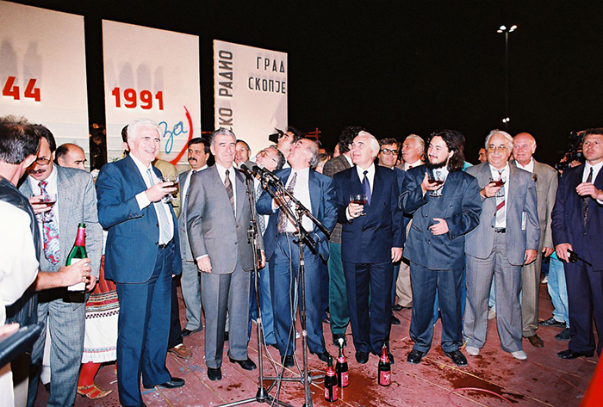
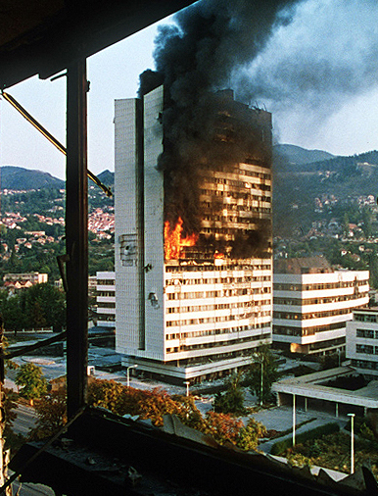
Macedonia before 1993
1990 – 1992, The breakup of Yugoslavia
Ethnic conflict among Bosniaks (Muslims), Croats, and Serbs.
1991, September 8 –Declaration of Independence
Saraevo - 1992
September 8, Independence Day

Slide 3
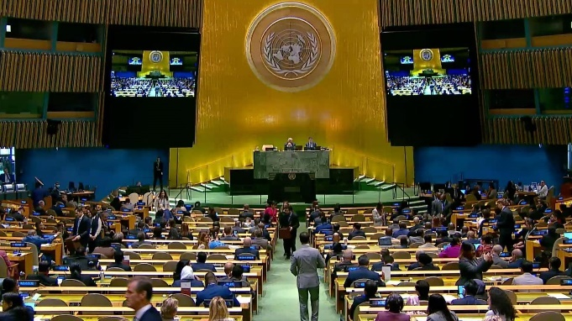
1993 – Macedonia 181st member of the UN
New York April 8, 1993
United Nations in New York City
United Nations – General Assembly

Slide 4
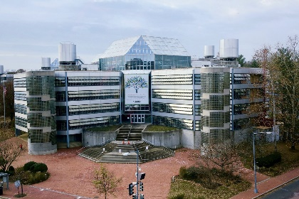
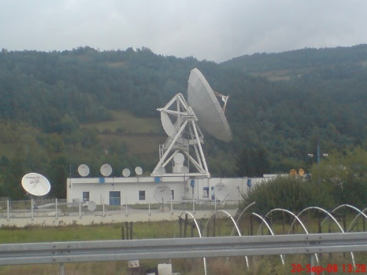
1993 - Important meetings
INTELSAT
SPRINT
Macedonian Telecom Satellite Center
NTELSAT headquarters, Washington, D.C
EX-YU Earth Station - Ivanjica, Serbia

Slide 5
1993 - Important persons
USTTI, Washington D.C
USTTI – 2005
USTTI – 1993

Slide 6
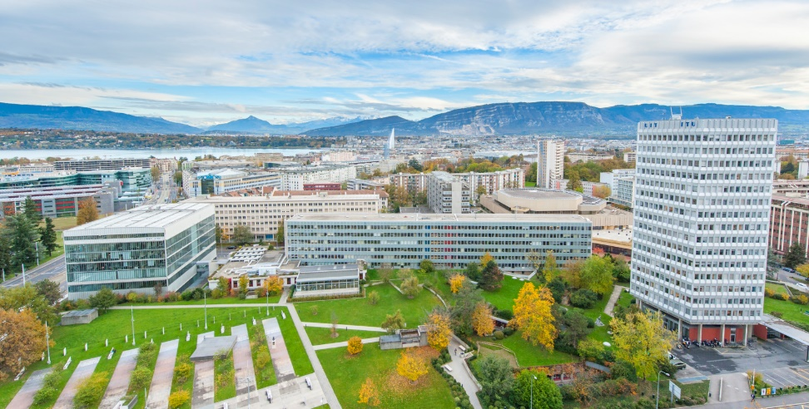
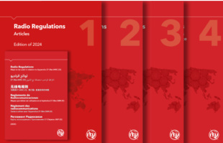
1993 – Macedonia member of the ITU
Geneva May 4, 1993
ITU – Radio Regulation
Geneva, International Telecommunication Union (ITU)

Slide 7
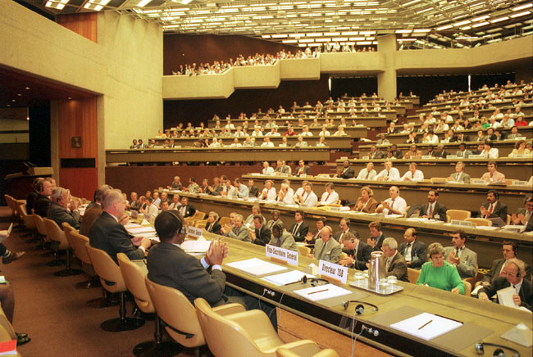
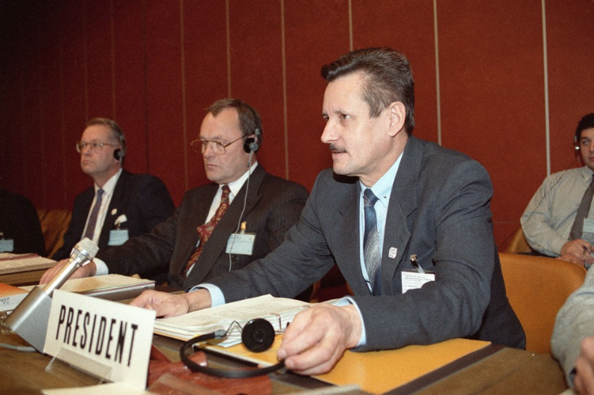
1993 – ITU First World Radiocommunication Conference (WRC-93) Geneva, November 1993
Geneva, ITU WRC Conference
ITU WRC-93 Chairman, Mr. V. Timofeev

Slide 8
ITU - World Radiocommunication Conference (WRC-93)
Macedonian Delegation at WRC-93
WRC-93 Macedonian Delegation

Slide 9
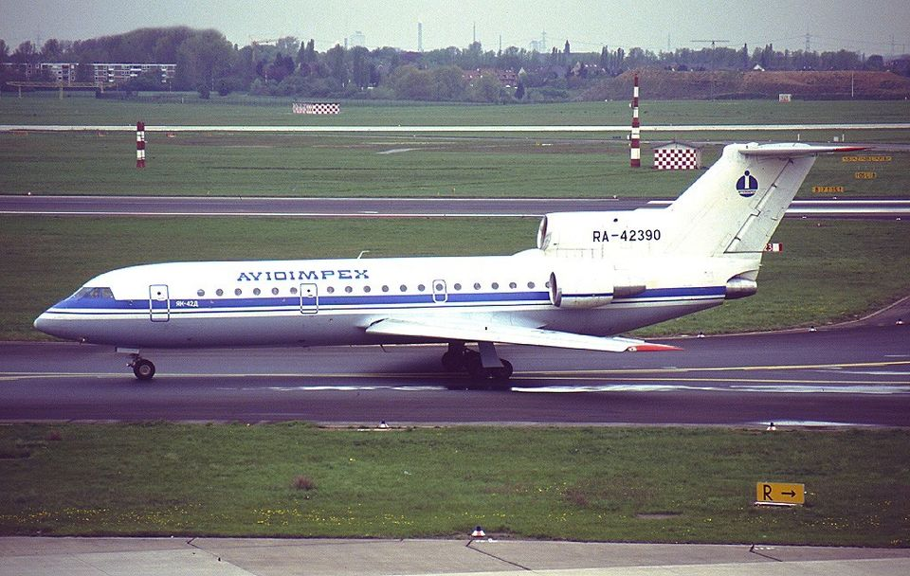
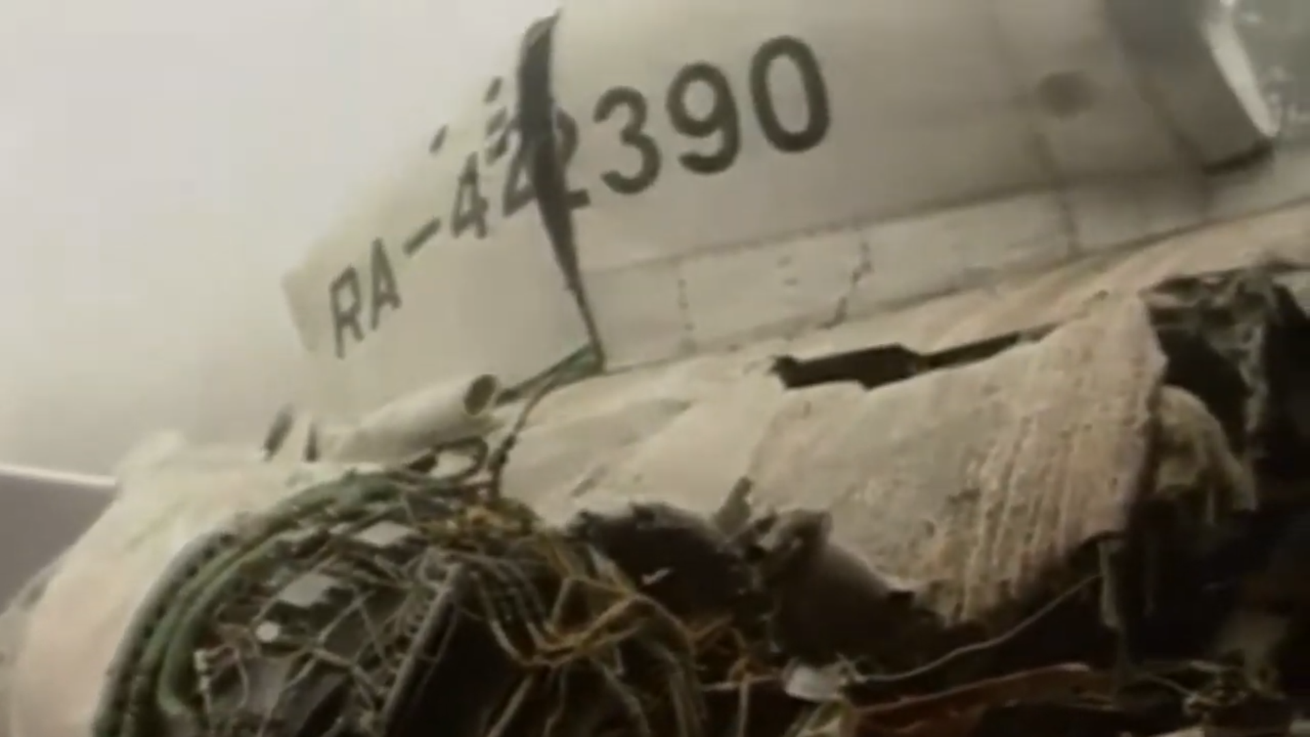
ITU - World Radiocommunication Conference (WRC-93)
Aviation accident – near Ohrid, November 20,1993
Yak-42D crash
Yakovlev Yak-42D, Avioimpex

Slide 10
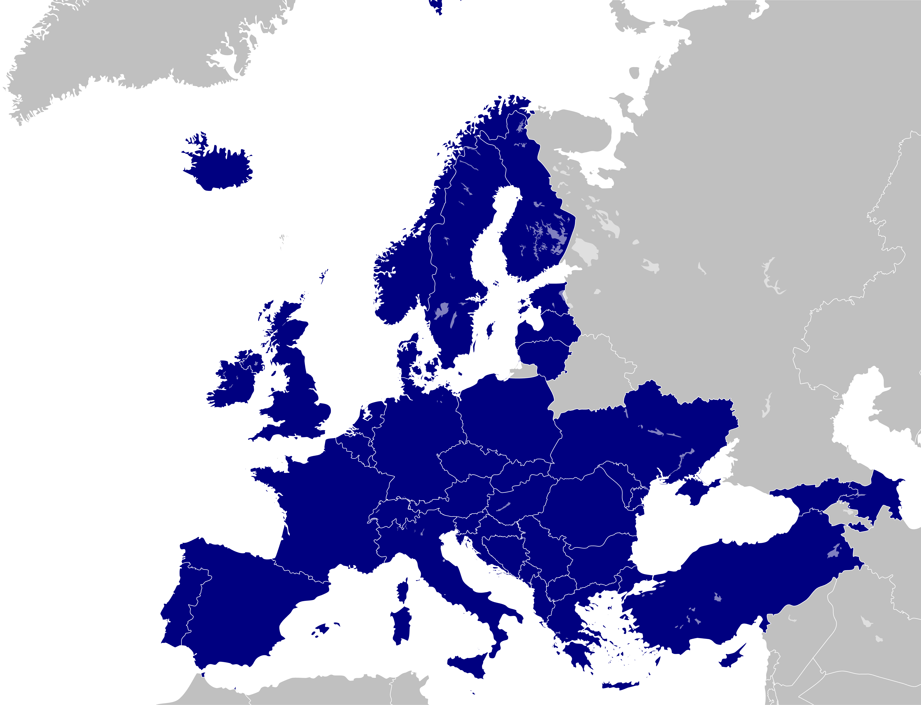
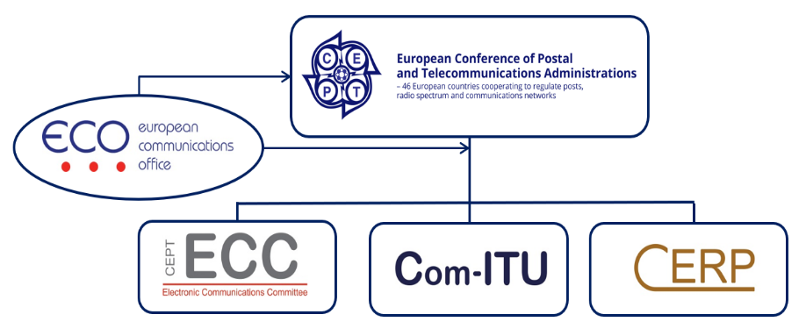
1994 - Macedonia member of CEPT European Conference of Postal and Telecommunications Administrations
46 countries are members of CEPT

Slide 11
1994 – Macedonia member of the CEPТ
Benefits of Membership:
Harmonization: Closer alignment with EU regulations and European standards, especially in spectrum management, licensing, and regulatory practices.
Participation: in CEPT’s committees and working groups.
Development: Access to expert reports, technical standards, and regional cooperation initiatives, boosting telecom development.
Received technical and policy support from many EU projects and international agencies.
Development of Macedonian standards for telecommunication networks and equipment
Facilitating integration into European markets.

Slide 12
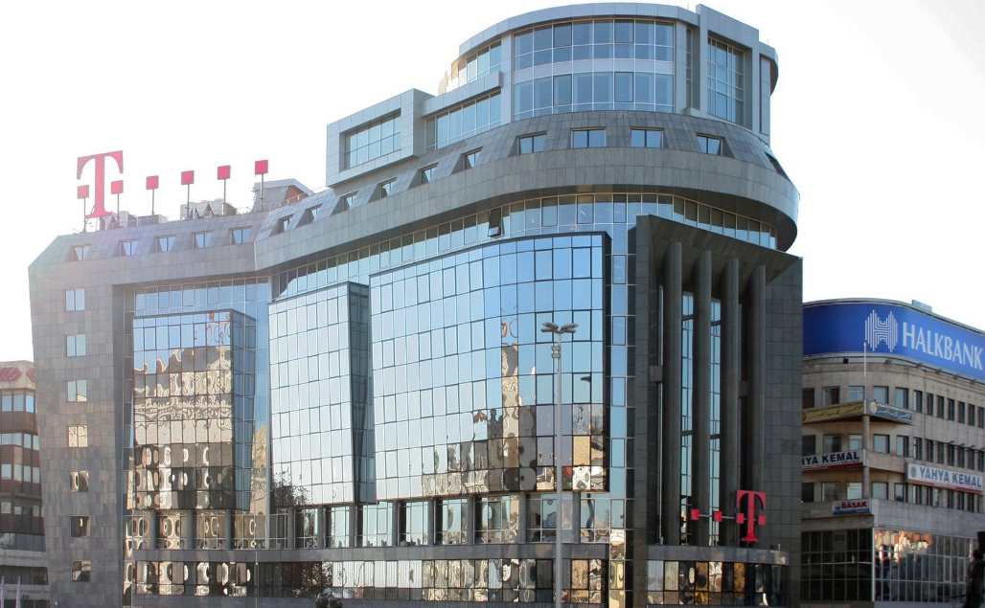
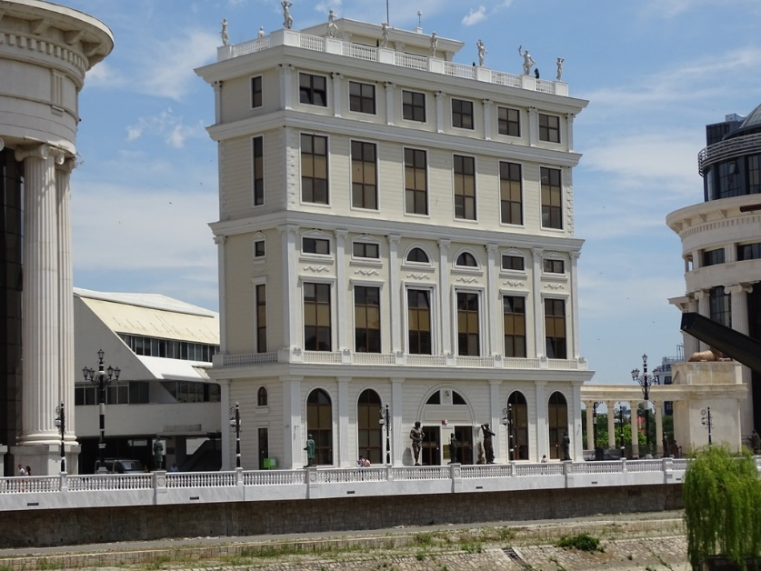
Cooperation with CEPT and EU
Reforms and structural changes in the telecommunications sector
Liberalization - in the early 2000s
Privatization - Macedonian Telekom was partially privatized
Independent regulatory authority - Agency for Electronic Communications (AEC)

Slide 13
1994 – ITU first World Telecommunication Development Conference (WDTC-94) Buenos Aires, March 1994
Buenos Aires declaration
Buenos Aires Action Plan
WDTC-94 Macedonian Delegation

Slide 14
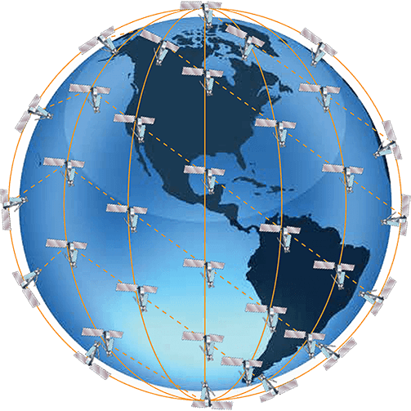
1994 - World Telecommunication Development Conference (WDTC-94)
Al Gore - Global Information Infrastructure (GII) – “network of networks”
- Global Internet networks
- Global satellite communication systems
Over the next few decades, SpaceX and Starlink
Year 2025
Iridium 66 satellites

Slide 15
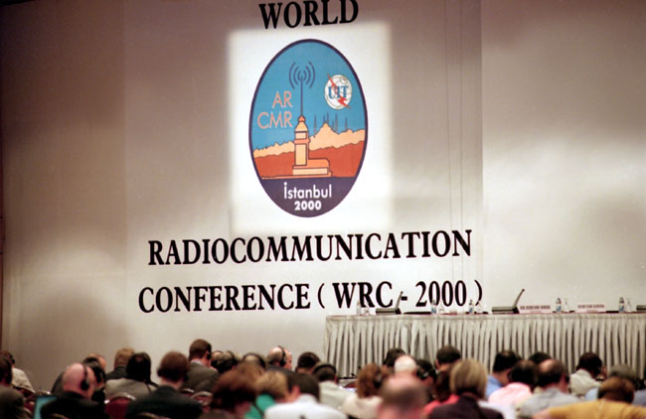
2000 - World Radiocommunication Conference (WRC-2000) Istanbul, May 2000
WRC-2000, Istanbul,
WRC-2000, Macedonian Delegation

Slide 16
2000 - World Radiocommunication Conference (WRC-2000)
Main Results of WRC-2000
Re-Planning of the Broadcasting-Satellite Service for Regions 1 and 3,
Additional spectrum for IMT-2000 applications in three optional frequency bands,
Additional spectrum for Russian GLONASS, US GPS and Galileo
WRC-2000, Istanbul, Chairman with delegates

Slide 17
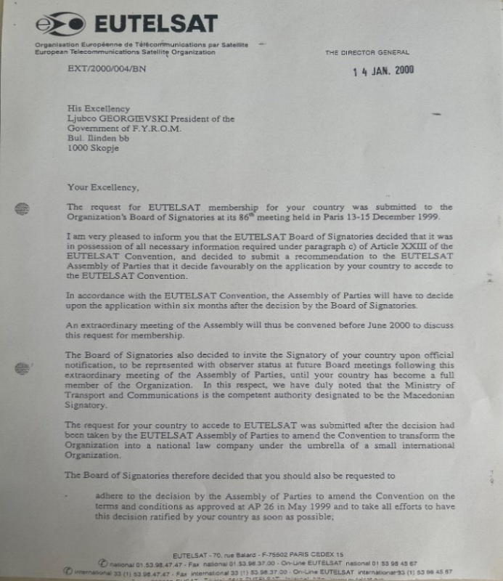
2000 - Macedonia member of the EUTELSAT Paris, May 14, 2000
Signing of the EUTELSAТ Accession
May 14 2000, Paris, Signing of Accession

Slide 18
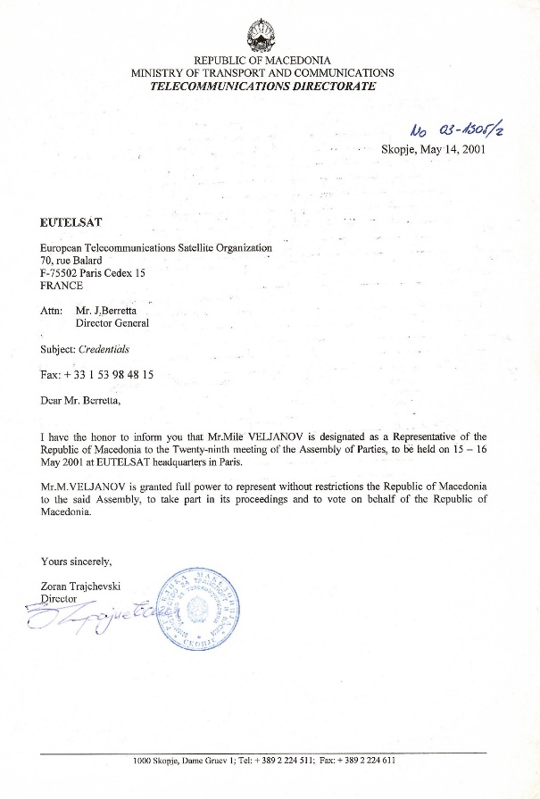
2001 - EUTELSAT Assembly of Parties Paris, May 15, 2001
EUTELSAТ - Assembly of Parties
May 15 2000, Paris, EUTELSAТ - Assembly of Parties

Slide 19
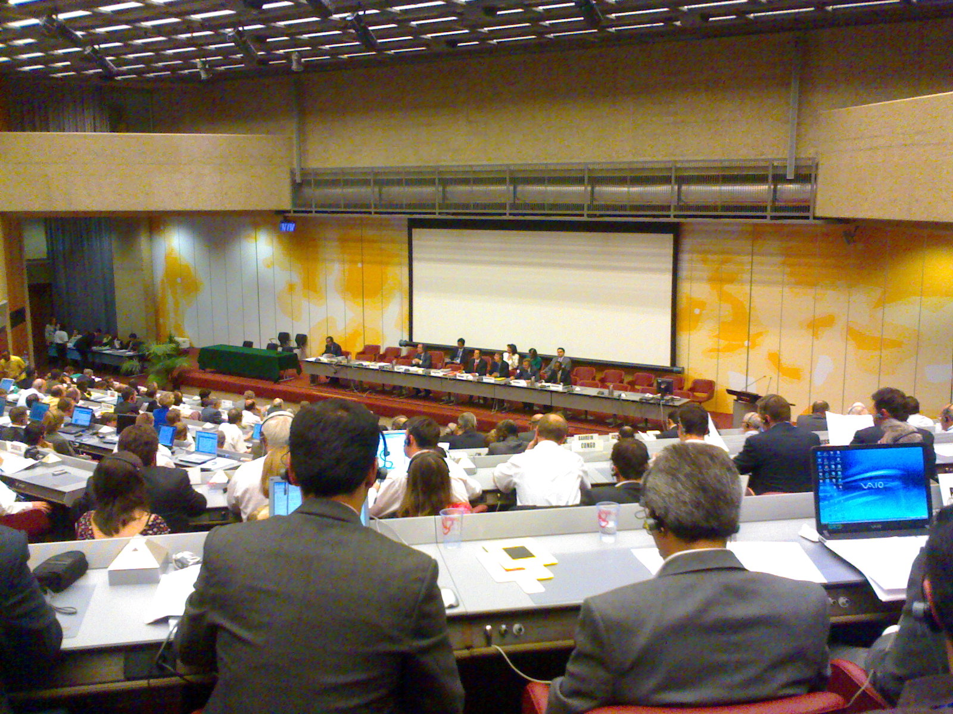
2006 – Regional Radiocommunication Conference (RRC-06) Geneva, 15 May - 16 June 2006
The First Session, RRC-04 (Geneva, May 2004)
The Second Session, RRC-06, (Geneva, 15 May 15 - 16 Jun, 2006)
Geneva, 15 May - 16 June 2006
RRC-06 Planning Area

Slide 20
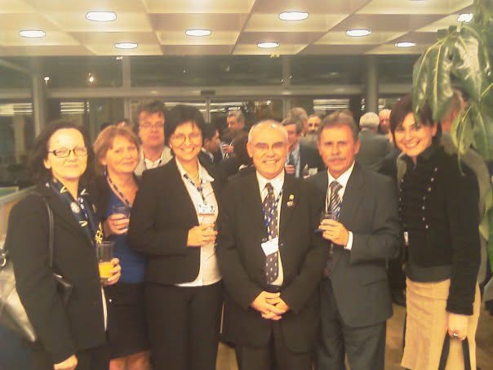
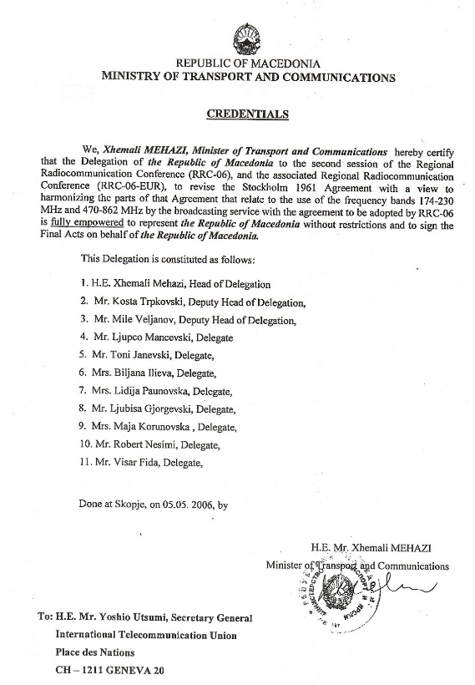
2006 – Regional Radiocommunication Conference (RRC-06)
Macedonian Delegation at RRC-06
RRC-06 , Macedonian Delegation with Mr.Fatih Yurdal

Slide 21
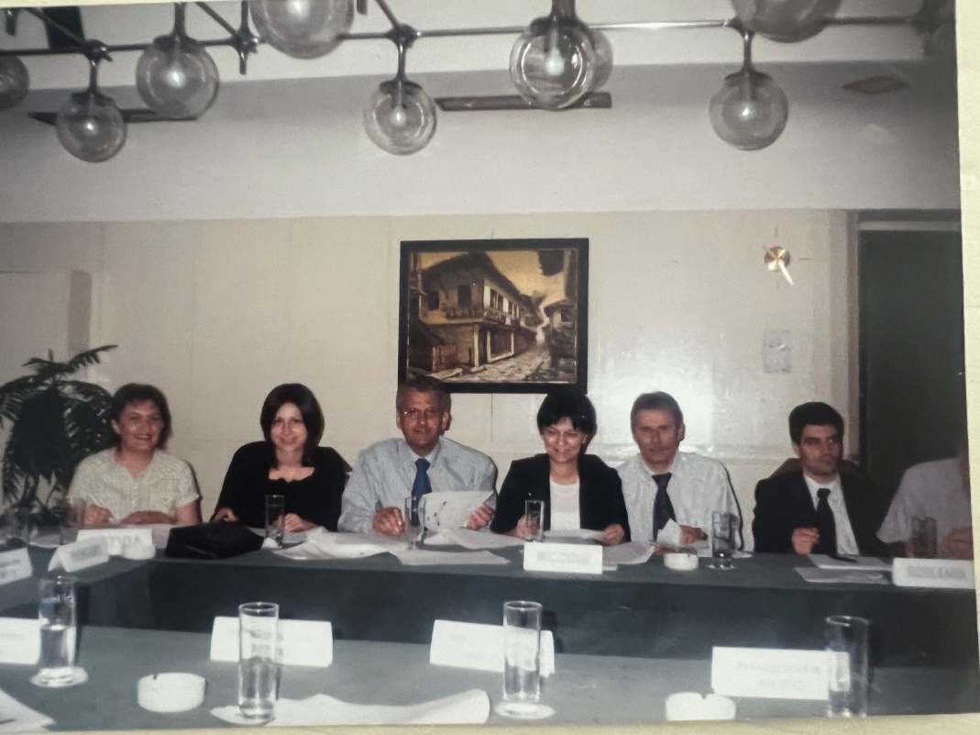
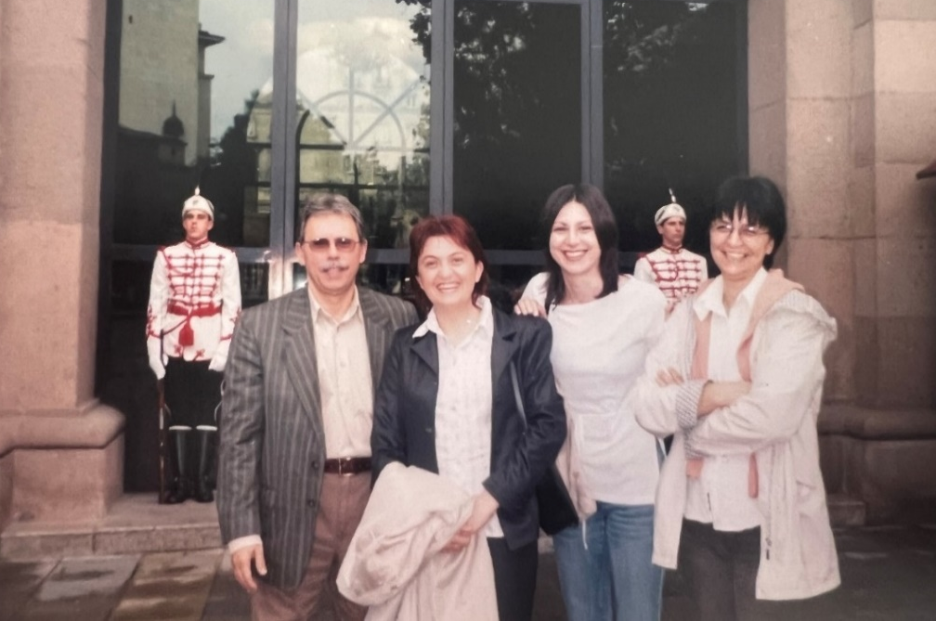
2006 – Regional Radiocommunication Conference (RRC-06)
2004 – 2006 International coordination
2005, Sofia – Coordination with Bulgarian Administration

Slide 22
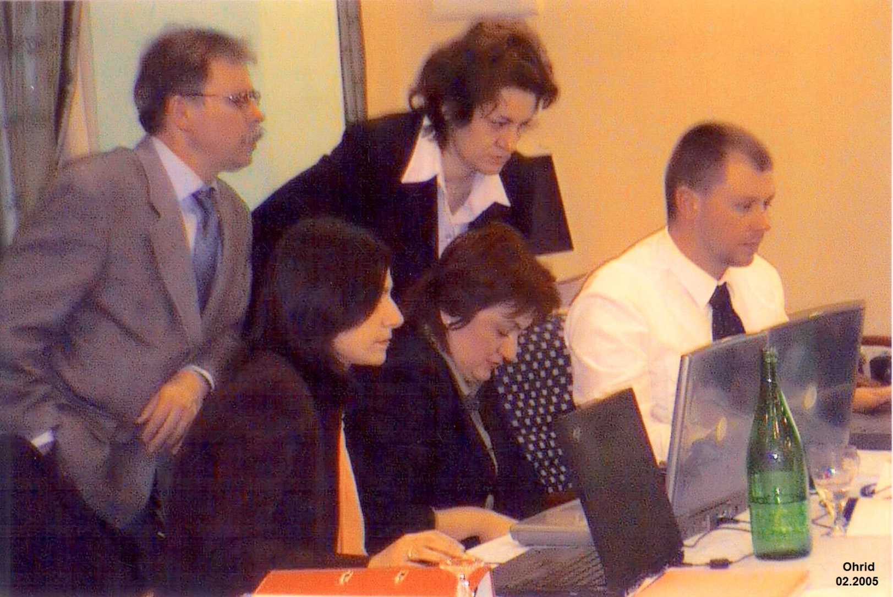
2006 – Regional Radiocommunication Conference (RRC-06)
2004 – 2006 International coordination
Valona 2006 – Coordination with Albanian Administration
2005, Ohrid – Coordination with Albanian Administration

Slide 23
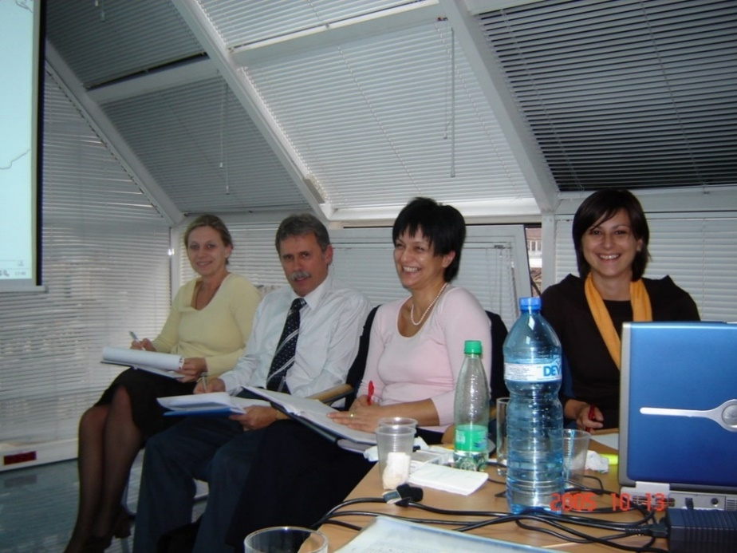
2006 – Regional Radiocommunication Conference (RRC-06)
2004 – 2006 International coordination
2006 Tivat – Coordination with Adriatic Group

Slide 24
2006 – Regional Radiocommunication Conference (RRC-06)
Digital dividend
Portion of Radio Frequency Spectrum - becomes available for other uses (mobile broadband), after the switch-off. from analog to digital platforms.
DVBT technology uses spectrum much more efficiently than analogue (transmitting four times more programs with better quality per MHz).
Digital dividend 1 (DD 1) from 790 MHz – 862 MHz (the 800 MHz band)
Digital dividend 2 (DD 2) from 694 MHz – 790 MHz (the 700 MHz band).
The switch-off in Macedonia was carried out on May 31, 2013.

Slide 25
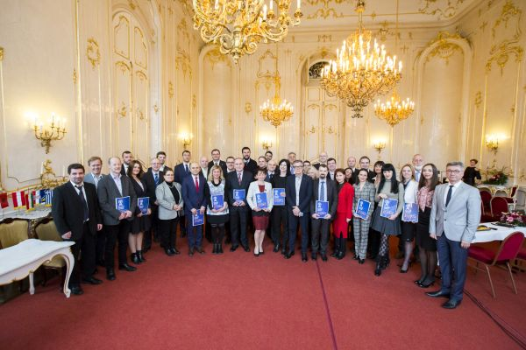
2017 – Macedonia and GE-06
Multilateral framework agreement - SEDIFF
December 2017 Godolo - Multilateral Framework Agreement - SEDDIF

Slide 26
2023 – World Radiocommunication Conference (WRC-2023)
Unique Geostationary orbital position
MKD
16.7° West
CONGRATULATIONS

Slide 27
Thank you

