Slide 1
Connectivity Infrastructure Investment Landscape
Mobile Industry Perspective
International Regulatory Conference
Skopje, 21 May 2025

Slide 2
Global Mobile Coverage and Usage Trends
39%
4%
Usage gap: people covered by mobile broadband but not using the mobile internet
Coverage gap: people not yet covered by mobile broadband
Source: GSMA (2024) The State of Mobile Internet Connectivity Report 2024
Notes:
With network expansion slowing, mobile internet adoption has begun to outpace increases in mobile broadband coverage.
After remaining relatively unchanged, the share of the population living within the footprint of a mobile broadband network but not using mobile internet (i.e. the usage gap) decreased from 45% in 2019 to 39% in 2023.
However, the usage gap remains substantial and is almost nine times the size of the coverage gap.

Slide 3
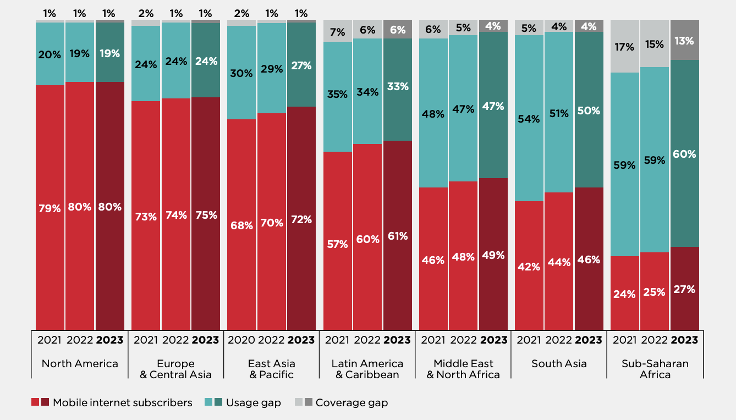
Regional Trends

Slide 4
Despite challenges, the coverage gap (4% of global population) can be further reduced
Innovation (e.g. modular or solar-powered base stations) can mitigate high CAPEX and OPEX resulting from lack of civil infrastructure (i.e. roads or electricity)
MNOs are investing in non-terrestrial solutions (satellite backhaul, D2D) that can supplement terrestrial coverage and reach the remaining 4% unconnected
© GSMA 2025
Notes:
Although the world is more connected than ever before, not everyone benefits equally.
As we saw from the previous slide 96% of the population lives in an area that is covered by mobile broadband leaving the remaining 4% in areas without mobile broadband coverage. We call this the coverage gap.
So, if 96% of the population lives in an area that is covered by mobile broadband, then the coverage gap is the 4% that remain uncovered.

Slide 5
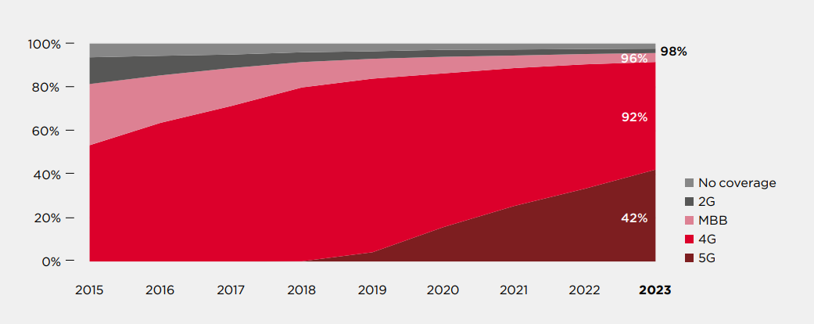
Population Coverage by Technology, 2015-2023

Slide 6
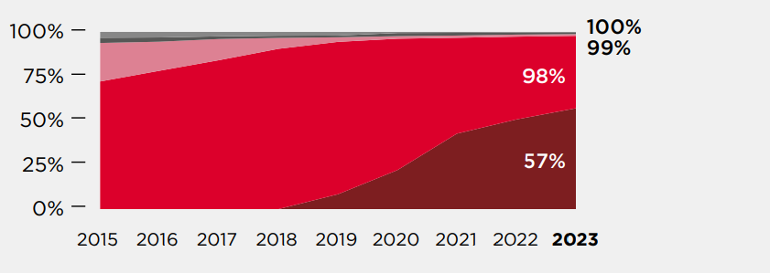
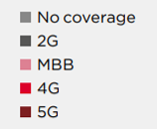
Europe and Central Asia

Slide 7
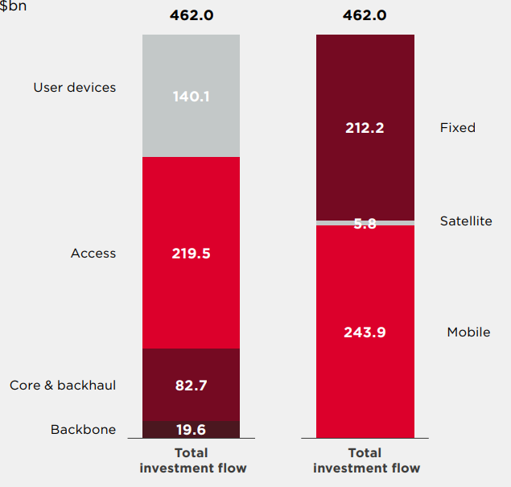
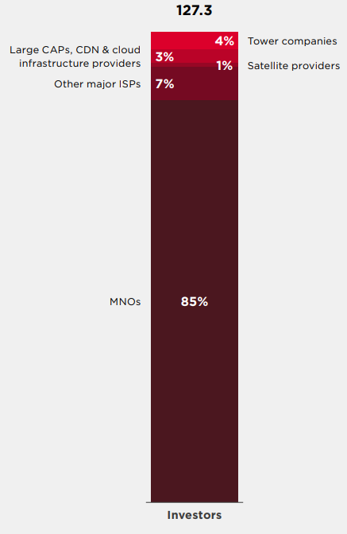
Total annual investment in internet connectivity infrastructure average 2019-2023, $bn
Mobile connectivity investment inflows and outflows (excl. devices)
$bn per annum
MNOs are the largest group of investors in mobile connectivity infrastructure - $109bn annually (85% of total investment excluding end-user devices)
Source: GSMA (2025) Mobile Infrastructure Investment Landscape

Slide 8
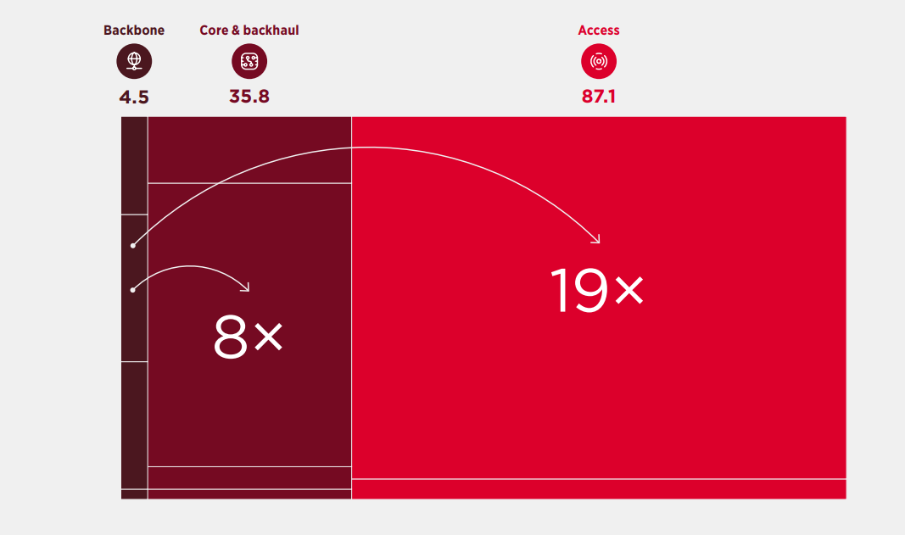
Mobile Investment by segment (excl. End-user devices) $bn per annum
Investment in backbone to be matched by a parallel and much greater investment in core and access
© GSMA 2025

Slide 9
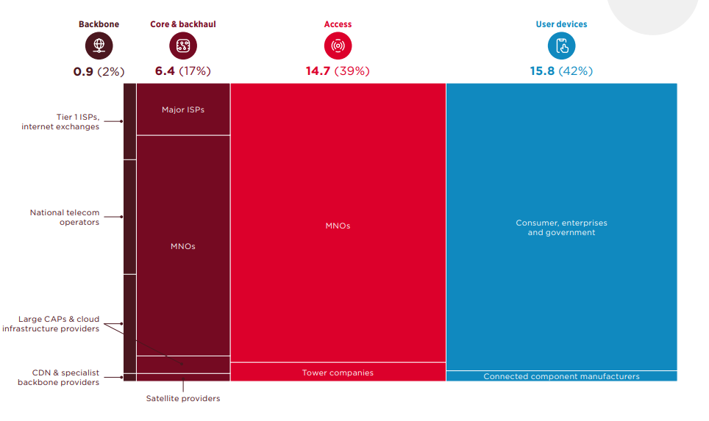
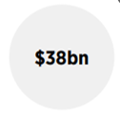
Europe: Mobile Investment Inflows

Slide 10
10
Conclusions
In order to achieve deployment objectives and support growth in data traffic, MNOs ability to invest (esp. in access networks) needs to be sustained
Pro-investment policy and regulation (e.g. technology-neutral licensing, rationalisation of taxes) drive down CAPEX and OPEX and help extend coverage to unserved areas
An enabling market environment should contemplate options (simplification, consolidation, reducing asymmetries etc.) that facilitate network investment

Slide 11
Thank you!

