Slide 1
Experience With Spectrum Auctions for Private Mobile Networks in Slovenia
Gašper Lakota
AKOS, Slovenia
20. 5. 2025, Skopje

Slide 2
About AKOS
📅 Established: 2001
🌍 Upcoming Role: BEREC Chairmanship (2026)
Areas of Activity
  📡 Electronic Communications – Regulation & supervision
  📶 Radio Frequency Spectrum – Management, supervision & measurements
  📺 Electronic Media – Content regulation
  🌐 Digital Services – Oversight and rules
  🚆 Railway Services – Regulation of transport communications
  📬 Postal Services – Licensing and fair operation

Slide 3
Our Mission
To ensure
  Development of communication networks & services
  Fair competition and operator neutrality
  Universal service availability
  Efficient spectrum & numbering management
  Media content regulation (TV, radio, on-demand)
  User rights protection across all services

Slide 4
Key Spectrum Strategy Actions (2019–2026)
Major Completed or Ongoing Projects
  700+ MHz Multiband Auction (2021): Included multiple bands (700/1500/2100/2300/3600/26000 MHz).
  Local Auctions for Verticals (2024–2025):
    2300/3600 MHz awarded in 2024 (9 winners).
    Second public tender ongoing in 2025.
Planned or Conditional Projects
  New Auctions (if interest exists)
    410–430 MHz and 450–470 MHz bands for business-critical and PPDR use.
  Local Allocation
    3800–4200 MHz for private networks – service/technology-neutral.
  Refarming
    Adjusting bands to increase capacity for point-to-point fixed links (completed 2024).
Future Directions (2024–2026 Strategy)
  UHF Band for 4G/5G/6G & Broadcasting
    In line with ECC DEC 2017/899.
    Coordination required with neighboring countries.

Slide 5
2300-3600 MHz band
hybrid public tender with auction
(2023 - 2024)

Slide 6
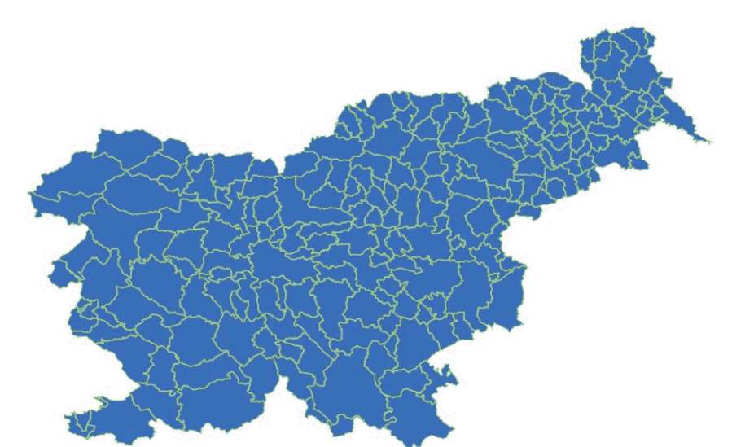
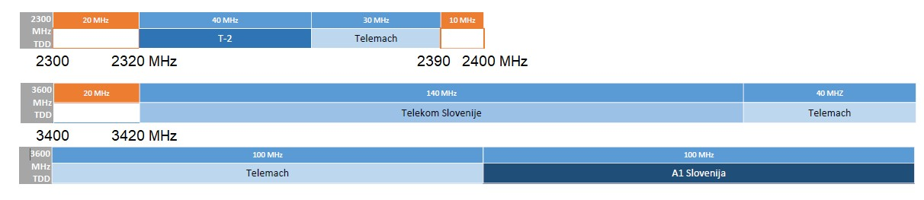
Public tender with auction 2300 & 3600 MHz for Local Use (2023-2024)
Setup
Timeline
draft tender documentation | Aug 2022
feedback collection | Sep 2022
Revision of tender documentation | Feb 2023
feedback collection | Mar 2023
public tender with auction | Nov 2023
frequency assignment process | H1 2024
Three rounds
Auction if interest > 1 for a frequency block
Only verticals allowed to bid in 1st round
Everyone allowed to bid in 2nd & 3rd round
Initial prices confirmed by the Government
212 Municipalities
Three frequency blocks in each municipality
Frequency band | Block | Frequencies [MHz] | Bandwidth [MHz] | Available until
2300 MHz | BA1 | 2300 – 2320 | 1 x 20 | 1. 1. 2042
2300 MHz | BA2 | 2390 – 2400 | 1 x 10 | 1. 1. 2042
3600 MHz | BB | 3400 – 3420 | 1 x 20* | 15. 6. 2041
Initial Prices in 2nd and 3rd round higher than in 1st

Slide 7


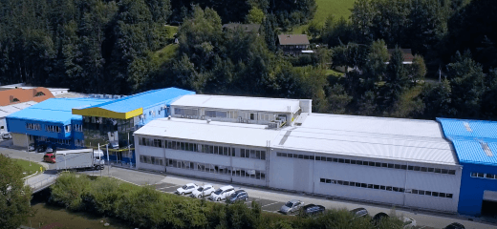


Public tender with auction 2300 & 3600 MHz for Local Use (2023-2024)
Results
 | Bidders |  | Freq. blocks
round | Total | Verticals | BA1 | BA2 | BB | Locations
1st | 7 | 7 | 4 | 0 | 4 | 8
2nd | 2 | 0 | 24 | 2 | 12 | 27
3rd | 1 | 0 | 0 | 11 | 0 | 11
Cablex Group
Port of Koper
Cinkarna Celje

Slide 8
Refarming
Original
Proposal
Final version

Slide 9
2300-3600 MHz band
2nd hybrid public tender with auction
(2025)

Slide 10
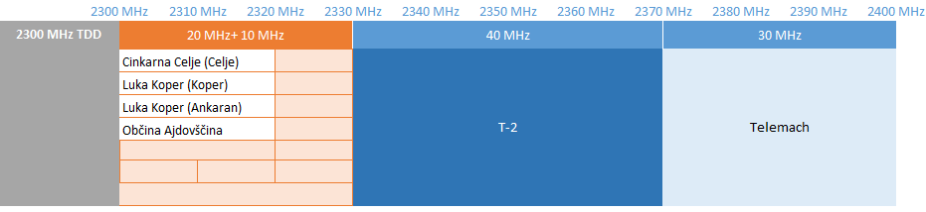
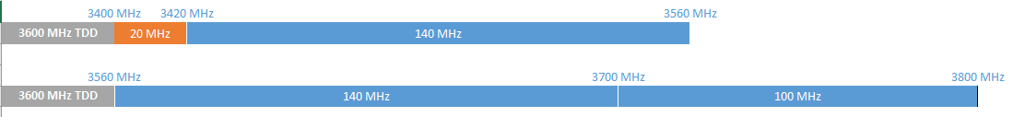
2nd Public tender with auction 2300 & 3600 MHz for Local Use (ongoing)
Setup
Setup is similar to the tender in 2023
All in 2023 non-allocated frequency blocks

Slide 11
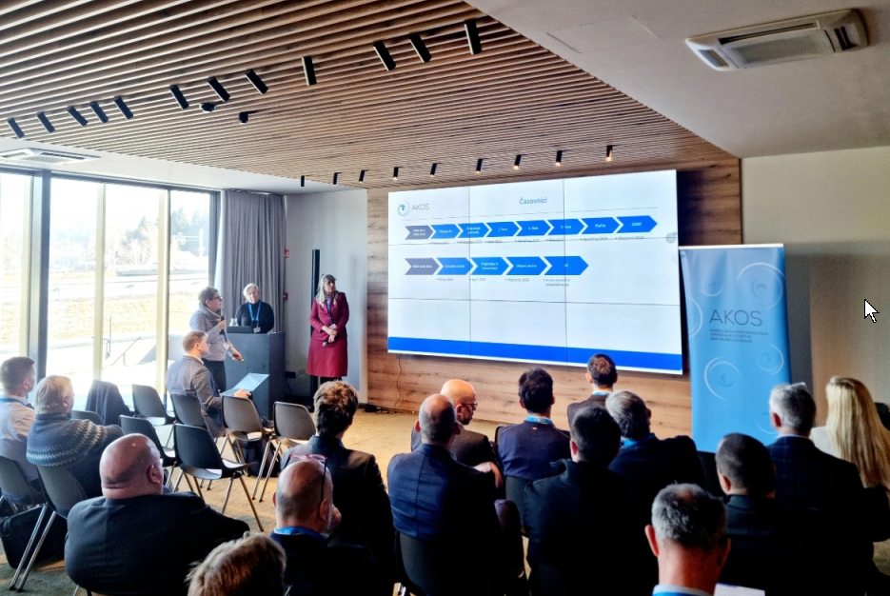
Public workshop
Workshop to bring together
Interested parties,
Suppliers,
Operators
in order to
Share experience from past tenders
Share future plans
Facilitate networking

Slide 12
3800-4200 MHz band
local only, simplified procedure
(planned)

Slide 13
Frequency allocation 3800 – 4200 MHz band – LMP for local use (planned in 2025-2026)
3800 – 4110 MHz band
  310 MHz – allocation on the basis of an expression of interest (first come-first served)
4110 – 4200 MHz band
  90 MHz – reserved, public tender in case of excess demand
Allocation process
The licence in the 3800 - 4110 MHz band will be awarded under a simplified procedure.
Interested parties will be given access to an online portal where they will select the frequency and channel width.
* the last 5 MHz (3995 - 4200 MHz) have limitations due to the protection of radio altimeters (4200 - 4400 MHz).

Slide 14
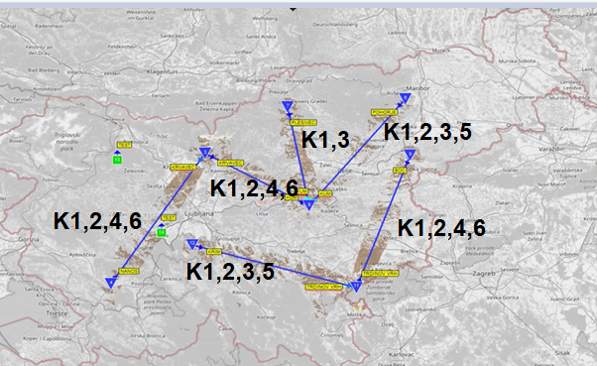
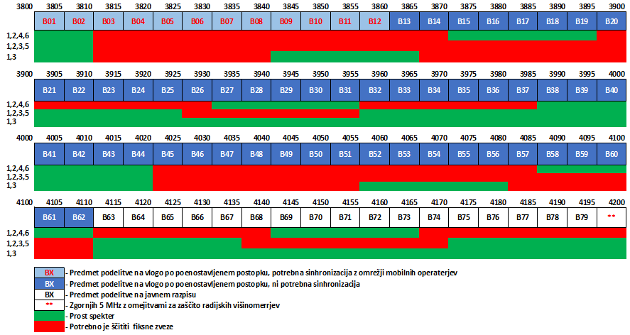
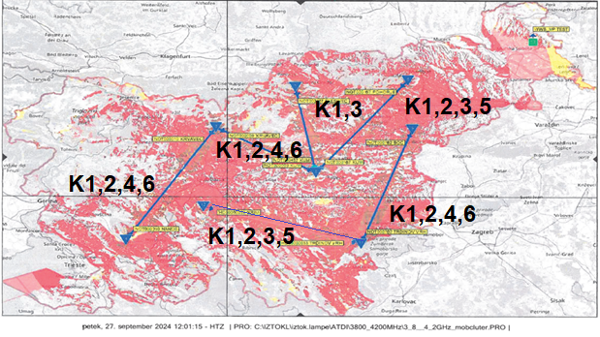
Protection of FS

Slide 15
Conditions and obligations
Spectral caps
100 MHz (unsynchronised WBB LMP, no interference)
200 MHz (synchronised WBB LMP, lower 100 MHz must be synchronised)
30 MHz (WBB LMP on specific routes)
Transfer of rights
allowed only for verticals
Other conditions
Must not have an ownership stake from a mobile operator (>25% ownership).
Permitted forms of cooperation: consortia, joint ventures, associations of undertakings.
Time frame | Municipalities | Campus/line network
2 years | => 1 base station for 5% population. | 25%
3 years | 25% population or 10% territory | 70%
4 years | 40% population or 20% territory | 90%
Coverage obligations

Slide 16
Conclusion
Key Takeaways
  Spectrum auctions in Slovenia have evolved to address diverse needs, including verticals and public/private usage.
  Public tenders and transparent pricing promote market entry and innovation.
  Ongoing initiatives aim to simplify access and ensure future readiness (e.g., 3800–4200 MHz band).
Looking Ahead
  Continued refinement of auction strategies in alignment with technological and market developments.
  Active collaboration with stakeholders through workshops and consultations.
  Commitment to equitable, efficient, and transparent spectrum management.

Slide 17
Thank you for your attention!
Contact: gasper.lakota-jericek@akos-rs.si
https://www.akos-rs.si

