Slide 1

Creating a new
5G-centric regional
infocommunications group
Pál Zarándy
Chief Strategy Officer for Mobile & 5G
4iG Group
Skopje
20 May 2025

Slide 2





We are creating a new integrated infocommunications group of the region
Hungary + Balkans focus
Bridging Hungary and EU with „pre-EU” countries
Strategic partners
Seeking further market entry opportunities in Western Balkans and CEE
8.000 employees
10 million subscribtion base
1.8bn EUR revenue, 595mn EUR EBITDA in 2024
2

Slide 3






















4iG Group – what do we do?
IT & system integration
Telecommunications
Space & defence technologies
AI

Slide 4

5G is a central enabler platform for 4iG Group’s all three divisions
IT & system integration
Telecommunications
Space & defence technologies
AI

Slide 5


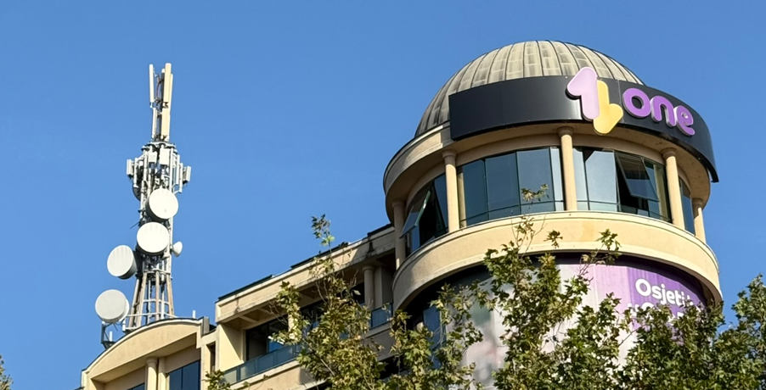
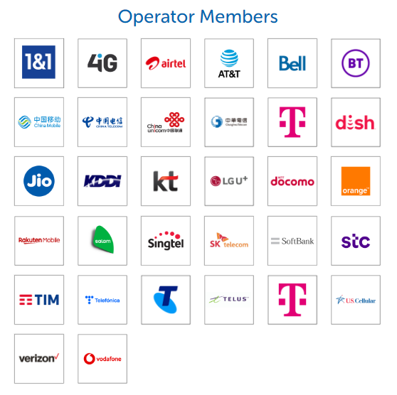
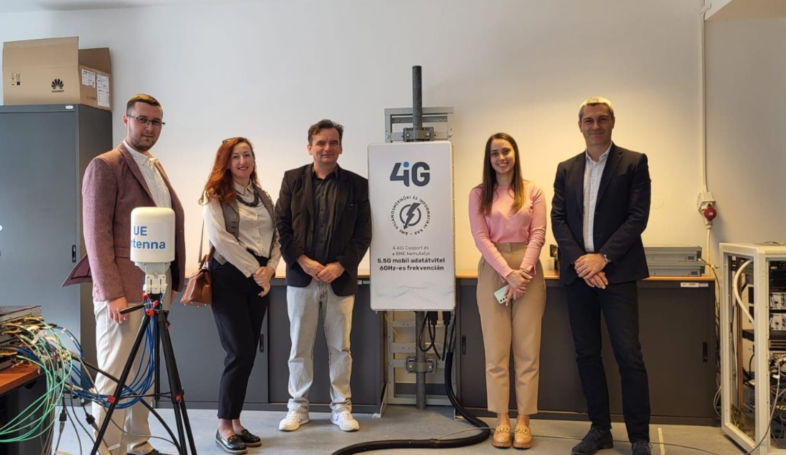
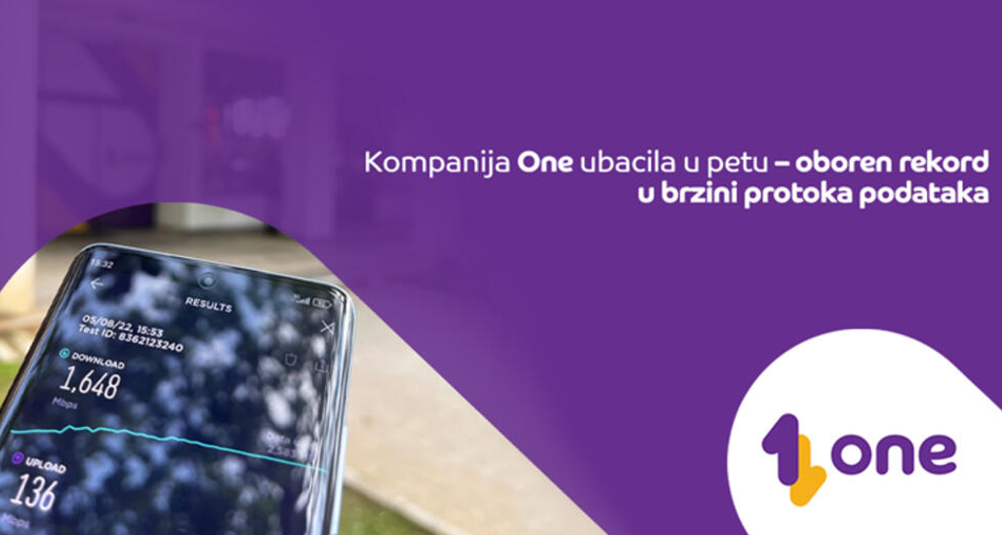



Highlights of our 5G leadership ambitions
2022
2023
2024
Joining O-RAN Alliance
5G speed record in Montenegro
6GHz 5.5G technology trial with three universities

Slide 6

Our next stop: North Macedonia
Great fit with 4iG’s expansion strategy, next piece in the 4iG Western Balkans puzzle
Only 2 mobile operators with own frequencies, space for a new ultra efficient 5G-first challenger player
Strong 5G-centric radio frequency portfolio available for the new entrant – 700 MHz – 1800 MHz – 3.6 GHz spectrum acquisition in progress
Independent TowerCompany with countrywide tower grid with very low utilization – minimizes the need to build new towers (would be expensive and slow) – Letter of intent singed with EuroTelesites
No legacy technology and business processes burden: 5G Standalone from day 1.
Synergies with 4iG’s existing operations in neighboring Albania and in Montenegro
Platform for 4iG Group’s IT and Space & defence expansion
Challenging Business Case, strategic investment, part of a much larger story. It is a marathon, not a sprint
1.
2.
4.
3.

Slide 7
Thank you, Благодарам!

