Slide 1
TLP:CLEAR
Beyond Prevention
Reducing Chaos During a Cyber Incident
transform potential cyber disasters into manageable situations
Mickov Saso
AEK, Ohrid 2026
20.05.2026
I
k
S
INFROMATION
KNOWLEDGE
SUCCESS >>>>>
www.iksnets.com

Slide 2
Agenda
Beyond Prevention: Incident Readiness as a Resilience Strategy
Reducing Chaos During a Cyber Incident: Key Challenges and Pitfalls
Redefining Cyber Readiness: How to Maximize the Value of Tabletop Exercises
I
k
S
INFROMATION
KNOWLEDGE
SUCCESS >>>>>
www.iksnets.com

Slide 3
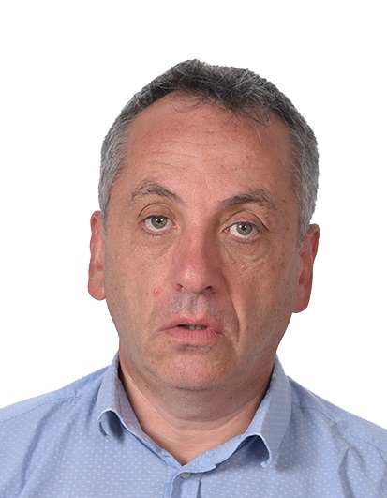

Contact Info
Saso Mickov
+389 71 248 992
@
contact@iksnets.com.com
www.iksnets.com

Slide 4
From Cyber Security to Cyber Resilience
It's not a matter of if but when’’
an organization will suffer an attack.
I
k
S
INFROMATION
KNOWLEDGE
SUCCESS >>>>>
www.iksnets.com

Slide 5
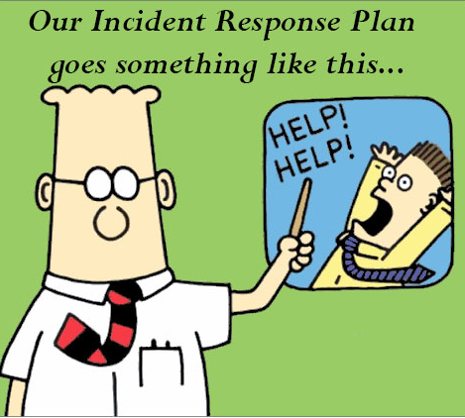
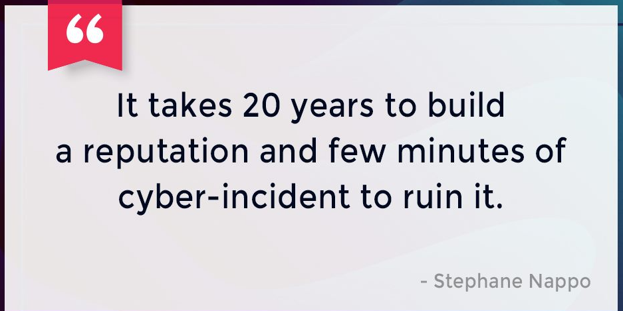
From Cyber Security to Cyber Resilience
Incidents do not destroy value.
Uncontrolled response does.
Source: Disaster Recovery Plan - Dilbert cartoon first published on Tuesday 15th August 2000
I
k
S
INFROMATION
KNOWLEDGE
SUCCESS >>>>>
www.iksnets.com

Slide 6

From Cyber Security to Cyber Resilience
Incidents do not destroy value.
Uncontrolled response does.
Phishing
CERT Team
DDoS Attack
Response
Ransomware
Escalation
Lateral Movement
Regulations and Law
Data Leaking
Customer
BEC
Management
Identity theft
Restoration
Data Leaking
Reporting
Privilege escalation
Lesson learned
Database compromise
Closing

Slide 7
From Cyber Security to Cyber Resilience
- Incident Management that works
focus on prevention and defense - stopping the hackers from entering the system, stealing data or disrupting operations
Cyber security - - - ->
focus on response and recovery – ensuring your business can continue to operate, adapt and recover quickly even the incident happens
Cyber resilience - - - -> com
I
k
S
INFROMATION
KNOWLEDGE
SUCCESS >>>>>
www.iksnets.com

Slide 8
Cyber Resilience
Cyber resilience is an organization’s ability to minimize the impact of significant cyber incidents on its primary goals and objectives.
2030s
1960s
1990s
2000s
2010s
2020s
The computer security era.
The information security era
The information assurance era
The cybers
security era.
The era of the rise of cyber resilience
Future of
disruptive technologies
Source: Unpacking Cyber Resilience WEF
I
k
S
www.iksnets.com
INFROMATION
KNOWLEDGE
SUCCESS >>>>>

Slide 9
Cyber Resilience
Generic - simple Incident Management process
INCIDENT
PREPARATION BEFORE INCIDENT
INCIDENT RESPONSE
- - - ->
- - - ->
INCIDENT RESPONSE TEAM
INCIDENT RESPONSE ACTIONS
REPORT
I
k
S
INFROMATION
KNOWLEDGE
SUCCESS >>>>>

Slide 10
Cyber Resilience
NIST Incident Management process
Incident management consists of the processes, capabilities, and structures required to prepare for, detect, analyze, respond to, and recover from cybersecurity incidents.
NIST Incident Management Framework
PREPARATION
DETECTION and
ANALYSIS
CONTAINMENTERADICATION AND RECOVERY
POST-INCIDENT ACTIVITY (LESSONS LEARNED)
I
k
S
INFROMATION
KNOWLEDGE
SUCCESS >>>>>
www.iksnets.com

Slide 11
Cyber Resilience
Incident readiness as a core resilience capability
Practice - training, simulation and exercise is the key component of the incident readiness as a core resilience capability: ability to detect disruption early, respond decisively under pressure, sustain critical services, and recover with learning built in.
PREPARATION
PRACTICE
DETECTION
RESPONSE
REPORTING
I
k
S
INFROMATION
KNOWLEDGE
SUCCESS >>>>>
www.iksnets.com

Slide 12

Cyber Resilience
Incident readiness as a core resilience capability
Readiness - the state of being fully prepared for detect, respond to, contain, and recover from a cyber incident (like ransomware, phishing, data breach).
READINESS
PREPARATION
PRACTISE
DETECTION
RESPONSE
REPORTING
I
k
S
INFROMATION
KNOWLEDGE
SUCCESS >>>>>
www.iksnets.com

Slide 13
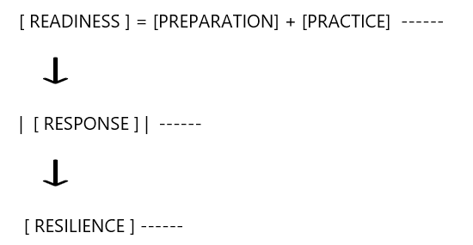
Cyber Resilience
Incident readiness as a core resilience capability
I
INFROMATION
KNOWLEDGE
SUCCESS >>>>>

Slide 14
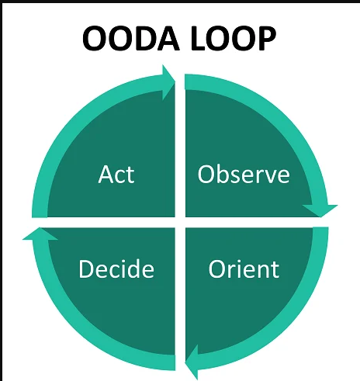
Redefining Incident Management Process
OODA Loop (Observe–Orient–Decide–Act)
Unlike traditional linear IR models OODA is non-linear and recursive, making it well‑suited for fast‑moving, ambiguous incidents like active intrusions or ransomware.
I
k
S
INFROMATION
KNOWLEDGE
SUCCESS >>>>>
www.iksnets.com

Slide 15
Incident Readiness - How to achieve ?
Key elements of the every Incident Management
PEOPLE
- - - -
PROCESS
- - - -
TOOLS
Incident Response Plan - An Incident Response Plan is a written document, that clarify roles and responsibilities for the PEOPLE.
Playbook - A playbook is a how-to manual that describe the PROCESS with steps and actions to take when a cyber incident happens.
Incident Detection and Recovery Tool - TOOLS for the timely detection, analysis and remediation of the incidents (SIEM, Threat Analysis, EDR, Patch Management, RAID, ….…)
I
k
S
INFROMATION
KNOWLEDGE
SUCCESS >>>>>
www.iksnets.com

Slide 16

PROCESS
TOOLS
PEOPLE
www.iksnets.com

Slide 17
Incident Readiness - How to achieve ?
PEOPLE
PROCESS
TOOLS
EXCESRISE
- - - -
TESTING
- - - -
SIMULATION
READINESS
I
k
S
INFROMATION
KNOWLEDGE
SUCCESS >>>>>
www.iksnets.com

Slide 18
Types of Exercise / Cyber Drills
1. Tabletop Exercise
Scenario discussion (organization level, no system impacted)
2. Technical Drill
Simulated attack
(e.g. ransomware, intrusion)
3. Full Simulation
Advanced simulation of real attackers
(end-to end)
Focus:
Decision-making
Regulatory reporting
Crisis communication
Focus:
Detection
Containment
Investigation
Focus:
Detection / Containment
Investigation
Decision-making
Involves:
Management
IT
Cyber Security
Legal / Compliance
Marketing
DPO
Involves:
IT
Cyber Security
DPO
Involves:
Red Team / Purple Team
Security
Marketing
Legal / Compliance
DPO
IT

Slide 19

✅ Each exercise must include
✅ Planning
Defined objectives
Scenario description
Participants
Timeline
✅ Execution
Realistic scenario
Role-based actions
Logging of actions
✅ Evaluation
Measure effectiveness of:
Detection time
Response time
Decision-making
Communication
✅ Reporting
Exercise report must include:
Findings
Gaps
Recommendations
✅ Improvement
Link findings to:
Risk management
Control improvements
Policy updates

Slide 20
NIS2 Regulation
You must demonstrate: Operational readiness (not just written Plan and Procedures)
Ability to meet strict reporting timelines:
24h early warning
72h notification
1-month final report
Exercise Type | Recommended Frequency
Tabletop (management) | 1–2x per year
Technical simulation (IR team) | 1–2x per year
Crisis / cross-functional exercise | annually
Ad-hoc exercises | after major changes/incidents
👉 Evidence required - Without exercises, this cannot be proven.
👉 Exercises are the primary mechanism to prove compliance
I
k
S
INFROMATION
KNOWLEDGE
SUCCESS >>>>>
www.iksnets.com

Slide 21
Other Regulation and standards
ISO 27001:2022
A.5.29 (Information security during disruption)
A.5.30 (ICT readiness for business continuity)
ISO 22301 - Requires exercising and testing plans
DORA (financial sector)Explicitly requires advanced testing (TLPT)
ЗАКОН ЗА БЕЗБЕДНОСТ НА МРЕЖНИ И ИНФОРМАЦИСКИ СИСТЕМИ
Член 32 – Мерки за управување со сајбер безбедносни ризици:
Incident management capability (справување со инциденти)
Business continuity and crisis management (континуитет + кризен менаџмент)
Policies and procedures to assess effectiveness of measures [
Cybersecurity training and awareness
I
k
S
INFROMATION
KNOWLEDGE
SUCCESS >>>>>
www.iksnets.com

Slide 22
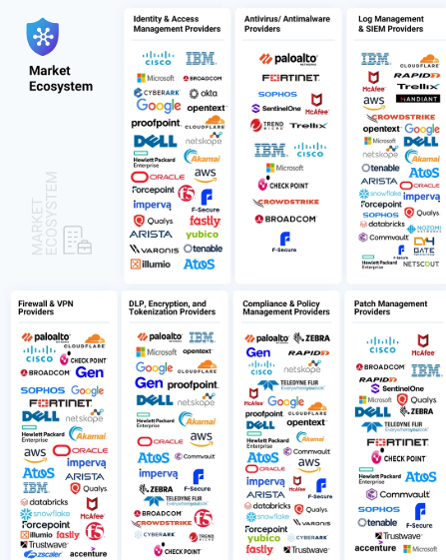


Reducing Chaos During a Cyber Incidentent
- Key challenges and pitfalls
Too much complexity
Too much to do
Too many vendors
Too many alerts
Run backup
Monitor events
Threat analysis
EDR Update
Review users
Disable user
Set MFA
Set password policy
Check the log
Implement firewall
Run Vulnerability scan
Run SAST / DAST
Run Penetration Test
Awareness training
Report
Write a procedure
.....
I
k
S
INFROMATION
KNOWLEDGE
SUCCESS >>>>>
www.iksnets.com

Slide 23
Table Top Exercises are not enough
Focus on the check box:
YES”- We have it
Does not validate tooling or access
Time consuming for
Planning and delivery
Lot of assumption and lack of realism
Difficult for the follow-up
Third-party dependencies are usually simplified
Limited Engagement of cross-functional Teams
Not flexible for the adapting and modification
I
k
S
INFROMATION
KNOWLEDGE
SUCCESS >>>>>
www.iksnets.com

Slide 24

Redefining Incident Management Process
Incident Readiness Platform
To validate (real) roles & responsibilities
Converting lessons learned into actionable playbooks
Key functionality
To test the workflow for detection / escalation and response actions
Executive-level visibility and reporting
Evaluate visibility of controls and tools
To provide the evidence for regulatory compliance
To set-up the metrics and benchmark for response
Produce an improvement plan
Test out-off band communication
I
INFROMATION
S
k
KNOWLEDGE
SUCCESS >>>>>
www.iksnets.com

Slide 25
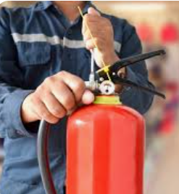
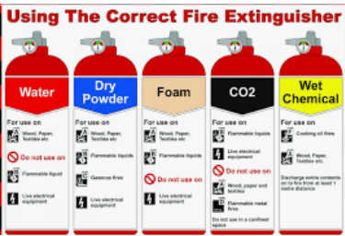

Incident Readiness Platform
- Core pillars
Incident Response Team ---
↑
Playbook → ----
↑
Tools → ----
Yes, people are aware and have
appropriately knowledge
Yes, steps for remediation and response are defined per different cyber security attack
Yes, tools are ready
www.iksnets.com

Slide 26
Redefining Incident Response Process
READINESS
PREPARE
PRACTICE
REPORT
RESPOND
RESPONSE
I
k
S
INFROMATION
KNOWLEDGE
SUCCESS >>>>>
www.iksnets.com

Slide 27
Demo
Reference and links
Q&A
I
k
S
INFROMATION
KNOWLEDGE
SUCCESS >>>>>
www.iksnets.com

Slide 28
In summary - Incident readiness platform benefits
Faster incident detection and response
Reduced cyber risk and operational impact
Compliance with law and regulations (NIS2, DORA)
Lower total cost of ownership (TCO)
Executive-level visibility and reporting
Respond to incidents effectively and consistently
Minimize business, legal, and reputational impact
Preserve evidence for legal or regulatory needs
Learn from incidents to reduce future risk
I
k
S
INFROMATION
KNOWLEDGE
SUCCESS >>>>>
www.iksnets.com

Slide 29
Reference and links
https://www.weforum.org/publications/unpacking-cyber-resilience/
https://csrc.nist.gov/projects/incident-response
https://www.sans.org/security-resources/glossary-of-terms/incident-response
https://www.ncsc.gov.uk/section/exercise-in-a-box/tabletop-exercises
https://www.cm-alliance.com/cybersecurity-blog/eu-dora-regulation-cyber-tabletop-testing-for-operational-resilience
https://www.isaca.org/resources/isaca-journal/issues/2022/volume-1/cybersecurity-incident-response-exercise-guidance
https://www.cisecurity.org/insights/white-papers/six-tabletop-exercises-prepare-cybersecurity-team
https://www.cortex.io/
https://concertium.com/nist-incident-response-playbook-template/
https://www.iksnets.com/
https://mkd-cirt.mk/
I
k
S
INFROMATION
KNOWLEDGE
SUCCESS >>>>>
www.iksnets.com

Slide 30

Don't Wait for a Breach
Thank you for attention.
This presentation is no generated by AI
I
k
S
INFROMATION
KNOWLEDGE
SUCCESS >>>>>
www.iksnets.com

Slide 31
Disclaimer
This presentation reflects the personal views and professional experience of the author and does not represent the official views, positions, or policies of any organization, company, or institution.
The content is provided for informational and educational purposes only.

