Slide 1
Spectrum Monitoring Solutions for LTE and 5G Networks CellScan
Gary Kenworthy
May 19, 2026
International Regulatory Conference 2026
OHRID, Republic of North Macedonia
Notes:
In slides where these notes suggest adding to or expanding on a bullet point, the bullet point or part of it is in bold type and then any comments to be added during the presentation are in lightface type.

Slide 2
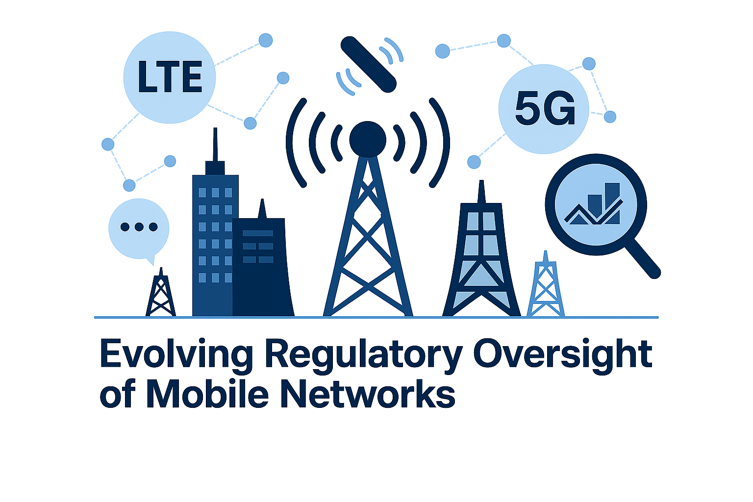
Evolving Regulatory Oversight of Mobile Networks
Regulatory oversight is growing more complex as LTE, 5G, and emerging non‑terrestrial networks increase density, variability, and cross‑border interactions.
Regulators are now expected to actively manage spectrum as a scarce national resource—not only enforce licenses.
Traditional RF tools provide signal presence and field strength but lack context to assess compliance, attribute transmissions, or reconstruct interference.
These visibility gaps reduce accountability and spectrum efficiency as networks rapidly evolve.

Slide 3
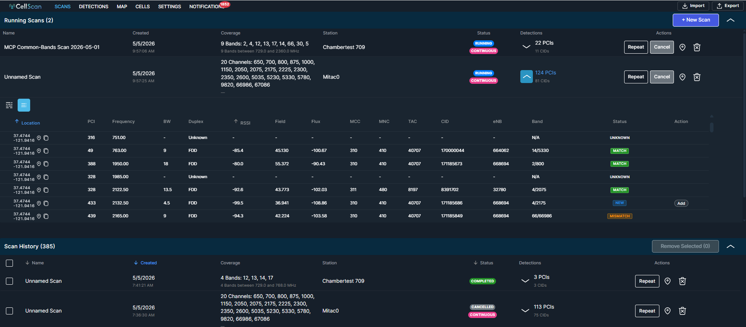
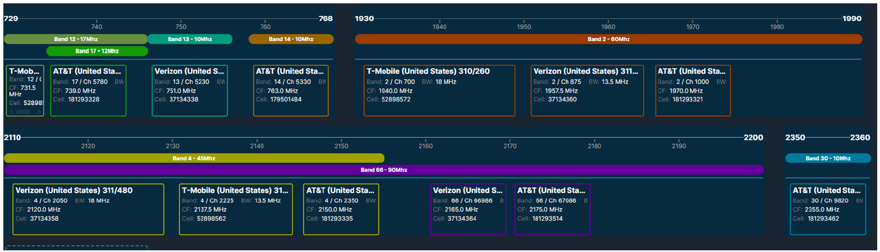
CellScan
Collection and database of detections of mobile cellsite transmissions
Incorporate Layer 3 Mobile Operator (4G/5G)
Operator Information (MCC, MNC, TAC, eNodeB_id, Cell_id)
Channel Frequency and Power Information (RSSI, Bandwidth)
Software upgrade to existing TCI Scorpio infrastructure
Setup Scan based on Bands of Interest
Realtime Band View of Detections

Slide 4
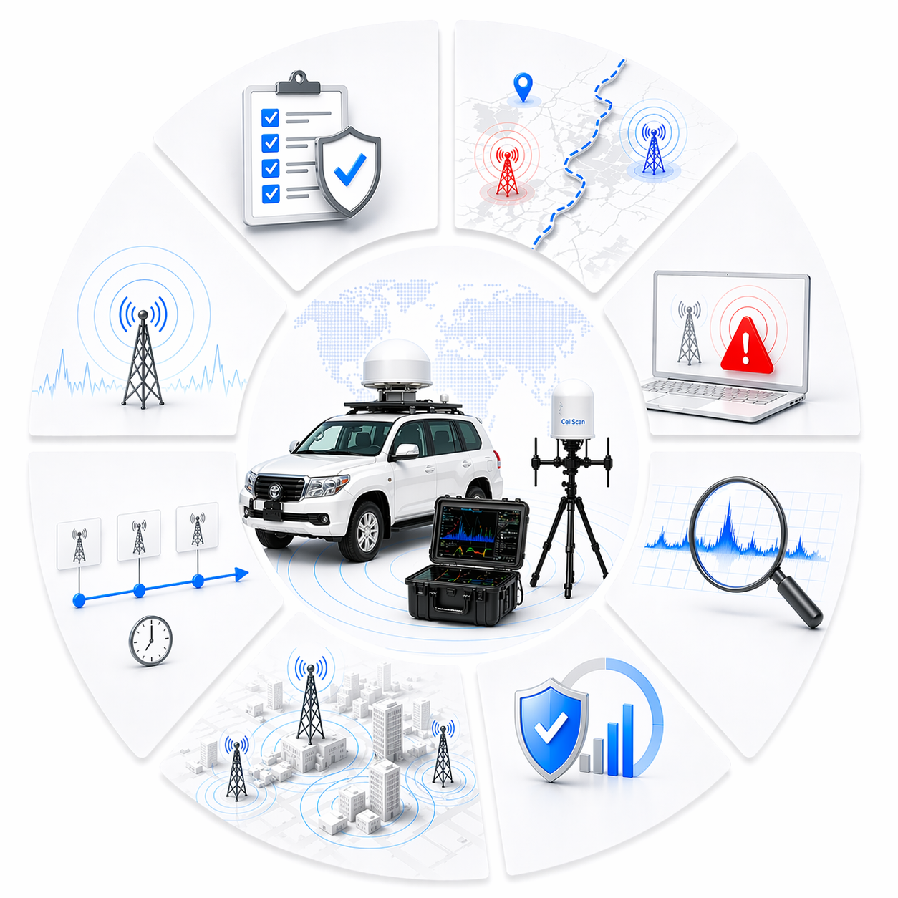
CellScan Regulatory Challenges – Use Cases
License compliance: Verify that transmissions occur only on authorized bands, bandwidths, technology use and geographic areas – comparing against previous scans and operator licenses
Cross‑border leakage: Monitor edge zones for foreign network overspill or illicit high‑power eNodeBs.
Rogue / unauthorized base stations: Rapidly surface unregistered or spoofed cells. Rogue IMSI catchers lead to significant fraud occurring within many territories with estimates on the order of $1 Million / Day in some countries
Interference mitigation: Correlate anomalous RF levels, unexpected bandwidth occupation, or drift conditions.
EMF / EIRP verification: Observe relative field strength and derived flux indicators supporting safety monitoring providing early indicator verify EMF/EIRP compliance at scale

Slide 5
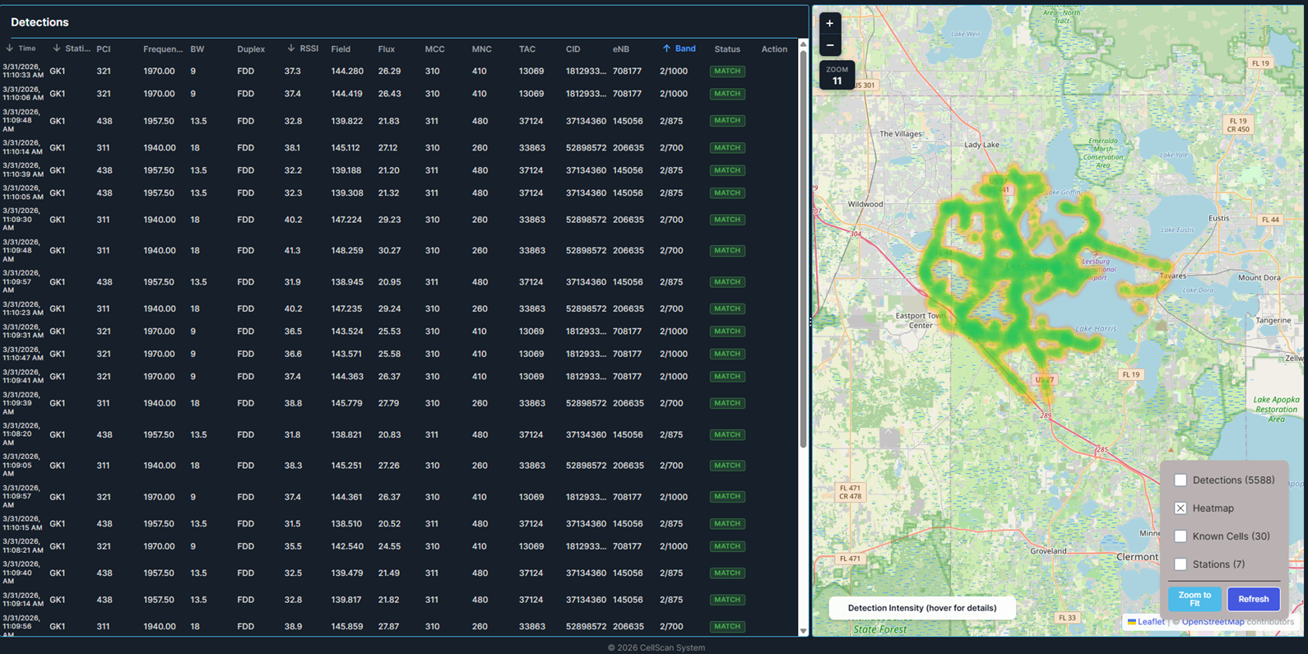
CellScan Dashboard and Reporting
Detections

Slide 6
CellScan
Live Demo

Slide 7
Key Features and Benefits
Software upgrade to existing TCI Scorpio infrastructure
Uses existing spectrum monitoring fixed- or mobile equipment
Web browser client
Tailored specifically to spectrum monitoring use cases
Less complex and lest costly that QoS systems designed for network operators
Passive downlink monitoring

