Slide 1
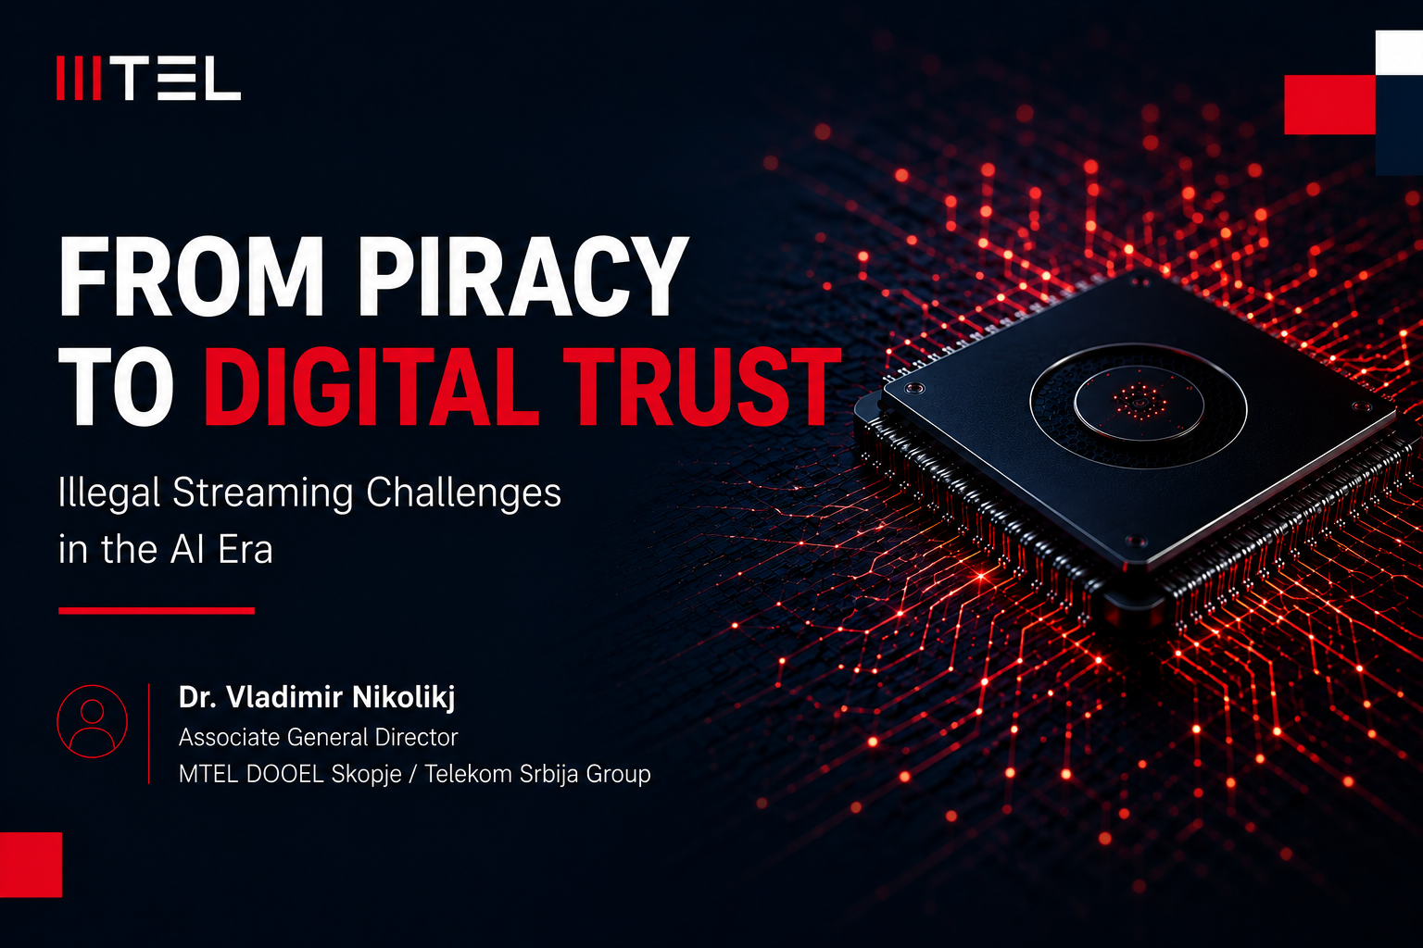
Notes:
Speaker Notes:
Distinguished representatives of the Agency for Electronic Communications,
dear colleagues, partners, ladies and gentlemen,
My name is Dr. Vladimir Nikolikj, Associate General Director at MTEL DOOEL Skopje, part of Telekom Srbija Group.
Today, I would like to talk about a challenge that is rapidly evolving across the digital world - illegal streaming and digital piracy in the era of artificial intelligence.
For many years, piracy was viewed mainly as a copyright issue. However, today it has become something much larger. It affects digital trust, cybersecurity, investments, innovation, and the sustainability of the entire media and telecom ecosystem.
At the same time, artificial intelligence is accelerating the scale and sophistication of illegal content distribution. Piracy networks are becoming more organized, automated, and harder to detect.
This is why the conversation must move from simply fighting piracy toward building a trusted digital future.
In this presentation, I will share the impact of illegal streaming on the regional ecosystem, explain how technology and AI are changing the landscape, and discuss why cooperation between telecom operators, regulators, institutions, and industry partners is essential for long-term success.
Our goal is not only to protect content - but to protect innovation, digital growth, and consumer trust.

Slide 2
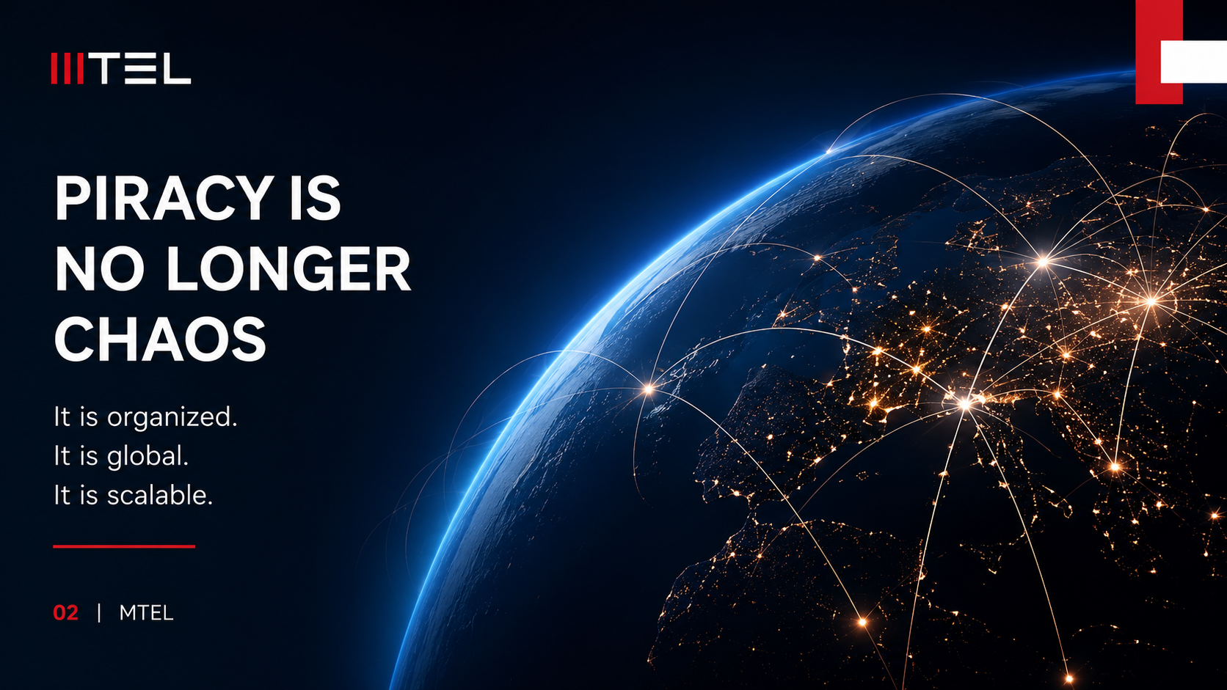
Notes:
Speaker Notes:
Piracy is not new. But today -piracy has fundamentally changed.
It is no longer an isolated activity performed by individuals.
Today, illegal streaming operates as a highly organized digital industry.
We now see IPTV ecosystems, illegal streaming platforms, mirror infrastructures, and global distribution networks operating with professional efficiency.
These platforms have: business models, subscription systems, customer support and millions of users worldwide.
This is no longer digital chaos. This is business.And because of that, the challenge becomes much larger.Illegal streaming today is scalable, international, and technologically advanced.
It adapts quickly, bypasses restrictions, and continuously evolves through modern digital infrastructure.
That is why piracy today is not only a legal or technical issue.
It is becoming a strategic challenge for the entire digital ecosystem.

Slide 3
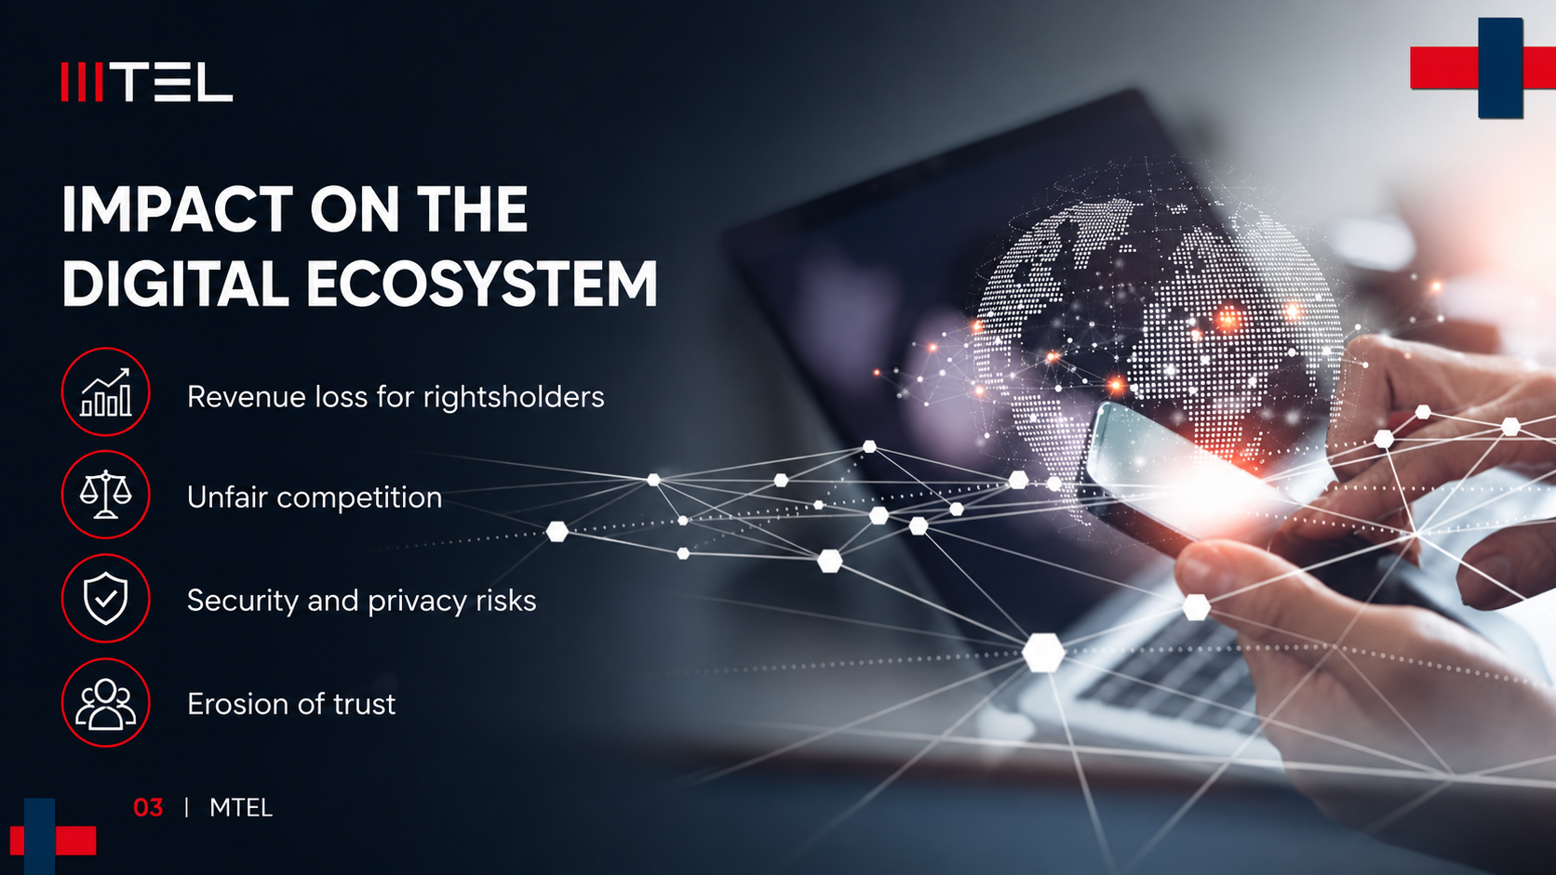
Notes:
Speaker Notes:
The impact of illegal streaming extends far beyond copyright infringement.Its consequences affect the entire digital ecosystem.
First, there are significant revenue losses for operators, broadcasters, and content owners.
This directly reduces the ability to invest in premium content, local productions, innovation, and future digital services.
Second, piracy creates unfair competition.
Legal operators invest heavily in infrastructure, licensing, cybersecurity, and compliance — while illegal platforms operate without those obligations.
But perhaps the most important issue today is the growing security and privacy risk for users themselves.
Many illegal streaming platforms expose users to: malware, phishing attacks, identity theft, financial fraud and unauthorized data collection.
And over time, this creates something even more dangerous: an erosion of digital trust.
Because when users can no longer distinguish between trusted and untrusted digital environments, the entire ecosystem becomes more vulnerable.
That is why piracy today is not only a business problem.
It is also a cybersecurity and trust problem.

Slide 4
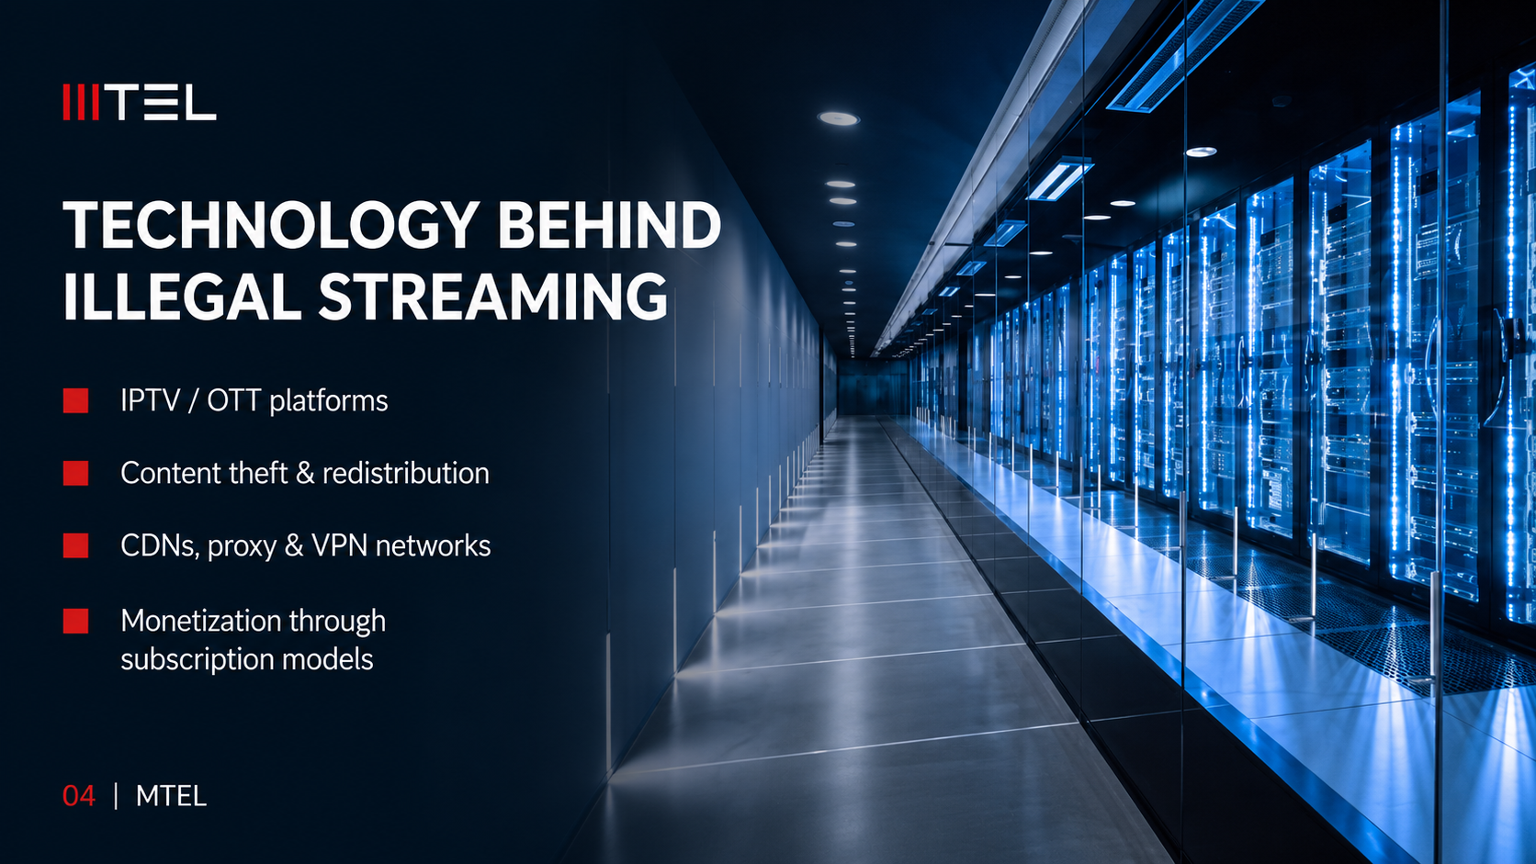
Notes:
Speaker Notes:
Behind illegal streaming there is a surprisingly sophisticated technological ecosystem.
This is not only about simple websites sharing content illegally. Today, piracy operates through highly organized digital infrastructures that are scalable, automated, and globally distributed.
One of the most common models is illegal IPTV and OTT distribution.
These platforms replicate the experience of legitimate streaming services -offering: live television, premium sports, movies and on-demand content through subscription-based illegal services.
In many cases, the user experience is intentionally designed to look professional and trustworthy.
At the infrastructure level, these operations rely heavily on: CDNs, proxy networks, VPN services and mirror platforms.
This allows illegal operators to: distribute traffic globally, avoid detection, bypass restrictions and rapidly recover when services are blocked. The ecosystem is highly adaptive.
Another major challenge is content theft and redistribution.
Authorized streams are captured, duplicated, modified, and redistributed in real time - often within seconds after original broadcasting begins.
This creates enormous pressure on operators and content owners. And perhaps most importantly -piracy today is fully monetized.
Illegal platforms generate revenue through: subscriptions, advertising, affiliate schemes, cryptocurrency payments and even reseller networks.
This means piracy is no longer simply unauthorized access to content. It has evolved into a digital business model operating at industrial scale.

Slide 5

Notes:
Speaker Notes:
Artificial intelligence is fundamentally changing the digital landscape -and piracy is evolving together with it.
Today, AI is no longer only a tool for innovation. It is becoming both a solution and a challenge.
On one side, AI enables telecom operators and security teams to improve: real-time detection, automated traffic analysis, predictive monitoring and faster incident response.
But on the other side, illegal platforms are also using AI to become more sophisticated. We already see: deepfakes and synthetic media, automated piracy distribution systems, AI-generated fake identities and smarter targeting of users through algorithms and behavioral analysis.
This makes illegal streaming networks harder to detect and much more adaptive. Traditional approaches are no longer enough.
The challenge is no longer only about content theft. It is becoming a challenge of trust, authenticity and digital integrity.
And this is why AI governance, cybersecurity and trusted digital infrastructure will become critical priorities for the telecom industry in the years ahead.

Slide 6
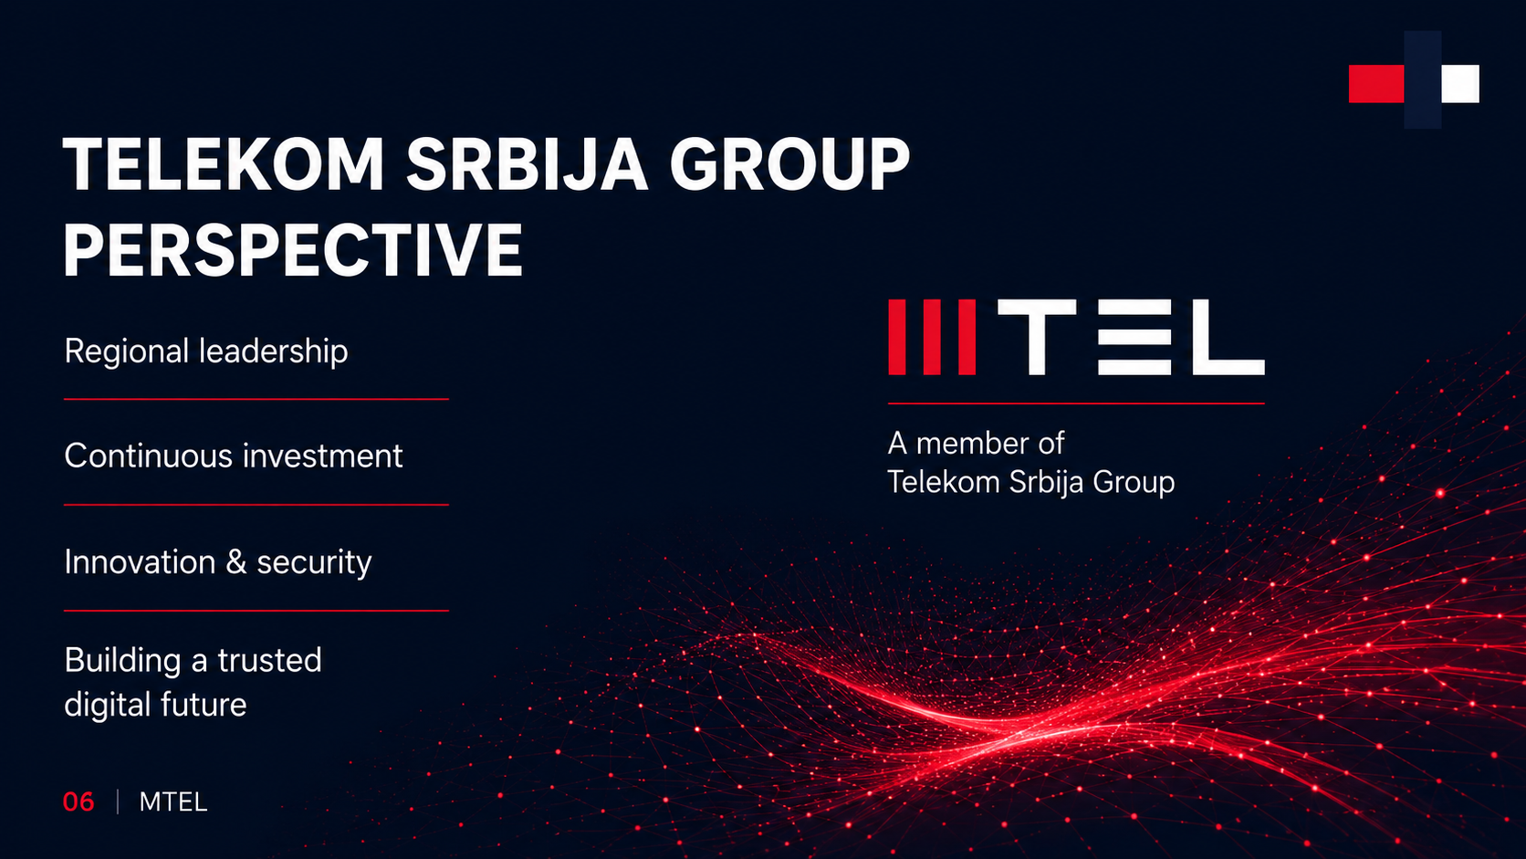
Notes:
Speaker Notes:
Telekom Srbija Group, headquartered in Serbia and operating across the region, is today one of the largest telecommunications operators in Southeast Europe.
The company serves almost 12 million users across six telecommunications markets and generates annual revenues of approximately 1.8 billion euros, reflecting strong regional presence and continuous growth.
This position allows Telekom Srbija Group to play an important role not only in telecommunications development, but also in shaping a more secure and trusted digital ecosystem across the region.
As part of the Telekom Srbija Group, we are committed to combating digital piracy as a long-term strategic priority.
That is why we continuously invest in: secure infrastructure, licensed content, advanced digital platforms, and stronger cybersecurity capabilities.
Our focus is not only on connectivity and technological development, but also on building digital trust, improving user experience, and supporting responsible digital transformation.
We believe that sustainable digital growth can only exist in an environment where innovation, security, and authorized content protection evolve together.

Slide 7
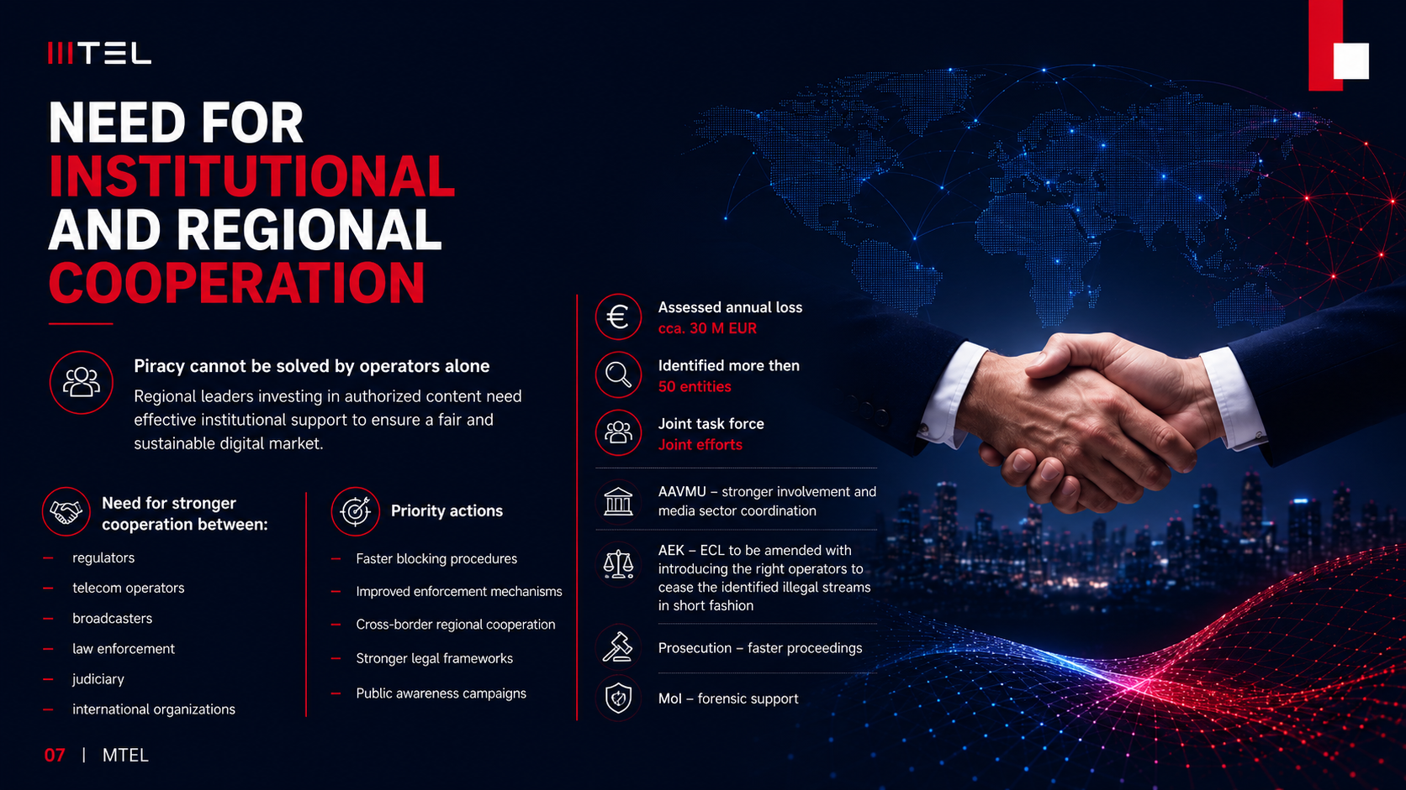
Notes:
Speaker Notes:
Digital piracy is not something telecom operators can solve alone.
It is a regional and institutional challenge that requires coordinated action from all stakeholders in the digital ecosystem.
The assessed annual loss from illegal streaming is approximately 30 million euros, while more than 50 entities connected to illegal distribution activities have already been identified.
This clearly shows the need for stronger cooperation between regulators, telecom operators, broadcasters, law enforcement institutions, judiciary authorities, and international organizations.
From our perspective, several actions are especially important:
establishing joint task forces and coordinated joint efforts, stronger involvement from AAVMU, and amendments to the Electronic Communications Law through AEK, allowing operators to stop identified illegal streams more efficiently.
At the same time, faster prosecution procedures and stronger forensic support from the Ministry of Interior are essential for improving enforcement.
Piracy today is not only a copyright issue — it also impacts cybersecurity, trust, investment, and the sustainability of the digital market.
For Telekom Srbija Group and MTEL, cooperation and responsible digital transformation remain key priorities in building a trusted digital future.

Slide 8

Notes:
Understanding user behavior is an important part of addressing digital piracy.
In many cases, users are not intentionally choosing illegal platforms — they are looking for convenience, affordability, and easy access to content.
At the same time, there is still a significant awareness gap regarding the risks connected to illegal streaming services, including cybersecurity threats, data privacy issues, and unreliable service quality.
Artificial intelligence additionally changes user behavior through personalized targeting, automated recommendations, and more sophisticated illegal distribution models.
Because of this, the response cannot be based only on enforcement.
We must also focus on education, user trust, better digital experiences, and accessible legal alternatives.
Only by understanding user expectations and habits can we build a safer and more sustainable digital ecosystem.

Slide 9
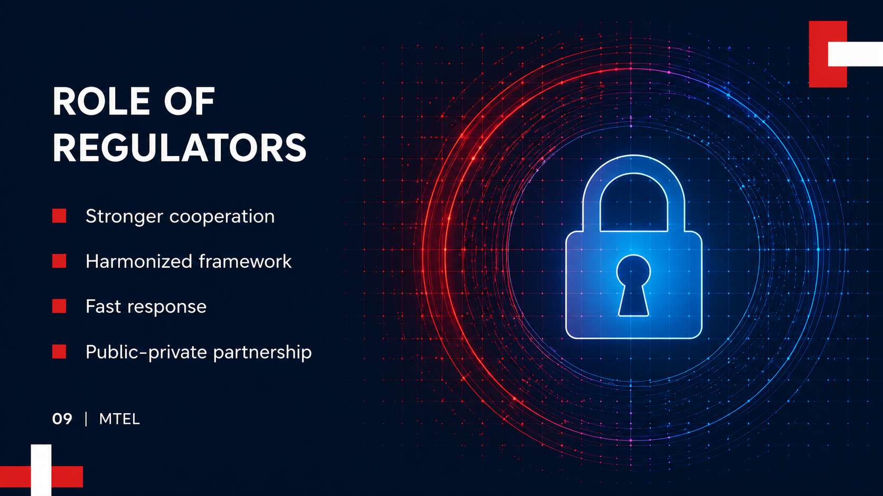
Notes:
Regulators have a central role in addressing digital piracy effectively.
Illegal streaming today operates across borders, platforms, and technologies, which means isolated actions are no longer enough.
What is needed is stronger cooperation between institutions, telecom operators, broadcasters, and law enforcement agencies, supported by a harmonized legal framework and faster response mechanisms.
Public-private partnership is especially important, because telecom operators often have the technical capability to identify and react to illegal distribution channels quickly.
At the same time, regulatory frameworks must continue evolving in order to support faster enforcement, better coordination, and stronger protection of authorized digital services.
Only through aligned institutional action can we create a more secure and trusted digital environment.

Slide 10
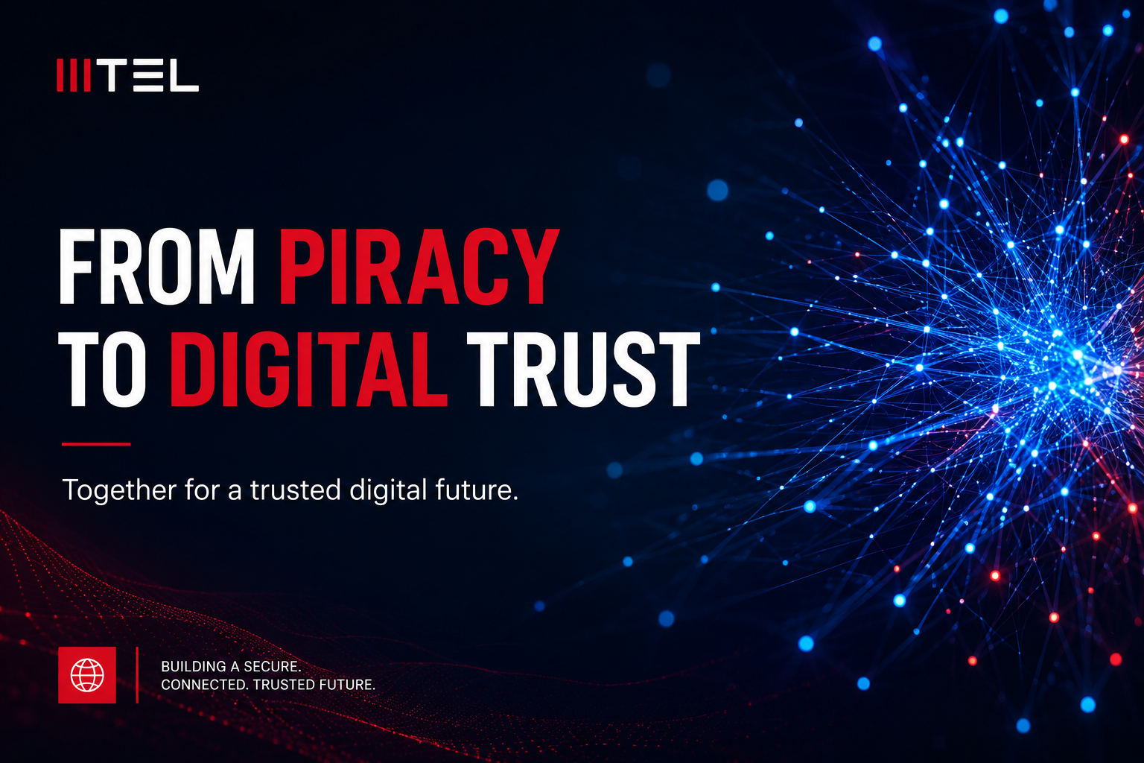
Notes:
Ladies and gentlemen,
Digital piracy today is no longer only a copyright problem — it has become an issue of trust, security, and long-term digital sustainability.
If users cannot trust the integrity of digital platforms and content distribution, the entire ecosystem becomes vulnerable.
That is why the solution requires much more than technology alone.
It requires cooperation between telecom operators, regulators, institutions, broadcasters, and users themselves.
Our goal is clear:
to protect authorized content, empower users with secure services, strengthen regional cooperation, and continue driving innovation responsibly.
At Telekom Srbija Group and MTEL, we believe that only through joint efforts can we build a safer and more trusted digital future for the entire region.
Thank you.

