Slide 1


Navigating Digital Frontiers GSR-26 and beyond
International Regulatory Conference (IRC-26)
19-20 May 2026
Ohrid, North Macedonia

Slide 2
Outline
Global Symposium for Regulators (GSR-26)
GSR-26 Best Practice Guidelines
Connectivity Planning Platform (CPP)
Global Economic Model and Study (GEMS) Tool for Digital Infrastructure Deployment
Regulatory Perspectives for Satellite Communications to Connect Underserved Communities

Slide 3
Global Symposium for Regulators (GSR-26)

Slide 4


Slide 5


Slide 6


Global Symposium for Regulators 2026
Navigating the Digital Frontier: GSR Key Takeaways
Notes:
Align the texts
Decisions are fragmented, not evidence-driven

Slide 7

GSR Best Practice Guidelines
Regulatory Governance Essentials: The new core kit regulators need to make digital markets deliver
We, the regulators participating in the 25th Global Symposium for Regulators, have collectively contributed to and endorsed these Best Practice Guidelines to support digital markets and ecosystems in delivering public-interest outcomes in an inclusive, trusted, and sustainable manner.
Building on the series of GSR Best Practice Guidelines developed since 2003, this edition does not revisit established principles that remain valid. Instead, they focus on the priority regulatory capabilities, institutional arrangements, and practical tools regulators now need to navigate increasingly complex digital ecosystems with coherence, adaptability, and evidence-based decision-making.
At its core, effective regulation aims to ensure that digital markets deliver public-interest outcomes consistently, credibly and at scale. This requires more than a broad set of instruments; it calls for a coherent governance architecture built around a defined set of foundational capabilities. These Guidelines therefore highlight the essential regulatory design elements that enable regulators to define outcomes clearly, allocate responsibilities, generate evidence, adapt to change, intervene proportionately, and maintain coherence across institutions and borders.
Notes:
Align the texts
Decisions are fragmented, not evidence-driven

Slide 8
GSR Best Practice Guidelines
ESSENTIAL 1. PUBLIC-INTEREST OUTCOMES AND STRATEGIC FOCUS
Regulators should begin by defining a limited set of outcomes that digital markets are expected to deliver and use them to discipline regulatory action.
ESSENTIAL 2. RISK-BASED AND PROPORTIONATE CALIBRATION OF OBLIGATIONS
Where warranted, regulators should consider differentiating obligations -for market actors according to function, market position, and risk, so that responsibility sits where it is most relevant and regulatory action remains proportionate to likely harm.
ESSENTIAL 3. OBSERVABILITY AND CREDIBLE EVIDENCE
Regulators should ensure that public-interest outcomes in digital markets can be measured, observed, and verified through a proportionate observability model that supports effective oversight without excessive burden.
ESSENTIAL 4. INCENTIVE-BASED MARKET SHAPING
Regulators should use incentive levers and enabling measures to steer behaviour toward public-interest outcomes before relying on more directive intervention.
ESSENTIAL 5. GRADUATED SUPERVISION, DUE PROCESS, AND DE-ESCALATION
Regulators should put in place a predictable supervisory pathway that moves from guidance and corrective action to stronger intervention where justified, and that includes clear conditions for scaling measures back.
ESSENTIAL 6. ADAPTIVE REGULATION AND STRUCTURED LEARNING
Regulators should treat the capacity to test, learn, review, and adjust as a core requirement, using evidence, experience and structured engagement with market actors, consumers, technical experts, and other public authorities so that governance can evolve with technologies, markets, and patterns of harm.
ESSENTIAL 7. DOMESTIC AND CROSS-BORDER REGULATORY COHERENCE
Regulators should ensure that governance remains coherent across mandates, sectors, and jurisdictions, and over time, so that digital services are not hampered by institutional fragmentation.
Notes:
Align the texts
Decisions are fragmented, not evidence-driven

Slide 9
GSR Best Practice Guidelines:
PRACTICAL IMPLEMENTATION PATHWAYS FOR THE CORE GOVERNANCE TOOLKIT
The following translates the seven essential components of the regulatory governance architecture into a practical checklist of priority actions that regulators can introduce, review, measure and track over time to put the core toolkit into operation, with implementation sequenced and scaled according to institutional capacity, technical and resource constraints, and market maturity.
It can also be used as a structured self-assessment tool to identify strengths, gaps and priorities, support internal coordination, and guide the sequencing and implementation of institutional and regulatory improvements.
PUBLIC-INTEREST OUTCOMES AND STRATEGIC FOCUS
RISK-BASED AND PROPORTIONATE CALIBRATION OF OBLIGATIONS
OBSERVABILITY AND CREDIBLE EVIDENCE
INCENTIVE-BASED MARKET SHAPING
GRADUATED SUPERVISION, DUE PROCESS, AND DE-ESCALATION
ADAPTIVE REGULATION AND STRUCTURED LEARNING
DOMESTIC AND CROSS-BORDER REGULATORY COHERENCE
Notes:
Align the texts
Decisions are fragmented, not evidence-driven

Slide 10

IAGDI-CRO – Outcome Statement
Actions recommended to policy makers and regulators
Adopt predictable, investment-friendly and technology-neutral regulatory frameworks that maintain incentives for long-term infrastructure investment, with flexible coinvestment and infrastructure-sharing arrangements that preserve service-quality differentiation and the freedom to build resilient, multi-fibre networks.
Ensure that all actors benefiting substantially from the digital ecosystem contribute proportionately to the sustainability of underlying infrastructure and to shared digital commons priorities, including resilience, cybersecurity and digital inclusion.
Mobilise long-term capital and innovative financing mechanisms—including blended and concessional finance and risk-mitigation instruments—through coordinated action by governments, multilateral development banks, development finance institutions and the private sector, particularly for low-income and underserved markets.
Strengthen international cooperation to safeguard digital infrastructure—including telecommunications networks, submarine cables, data infrastructure and cross-border digital systems—and ensure continuity of connectivity during periods of instability and crisis.
Advance cybersecurity through multi-stakeholder partnerships, real-time intelligence sharing, aligned international standards and layered resilience that prepares for simultaneous cyber, operational and geopolitical disruption.
Promote balanced and technology-neutral frameworks that allow terrestrial and nonterrestrial systems to operate in complementary roles—supported by coordinated approaches to spectrum, licensing and sustainability—while preserving fair competition and fit-for-purpose regulation across mobile, satellite and digital-platform participants, whilst taking into account the underlaying technological difference and business models of each technology.
Close the usage gap through coordinated action on affordability, digital skills, locally relevant services and trusted online environments, with proportionate responses to misinformation that protect digital trust while preserving freedom of expression.
Notes:
Align the texts
Decisions are fragmented, not evidence-driven

Slide 11
Beyond Connectivity: Turning Infrastructure Into Impact

Slide 12
CPP
The scale of the connectivity challenge
2.2B
72%
up to 3×
people still offline globally
of unconnected people live in rural or remote areas
higher cost to connect rural vs. urban populations
Sources: ITU Facts and Figures 2024; World Bank Digital Development Report
Notes:
Align the texts
Decisions are fragmented, not evidence-driven

Slide 13
Connectivity Planning Workflow
CPP
Assess current connectivity & infrastructure
Plan network expansion & optimization
Estimate deployment costs
Assess economic & social impact

Slide 14
Case Study

Slide 15
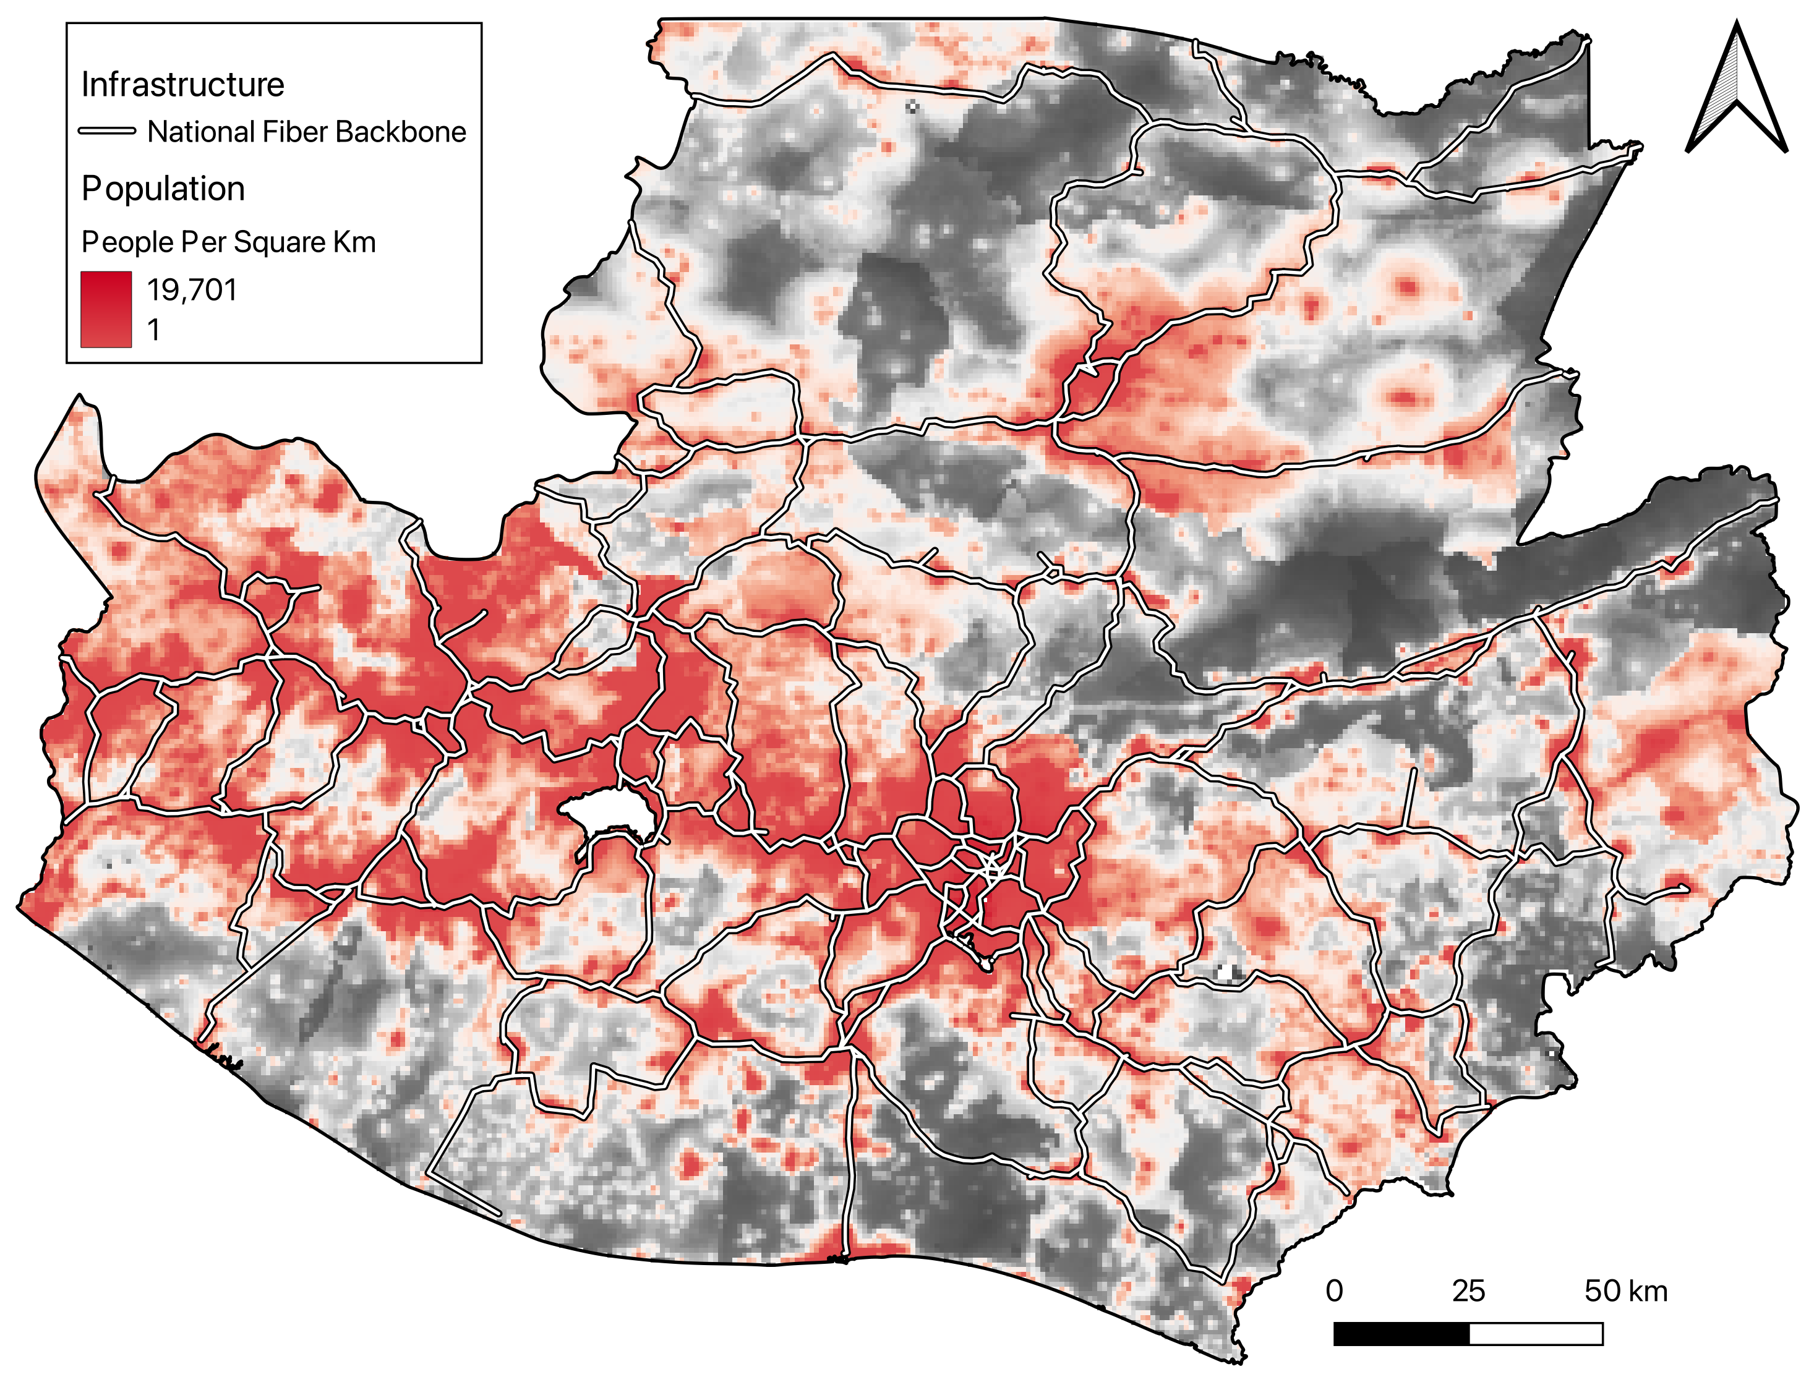
Republic of Cobertura: a Country at a Crossroads
CPP
The Republic of Cobertura is a fictional developing country which is full of promise: a young population, growing demand and bold digital ambitions.
However, its progress is uneven: Urban centers are connected and advancing while rural communities remain underserved
Investment in infrastructure flows where returns are highest, leaving parts of the country behind.
Infrastructure and Population At a Glance.

Slide 16
Connectivity Planning Workflow
CPP
Assess current connectivity & infrastructure
Plan network expansion & optimization
Estimate deployment costs
Assess economic & social impact

Slide 17
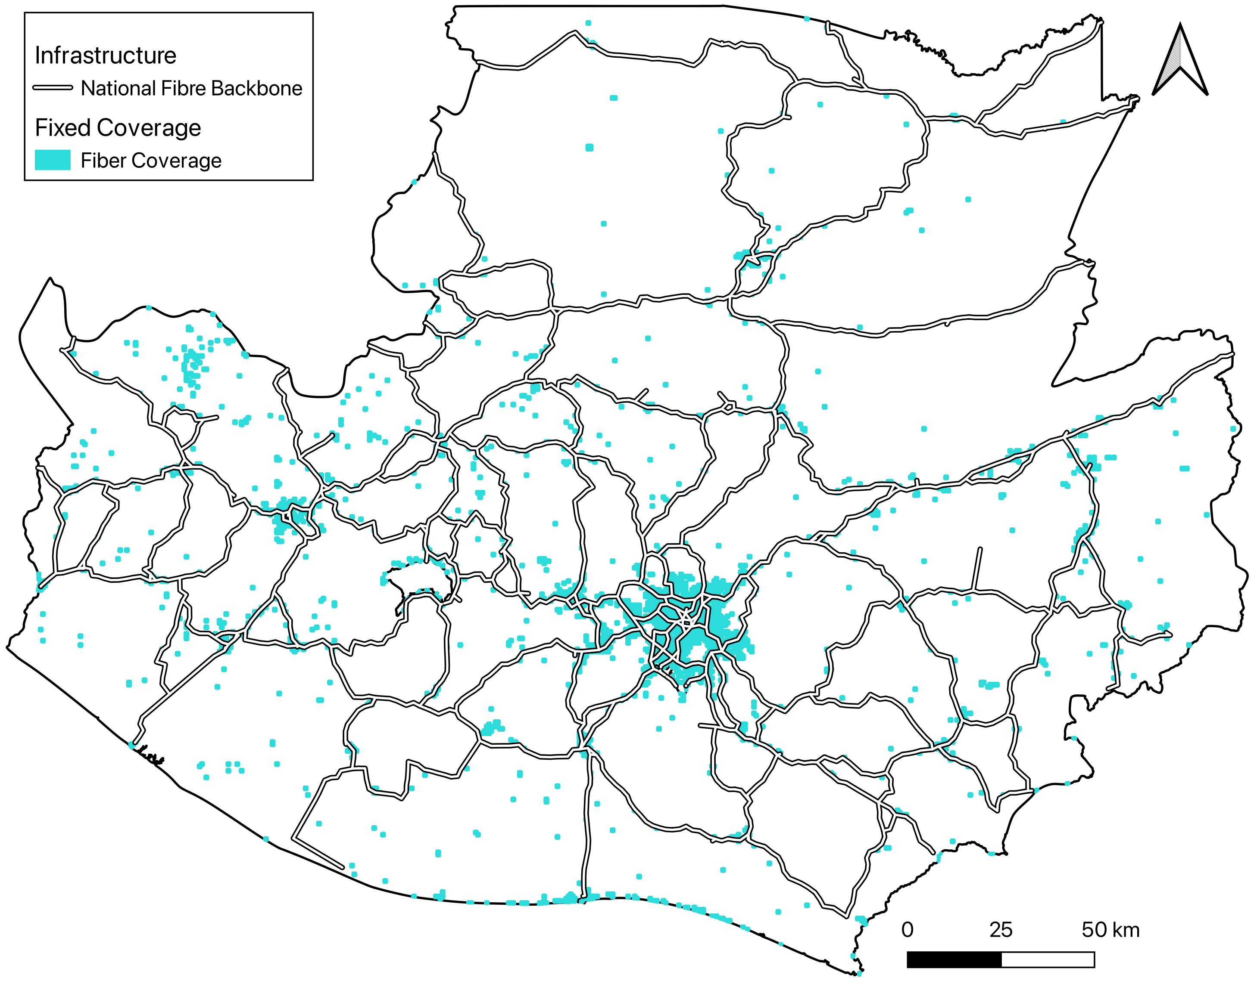
Quick facts about the Republic of Cobertura
CPP
Economy
Population: 15.1 million people (3.8 million households)
GDP: 100 billion USD
Infrastructure and Coverage
National Fiber Backbone: 4,000 km
Only 19% of the population covered by fiber → 12 million people lack access
Mobile coverage is higher: 87% covered by 4G and 27% by 5G
Fiber Coverage in Cobertura.

Slide 18
Connectivity Planning Workflow
CPP
Assess current connectivity & infrastructure
Plan network expansion & optimization
Estimate deployment costs
Assess economic & social impact

Slide 19
Data for connectivity modelling
CPP
Connectivity Models
Roads (OSM)
Quality of Service (Ookla)
Terrain (NASA)
Mobile Coverage (ITU)
Population (WorldPop)
To run our connectivity models, we use the following core data:
Locations of:
~ 500 public institutions (schools, town halls, health centers)
~70 fiber nodes on the backbone network
~400 cell sites
In addition, our models automatically source open datasets based on the area of analysis.
Datasets Automatically Sourced by Models.
Notes:
Visually, create a frame around the locations block

Slide 20


A National Broadband Plan to Expand Connectivity
CPP
Strategy: The government of Cobertura wants to develop a national strategy to expand fiber coverage from 19% to at least 50% within 5 years.
Two-stage approach:
Stage 1: Link the national backbone to Points of Interest (PoIs) such as schools, health centers, and town halls (Middle Mile).
Stage 2: Build local access networks around them to reach surrounding households (Last Mile).
Stage 1
Stage 2
Middle Mile: Connect fiber backbone to public institutions.
Last mile: Develop access networks from institutions to households.

Slide 21
Modelling Technology Options
CPP
Fiber
Cellular
Point-to-Point Microwave
Satellite
Wired
Wireless

Slide 22
Identifying and Closing Connectivity Gaps
CPP
Map existing infrastructure
Close connectivity gaps
Fiber Nodes
Cell Sites
Fiber: Road-based network expansion
4G / 5G: Assess coverage
P2P: Line-of-sight radio links

Slide 23
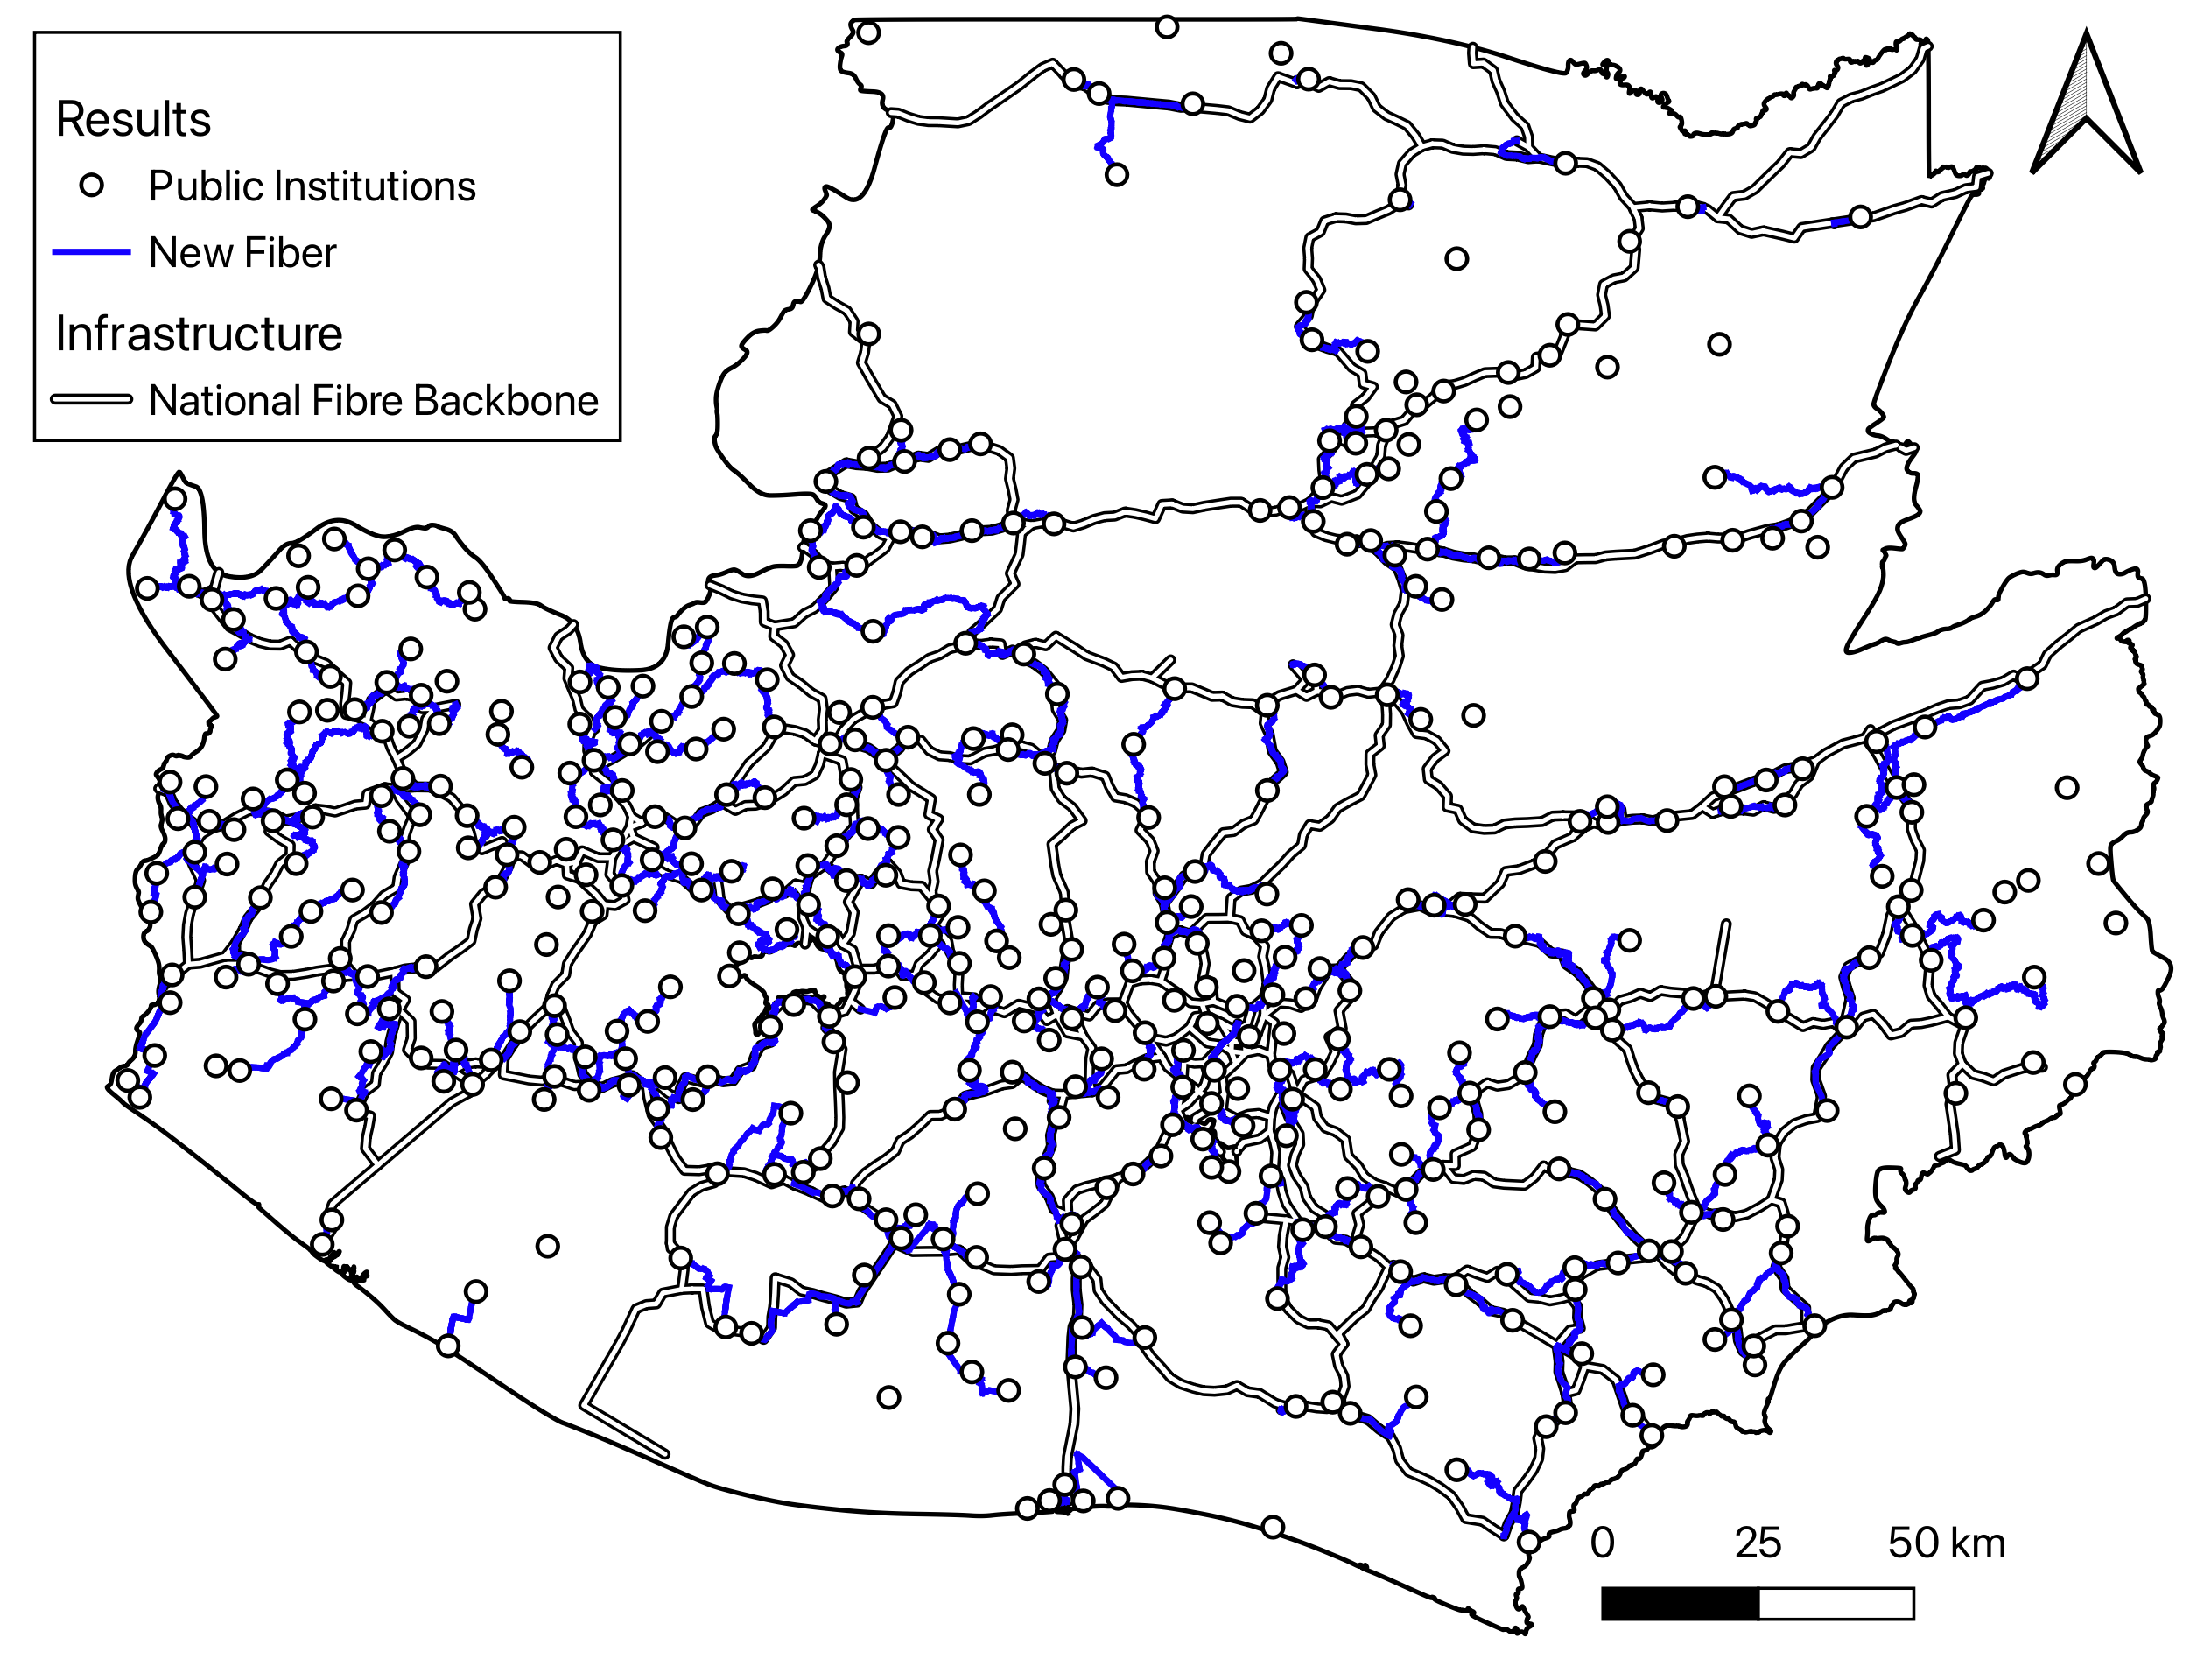
Fiber Deployment Results
CPP
Current situation
10% of institutions already connected
~450 institutions still require connection (mostly schools)
Model results
92% of institutions can be connected via fiber, 8% could not because of terrain or lack of roads
Requires ~3,800 km of new fiber, laid along existing roads (aerial or buried)
The longest link is 35 km from current fiber nodes
Proposed new fiber routes in Cobertura.

Slide 24
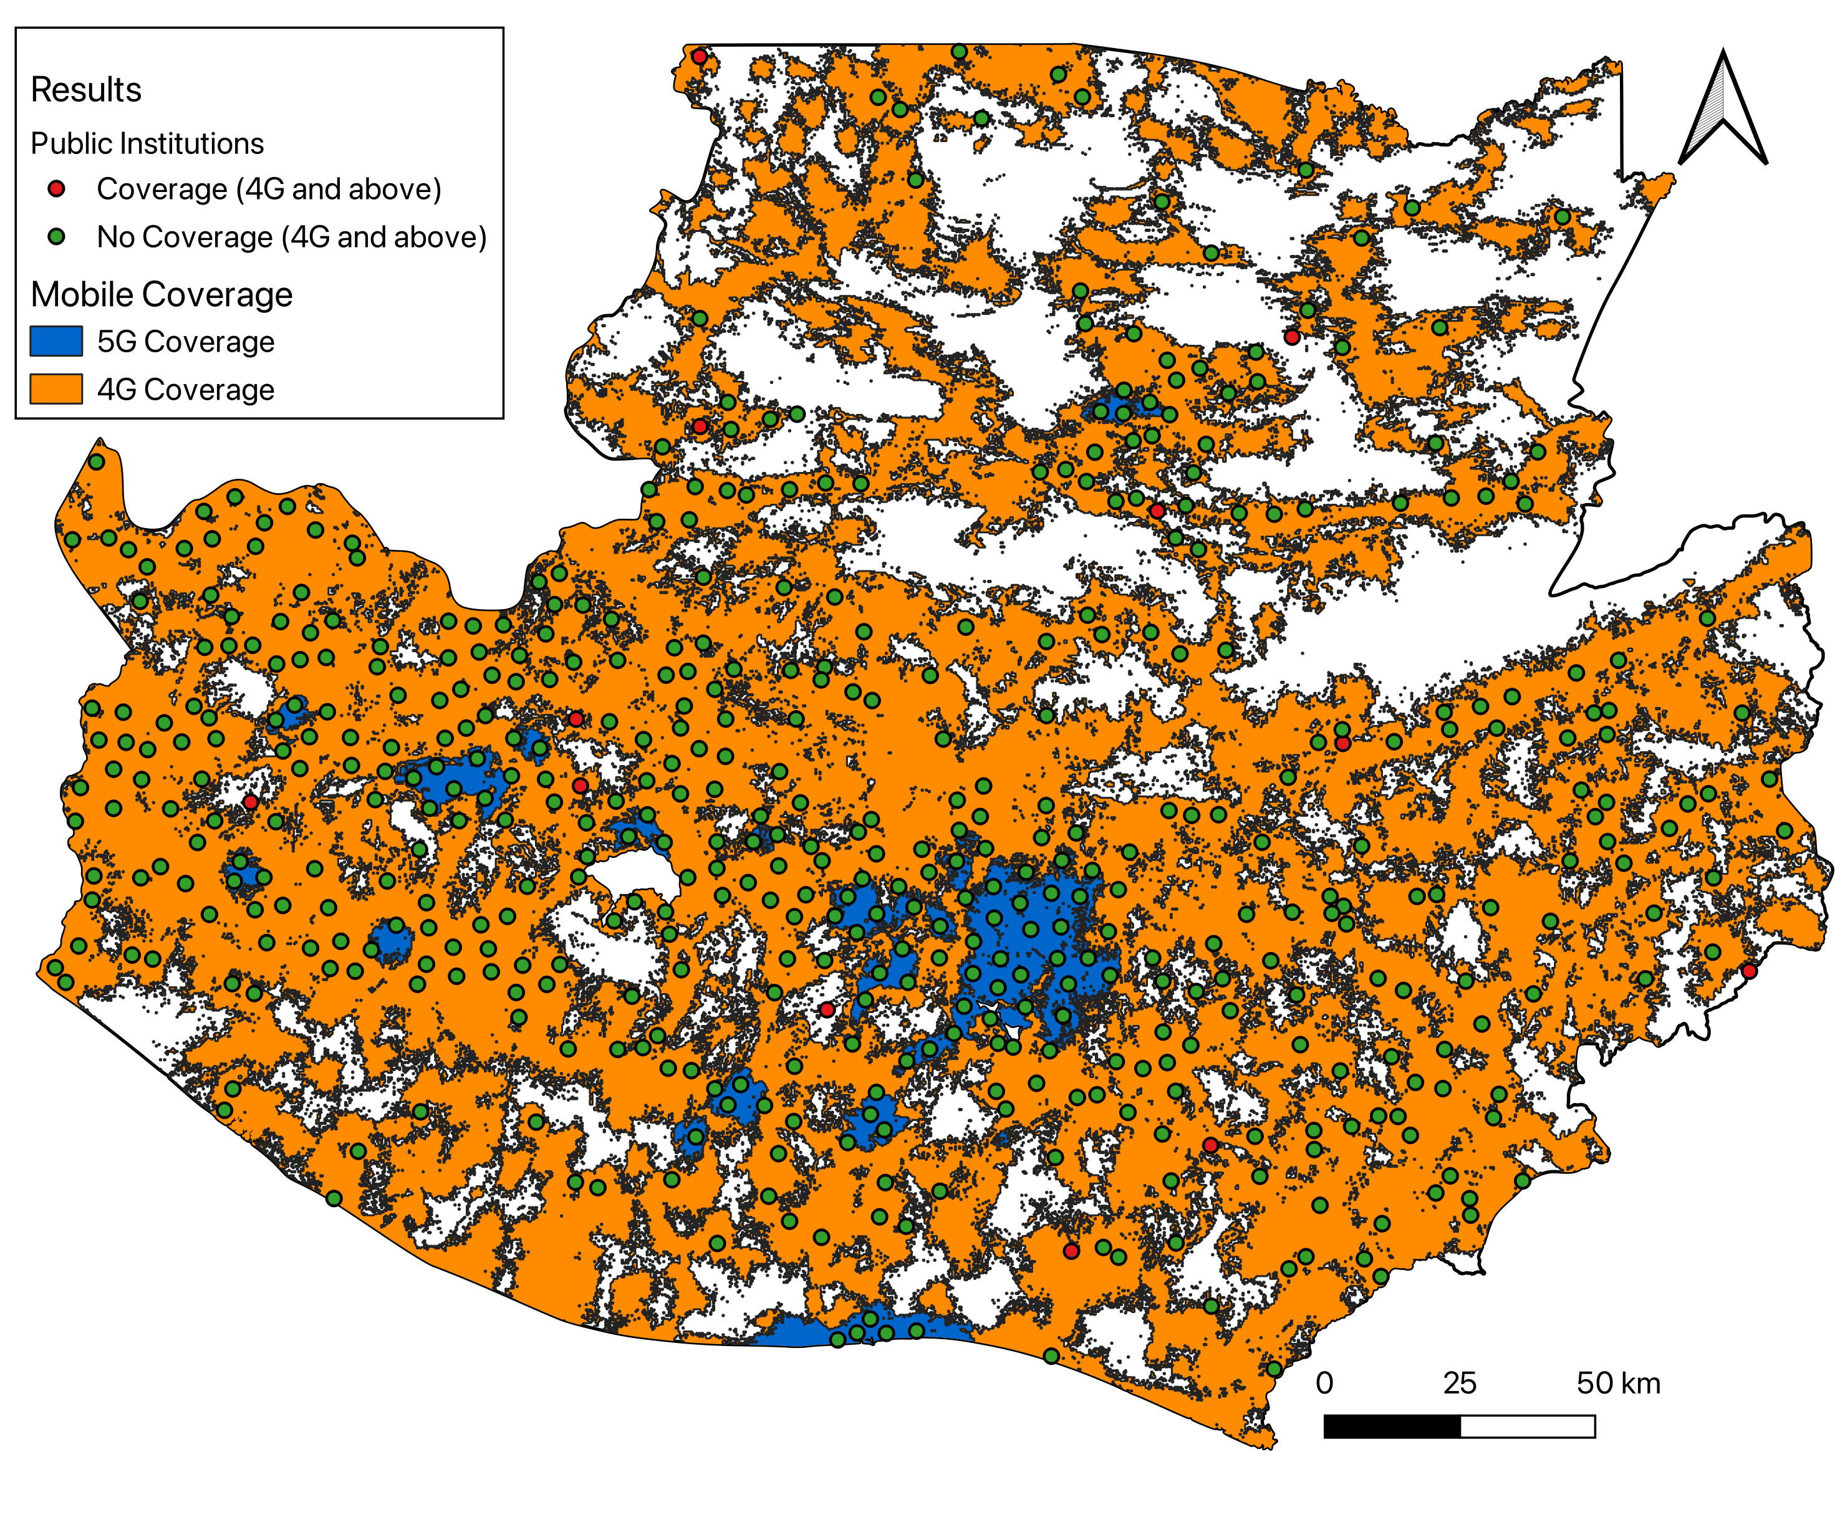
Wireless Connectivity Results
CPP
Cellular Coverage
98% of institutions already within 4G coverage and 12% within 5G coverage.
Point-to-Point (Microwave)
45% of institutions can connect to a nearby cell site (within 35 km and with unobstructed line of sight)
Satellite (LEO)
100% potential coverage, assuming available commercial capacity.
4G and 5G coverage.

Slide 25
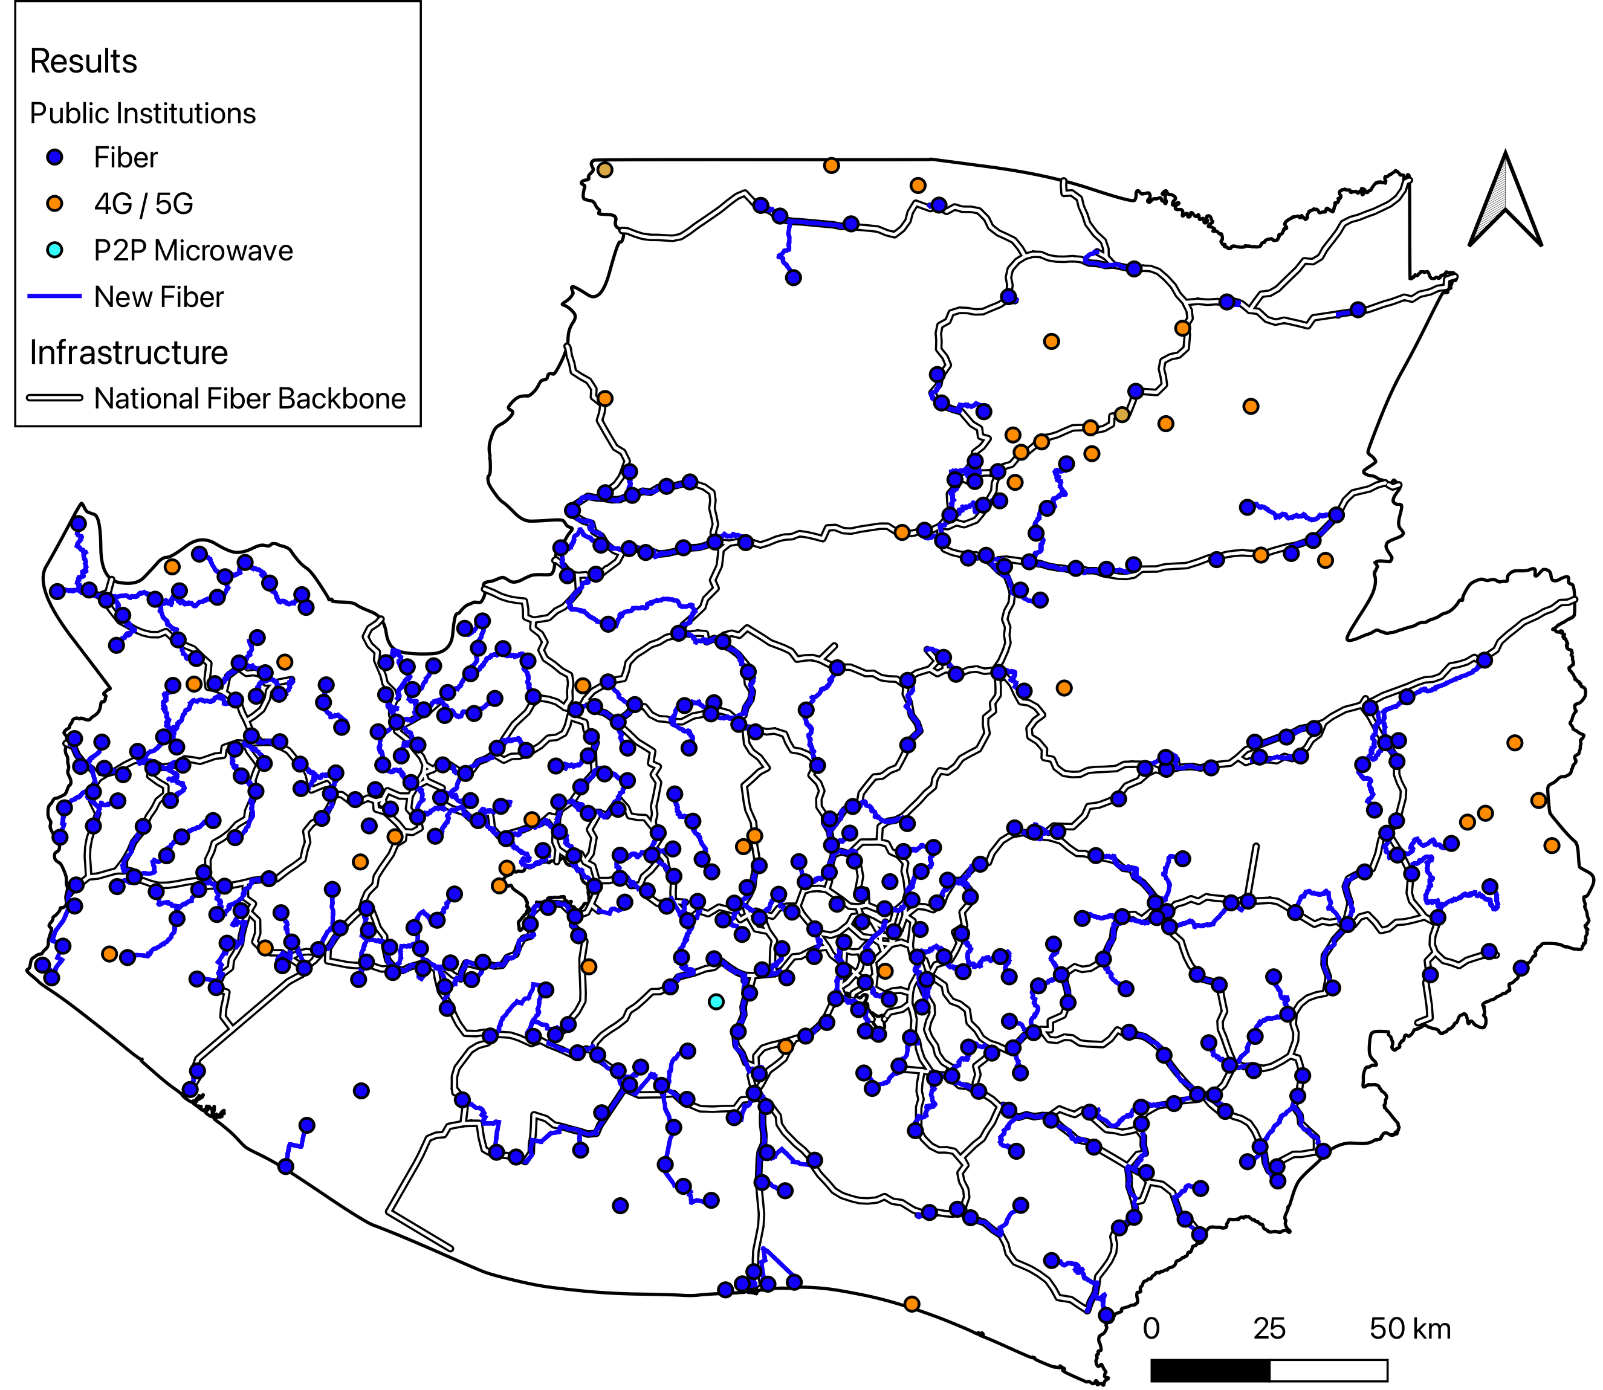
A Blended Solution for Universal Connectivity
CPP
Universal connectivity in Cobertura requires a mix of technologies:
Fiber can connect 95% of public institutions. It is the preferred solution due to high capacity and reliability.
Wireless technologies (4G, 5G, Point-to-Point Microwave or Satellite) can be used to connect the remaining 5%.
Mix of technologies required to reach institutions.
Notes:
Update map to remove satellite

Slide 26
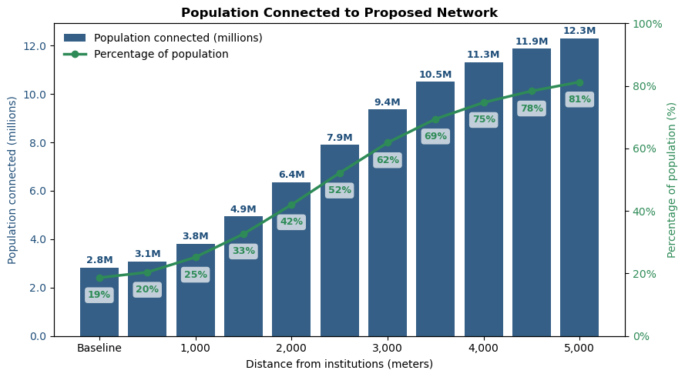
Reaching Households Through Access Networks
CPP
Challenge
Only 19% of the country is currently connected with fiber
Approach
Build access networks around institutions (2.5 km radius using GPON networks)
Impact
Those can reach 52% of Cobertura’s residents
Implications
Increases national fiber coverage from 19% to 52%, surpassing target
Notes:
ANALYSIS
make radius smaller, only 52% with smaller radius
BEGINNING
explanation slide of the transition between CPP and GEMS
what does each one do
what is the handover ... the role of each of them and the handshake
we can reuse the old table data on this ...
summary with the questions i just asked...
AFTER SUMMARY OF COBERTURA
we know how the close the gap now...
we now have the roadmap...
arrows of where we are
how muhc is it gonna cost?
how can i make it profitable?
who's gonna pay for it?
we will find out after the break...
OTHER
Kamila will add slide for the director intervention...

Slide 27
Summary: Impact of Intervention
CPP
 | 2025 (Baseline) | 2030 (After intervention)
Number of households connected with fiber (%) | 717,000 (19%) | 2 million (52%)
Assumption: 4 people per household
 | 2025 (Baseline) | 2030 (After intervention)
Number of people connected with 4G (%) | 13.2 million (87%) | 13.2 million (87%)
Number of people connected with 5G (%) | 4.06 million (27%) | 4.06 million (27%)
4G and 5G coverage remains unchanged, as the intervention relies on existing cellular infrastructure. Satellite is not required, as rural connectivity targets (50%) can be achieved with 4G/5G.

Slide 28
Connectivity Planning Workflow
CPP
Assess current connectivity & infrastructure
Plan network expansion & optimization
Estimate deployment costs
Assess economic & social impact

Slide 29
Connectivity Planning Workflow
CPP
Assess current connectivity & infrastructure
Plan network expansion & optimization
Estimate deployment costs
Assess economic & social impact

Slide 30
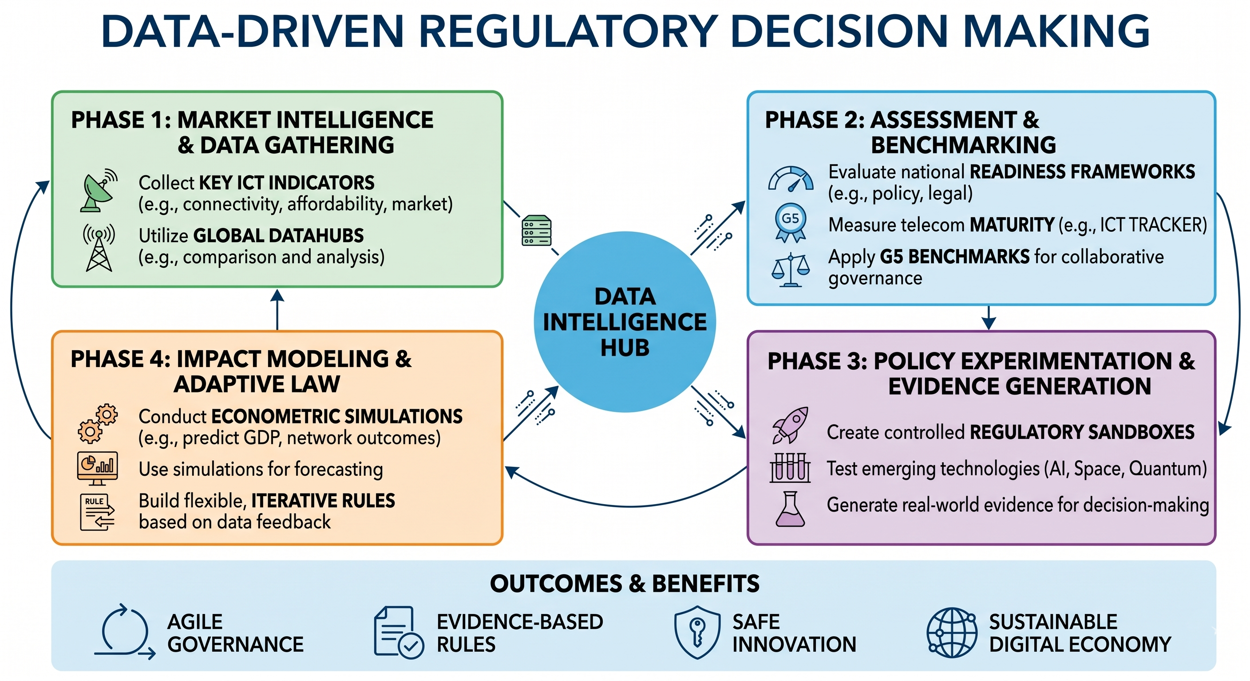

Slide 31

Global Economic Model and Study (GEMS) Tool
for Digital Infrastructure deployment
Quantify the economic impact of global connectivity

Slide 32

Purposes of the GEMS Tool
GEMS
Guide policymakers, regulators and the private sector on investment decisions, and in the application of regulatory practices to achieve full connectivity in a country
The tool estimates investment requirements, potential returns on such investment, stipulating business opportunities and models
The output is tailored to the context and capabilities of each country and region
Finally, the tool leverages the use of models and resources already developed for the ITU

Slide 33
Practical use Cases of the GEMS tool
GEMS
Use outputs to shape broadband plans and engage development partners (Multilateral Banks, Development Agencies)
Compare the investments and returns associated with different technology solutions (e.g., wired, wireless)
Find the optimal solution for each area of the country (urban, suburban, rural)
Explore satellite backup options for rural areas
Analyze the optimal policies to make investments possible

Slide 34
GEMS should be used to frame a discussion among stakeholders
GEMS
Government policy makers
Telecom regulators
Telecom operators
Private sector enterprises
How can we fulfill universal digital connectivity?
Regulatory framework to fulfill universal connectivity?
Achieve universal network deployment with positive ROI?
Digital transformation of production?
GEMS

Slide 35

Overall Caveats of GEMS platform (I)
GEMS
To calculate investment and return estimates the platform requires entering all data fields; even if data is not available, the user will have to provide reliable estimates for all data
The platform provides calculation of average investment and returns under a range of assumptions and econometric models within a confidence interval
Platform estimates provide an initial calculation of investment and results for a particular project/plan, which require further refinement in case they will be used for business case development

Slide 36

Overall Caveats of GEMS platform (II)
GEMS
The platform does not address topography conditions affecting investment; it only considers population density as a cost driver – if user needs to incorporate topographic considerations, use of the CPP platform for restricted territories is advisable
The regulatory options menu to simulate is limited, constrained by the availability of data for a cross-country sample
Beyond urban / suburban / rural, the model does not provide more granular disaggregation (e.g., covering specific schools or municipalities); in this case, rely on the CPP platform

Slide 37
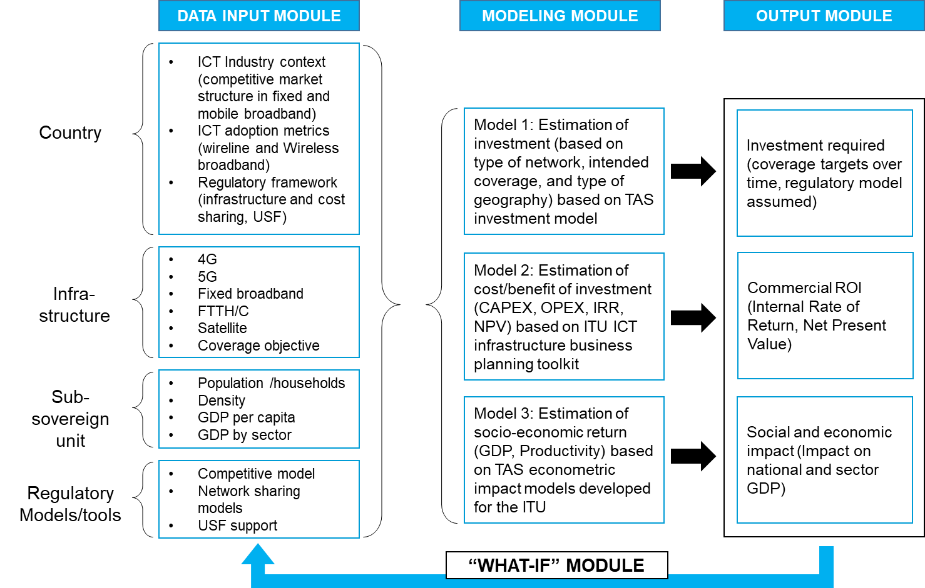
GEMS Tool: Conceptual Structure
GEMS
Datasets:
Combines user-provided and system-provided datasets to create the foundation for accurate, real-world economic impact analysis.
Models:
Econometric models apply technical and cost parameters to simulate economic impact of different technology options and calculate social and private returns.
Scenarios:
Allows testing alternative regulatory scenarios to support decisions regarding bankable business case

Slide 38

1. Access the Login Page
GEMS
1.1. Log In to Start Working
Once approved, log in using:
Your email
Your password
After login, you gain access to:
GEMS tool
1.2. User Roles
The GEMS tool supports economic assessment tool:
Viewer: Can view results of simulations
Analyst: Can develop simulation scenarios, enters data
Administrator: Can manage users, data, and country workspace

Slide 39
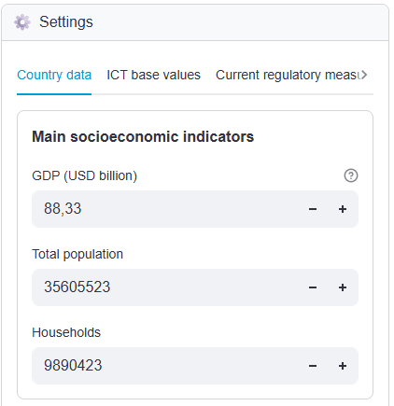
2. Enter economic and demographic country data
GEMS
Ensuring that the data you provide is accurate, complete, and relevant is essential — the platform’s analysis, modelling, and final recommendations will be based on the datasets you create and upload.
2.1 Upload main national indicators
Enter:
Main socioeconomic indicators of the country under consideration
Potential data sources: International Monetary Fund, World Bank, or National Statistics Office

Slide 40
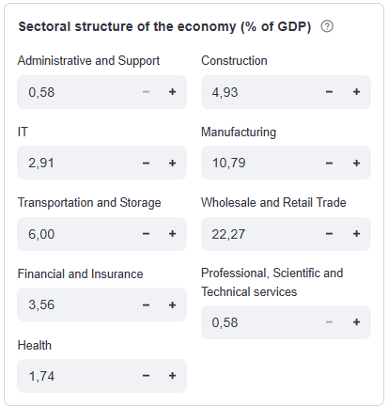
2. Enter economic and demographic country data
GEMS
2.2 Upload sectoral structure of the economy
Enter:
Weight of each sector of the national economy (as % of GDP)
This might require a calculation of percentages
Possible sources: Local National Accounts
Warnings
Not all sources provide a consistent structure of the economy
Sometimes the sector structure is not for the same year as GDP values; if so, calculate the share for the GDP of the year it is reported

Slide 41
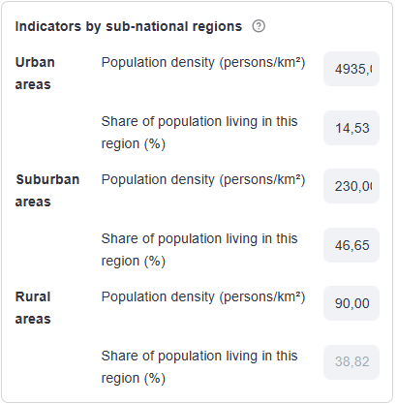
2. Enter economic and demographic country data
GEMS
2.3 Upload population subnational disaggregation for urban, suburban and rural areas
Enter:
Population density in each area
Share of population living in each area
Potential data sources: Local National Accounts, National Household Survey, or secondary sources
Warnings
Data does not need to be for the year of analysis; demographic statistics do not change substantially in the short term

Slide 42
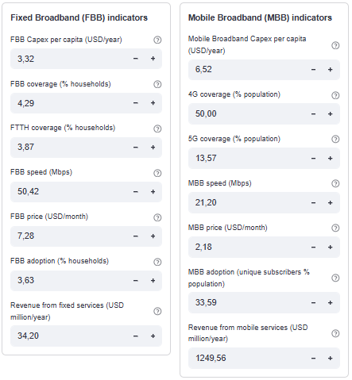
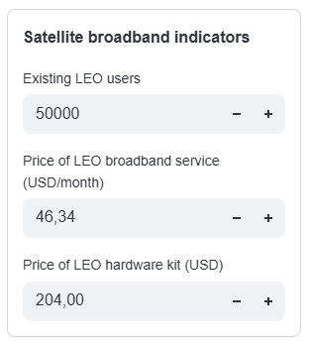
3. Enter base values for the telecom sector
GEMS
3.1 Upload data for country telecom sector
Fixed and mobile broadband coverage, adoption, average speed, average price, and CAPEX per capita
Fixed and mobile services revenues
Satellite broadband indicators (Users, Service and Kit prices)
Sources: Local regulator, ITU Data Hub, Telecom operators
If need of clarification, click on

Slide 43
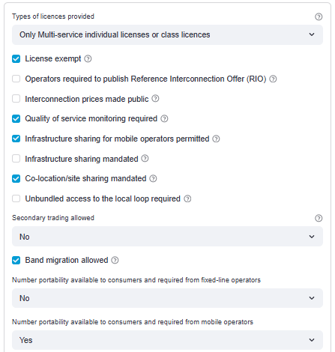
3. Enter base values for the telecom sector regulatory framework
GEMS
3.2 Upload telecom sector regulatory framework
Telecom licences exemption
Quality of service monitoring
Infrastructure sharing regime
Co-location/site sharing regime
Spectrum secondary trading
Band migration allowed
Source: ITU Regulatory Tracker
Warning:
You do not need to click all the regulatory measures of the Tracker, only the ones indicated in the tool for the country under consideration

Slide 44
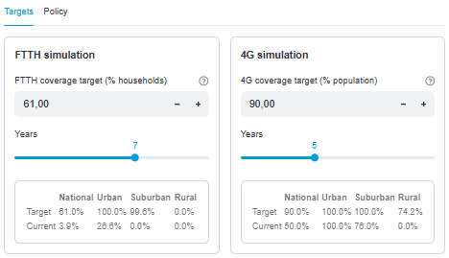
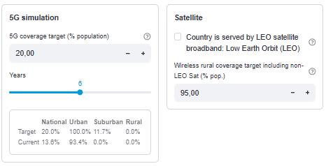
4. Enter data regarding national network deployment objectives
GEMS
4.1. Enter:
For each technology, fill the level of national coverage to simulate (subnational groups will be adjusted automatically)
For each technology, fill the years to reach the target (from 2 to 10 by relying on the sliding scale)
Warning:
If you do not want to simulate a particular technology, just leave the white cell empty (or put a zero)

Slide 45
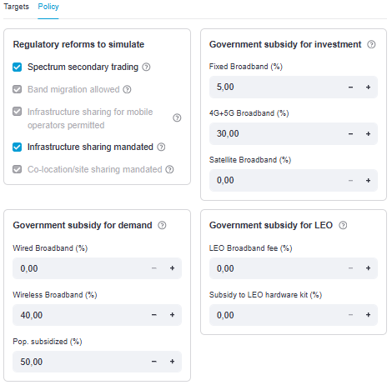
4. Define policies and regulations that can stimulate network deployment
GEMS
4.2. Enter:
Indicate which regulatory reforms you want to simulate
Potentially, subsidies for infrastructure deployment can be introduced (share of investment to be covered by the state through USF or another tool)
Demand can also be stimulated through subsidies to reduce prices to end-consumers

Slide 46
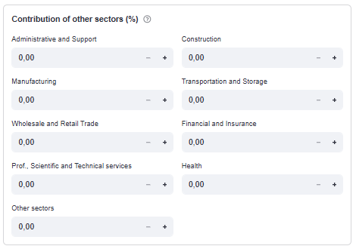
4. An additional incentive can be defined through sector contributions
GEMS
4.3. Enter:
Potentially, a fee can be charged to other sectors of the economy to contribute to finance the broadband investment
This is simulated by entering the fee imposed as a share of the sector revenues
Warnings:
A starting point could be 0.05% of revenues
Different sectors may face different contributions

Slide 47
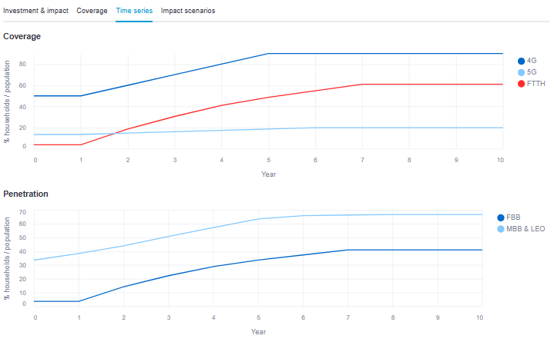
5. First output: network deployment objectives
GEMS
5.1. Network deployment objectives:
Coverage and adoption of all network technologies (FTTH, Mobile Broadband, 4G, 5G, Satellite)
Outcomes for a 10-year period

Slide 48
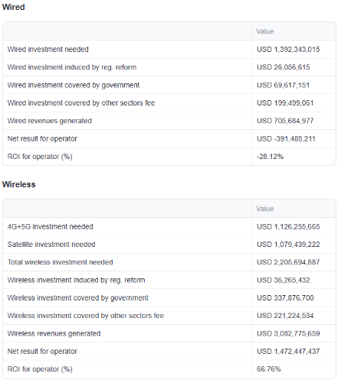
5. Second output: Return on Investment for Telecom operator
GEMS
5.2. ROI for telecom operator:
Results are grouped for wired / wireless technologies.
Maintenance of legacy infrastructure is omitted from investment requirements
Investment induced by regulatory reforms is also omitted, as it comes from cost-savings reform

Slide 49
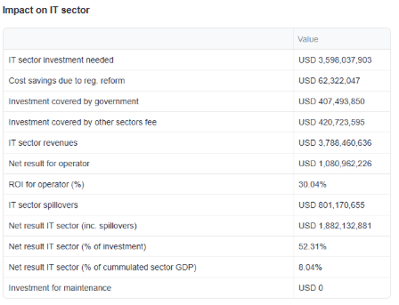
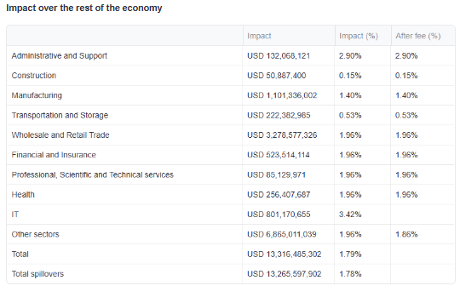
5. Third output: Return on Investment for economic sectors
GEMS
5.3. ROI for economic sectors:
Overall results for the IT sector (includes investment, revenue and spillovers).
Impact on the rest of the economy

Slide 50
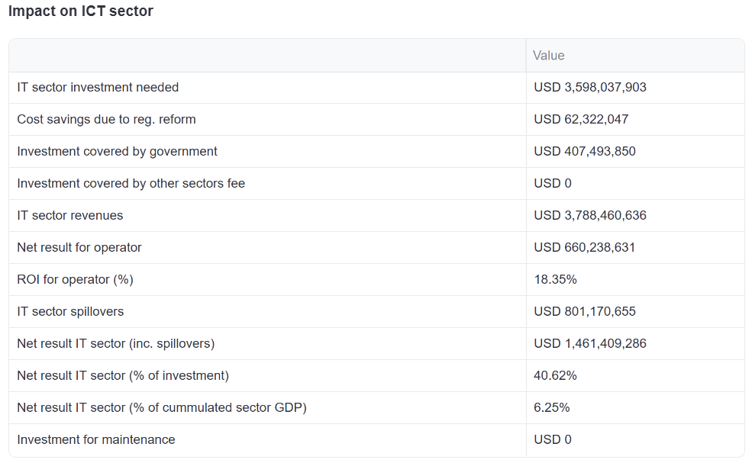
5. Third output: Return on Investment for economic sectors
GEMS
5.3. ROI for economic sectors:
Overall results for the IT sector (includes investment, revenue and spillovers).
Impact on the rest of the economy

Slide 51
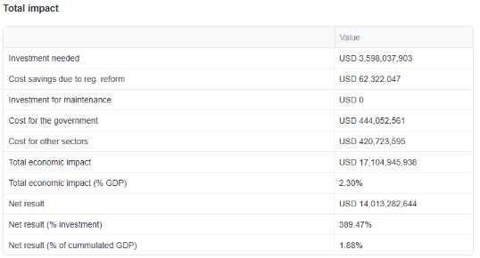
5. First simulation result: Total economic impact (measured as % of GDP)
GEMS
5.4. Social return:
An investment may not be worth for the telecom operator, but it is surely good for the society as a whole!

Slide 52
5. First simulation result: However, the ROI for the wireline telecom operator is negative
GEMS
5. Output provided
Detail is provided for both wired and wireless technologies
ROI (%) for telecom operator associated with the deployment projects.
A negative ROI indicates that no operator will be willing to conduct the project, being necessary to simulate further policy and regulatory reforms, that can contribute to a positive ROI

Slide 53
5. At this point, it is useful to have a discussion as to how to proceed
GEMS
FIRST RESULTS
Fulfilling telecommunication deployment targets has a positive impact on the GDP
However, the return on investment ROI for telecom operators associated with the deployment projects is negative
A negative ROI indicates that no operator will be willing to conduct the project
KEY QUESTION
What kind of regulatory changes or funding incentives can be made that can contribute to a positive ROI of telecom operators?
TECHNOLOGY OPTION
REGULATORY OPTION
FUNDING OPTION
Rely on satellite technology (wholesale or LEO option) to reach remote areas
Enforce infrastructure sharing to lower deployment costs
Increase USO or charge a fee to other sectors benefitting from telecommunications

Slide 54
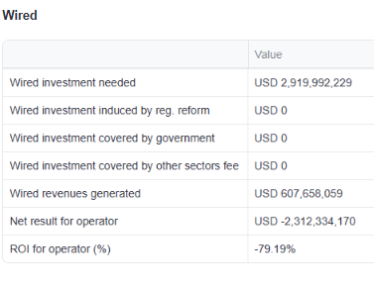
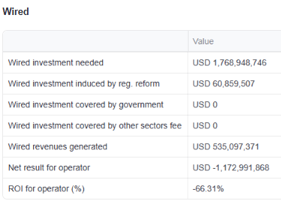
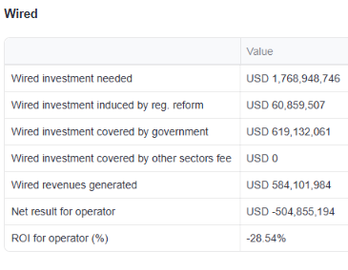
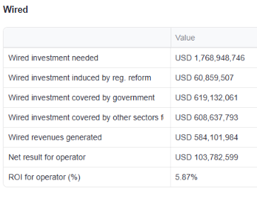
6. Based on the first results, the user can start changing inputs to render the business case more attractive
GEMS
Baseline case: project to expand FTTH coverage to all urban and suburban households (example)
1st scenario: regulatory reform to mandate infrastructure sharing
2nd scenario: (1) + USF covering 35% of investment + government subsidy 40% of price for 50% of population
3rd scenario: (2) + 0.06% fee on other sectors

Slide 55
GEMS is a strategic enabler to address the coordination among governments, private sector, multilateral institutions, and civil society to address the connectivity challenge
GEMS
Positioned as a “diplomatic instrument” to help policy makers negotiate with Multilateral Development Banks, sovereign funds, and other sectors ministries (finance, health, education, etc.) and agencies (innovation, technology competitiveness, etc.)
Promoted as an advocacy platform that can help regulators promote the idea of collaborative digital investment to other sectors of the economy
Help the private sector with access to capital
Stimulate awareness in other government agencies regarding the connectivity challenge

Slide 56



Key Takeaways
CPP and GEMS
1
CPP reveals infrastructure realities, gaps, costs, and optimal rollout paths
2
GEMS translates those realities into GDP
3
Together, they create a powerful evidence loop for regulators, policymakers, and investors
4
Decisions backed by data reduce risk, increase impact, and accelerate digital inclusion
Sophie Kiladze, Chair of the UN Committee on the Rights of the Child
Sophie Kiladze, Chair of the UN Committee on the Rights of the Child
ITUCPP
@ITUCPP
Notes:
Choose which one prefer

Slide 57

Satellite Communications: Regulatory Perspectives
Satellite telecommunications practices across five emerging markets: Brazil, Indonesia, Kenya, Nigeria, and South Africa.
These countries have adopted measures to address universal digital connectivity challenges through satellite technology that represent varying stages of satellite market development and regulatory sophistication.
Each of these countries faces unique geographical, economic, and political considerations as they navigate the expansion of satellites services, from traditional geostationary orbit (GSO) satellites to emerging satellite opportunities such as non-geostationary satellite orbit (NGSO) constellations.
Through detailed case studies of both successful practices and persistent challenges, this analysis provides valuable insights for policy-makers seeking to leverage satellite technology as a crucial component of universal digital access strategies in emerging markets. The case studies analyse topics regarding the regulatory framework, market dynamics, key policy debates, and implementation challenges of the five key countries.

Slide 58
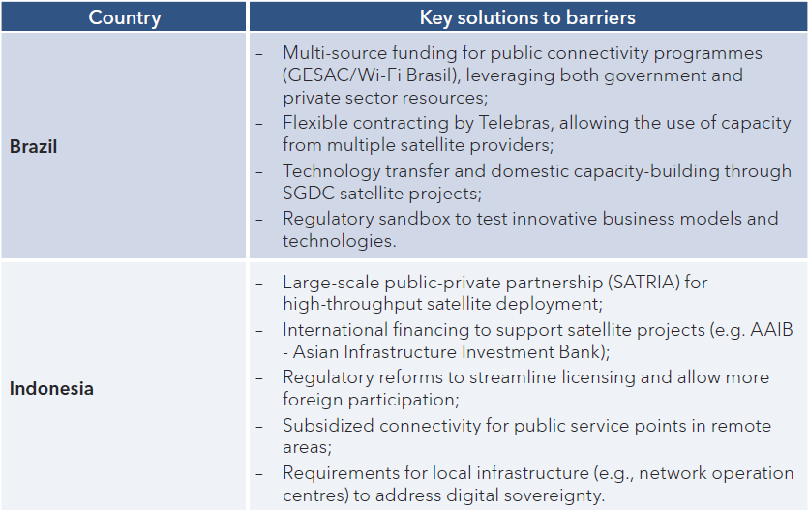
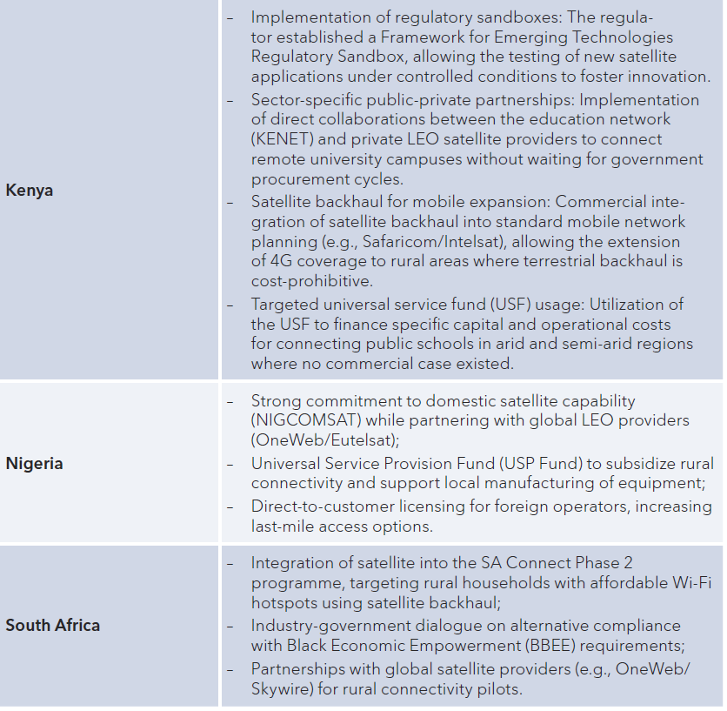
Satellite Communications: Regulatory Perspectives
The main barriers to the expansion of satellite connectivity:
Affordability and funding constraints: the cost of satellite Internet services and equipment remains high relative to average incomes, especially in rural and underserved areas. All countries face challenges in making satellite connectivity financially sustainable, both for end-users and for government-backed programmes.
Digital sovereignty and market concentration concerns: the dominance of foreign satellite operators and the implications for digital sovereignty, including risks of unilateral service disruption and dependency on external providers.
Infrastructure gaps: limited access to reliable electricity in remote areas is a significant barrier, affecting the deployment and operation of satellite terminals. This is particularly acute in rural regions where grid infrastructure is lacking or unreliable.
Technical expertise limitations: there is a shortage of domestic technical capacity to manage, operate, and maintain complex satellite systems, which affects the sustainability and effectiveness of satellite programmes in all count

Slide 59

Thank You !!!
VISIT US: www.itu.int/europe
FOLLOW US: @EURregion
CONTACT US: EURregion@itu.int

