Slide 1
Panel Discussion:
ELECTRONIC COMMUNICATIONS STANDARDS
MODERATOR:
MSc. Liljana Hadjievska – Antovska, ISRSM
PANELISTS:
Prof. Venceslav Kafedziski, FEIT
Msc. Igor Bojadjiev, AEK
Prof. Ljupcho Antovski, FINKI
Jane Antov, Neocom

Slide 2
NATIONAL STANDARDIZATION
IN ELECTRONIC COMMUNICATIONS
MSc. Liljana Hadjievska – Antovska, Head of unit for support of the work of technical committees in the area of electrotechnical standards,
Standardisation Department,
Standardization Institute of the Republic of N. Macedonia

Slide 3

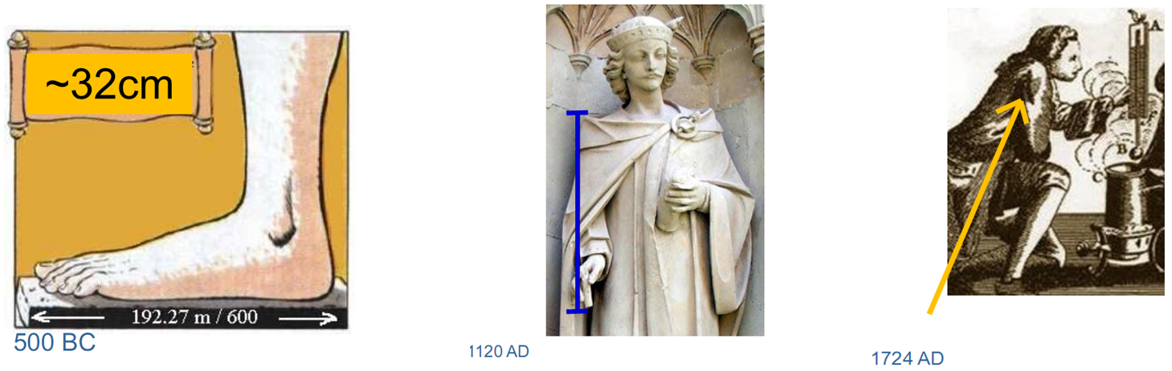
Hercule’s foot =
1 big foot
Distance between the tip of King Henry I's nose and the tip of his index finger = 1 yard
Daniel Fahrenheit's armpit = 96°F

Slide 4


Slide 5
Principles of the European
Standardization system
Transparency
Openness and development dimension
Impartiality and consensus
Effectiveness and relevance
Consistency
Sustainibility and Stability
Notes:
Transparency: European working standardization programme is public and notifications are made in accordance with the Code of Practice for standardization within WTO/TBT
Structures and procedures are public, and there are different mechanisms for cooperation and informing.
Openness: Structures for development of European standards are open for all interested parties (through national delegations and relations organizations etc) National mirror committees are open for representatives of all interested parties, public enquiry is a additional openness element.
European standards are brought on the basis on Consensus.
Coherence: European standards catalogue coherence is supported with coordinative mechanisms within and between European standardization bodies, particularly between the Technical committees.
Globalization: European standardization bodies primarily are taking into account the international standards. Efforts are made, approved international standards to be adopted as European standards. There are cooperation agreements between European organizations and their accompanying international partners towards to competitiveness between standards and its doublings to be avoided.

Slide 6
BENEFITS OF STANDARDIZATION
Improving products or services;
Increasing competitiveness;
Increasing trust;
Reducing the likelihood of errors;
Increasing efficiency and reducing costs;
Product compatibility;
Facilitating the export of goods;
Improving the chances of success;
Improving customer satisfaction;
Reducing negative environmental impacts;
Regulatory compliance.

Slide 7
European towards Macedonian legislative and standardization system
NEW APPROACH DIRECTIVES
EUROPEAN COMMISSION
Official Journal of European Union
MACEDONIAN LEGISLATIVE – TRANSPOSED DIRECTIVES
MINISTRIES WITHIN THE GOVERNMENT OF THE RM
Official Journal of the Republic of N. Macedonia
HARMONIZED EUROPEAN STANDARDS
CEN/CENELEC/ETSI
Official Journal of European Union
MACEDONIAN STANDARDS – ADOPTED HARMONIZED EUROPEAN STANDARDS
ISRSM
Official Journal of the Republic of N. Macedonia
IMPLEMENTATION OF STANDARDS CREATE LEGAL CONFORMITY ASSESMENT OF THE LEGISLATIVE AND MAKES EASIER THE PLACEMENT OF THE PRODUCT ON THE MARKET

Slide 8
History of national standardization
in the Republic of North Macedonia
Bureau for Standardization and Metrology
Standardization Institute of the Republic of North Macedonia
Ministry of Economy
Sector for standardization
2003-
1995-2003
1994-1995

Slide 9
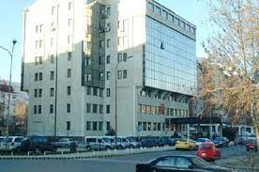
Established in March 2003 as a public institution, with the capacity of a legal entity.
ISRSM as the national standards body represents the interests of the Republic of North Macedonia in international and European standardization, promotes standardization activities, and through the association of public and private stakeholders, prepares and adopts voluntary national standards.
Legal base:
Decision of the Government of the Republic of Macedonia (“OJ of the RM” No. 14/2003)
Law of standardization (“OJ of the RM“ No. 54/02, 84/12, 23/13, 41/14, 53/16, 83/18)
Total Number of Macedonian standards 32000 МКС
https://isrsm.gov.mk/mk/

Slide 10
The ISRSM operate independently and perform its activities under the terms and conditions and in the manner defined by the Law on Standardization, its Statute and internal regulations.
ISRSM perform its activity in accordance with the rules of the European and international standardization organizations and the Code of Good Practise for Preparation, Adoption and Application of standards of the World Trade Organization.
ISRM as a national standardization body represents national interest in international, European and regional organization for standardization, ISRM promotes standardization activities and through bringing together the public and private stakeholders ISRM develops and adopts voluntary national standards.

Slide 11
Preparation, adoption, publication, sale and withdrawal of Macedonian standards and other standardization documents of Macedonian standardization, sale of international and other standardization publications;
Establishment of ISRM technical infrastructure, establishment of Technical working bodies;
Providing information on the Macedonian, regional, European and international standardization;
Representing the interest of Macedonian national standardization in the international and European organizations for standardization;
Performing the notification procedure concerning standards, technical regulation and conformity assessment procedures, in accordance with WTO/TBT Agreement.

Slide 12
Benefits of membership in ISRSM
Regular reporting on the activities of Macedonian, European and international standardization;
Participation in the work of the governing bodies of ISRSM (Assembly and Council of ISRSM) and the Technical Working Bodies of ISRSM (ISRSM TC)
20% DISCOUNT on the purchase of Macedonian standards for members of ISRSM and TC
DISCOUNT on certain services of ISRSM;
DISCOUNT on registration fees for seminars and consultations organized by ISRSM

Slide 13
ISRSM STRUCTURE
Management bodies
ISRSM Assembly
ISRSM Council
Board for control of material and financial operations
Managing body
Director
Internal infrastructure of ISRSM
Technical infrastructure of ISRSM – ISRSM TCs
13

Slide 14
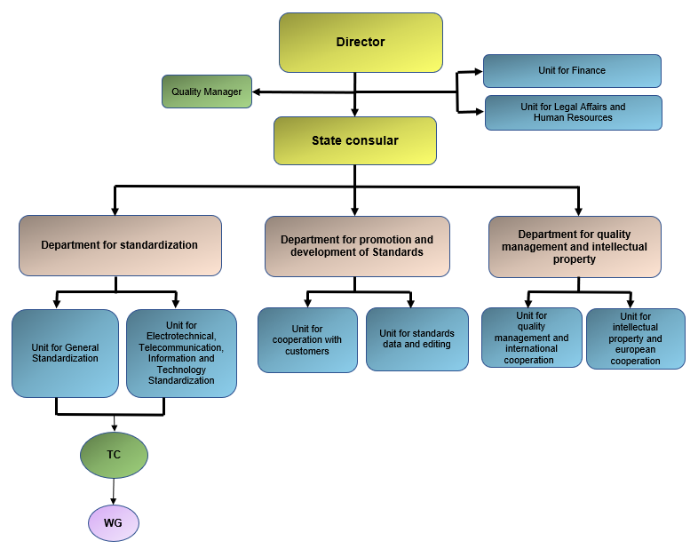
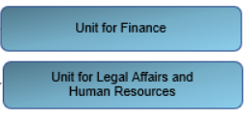
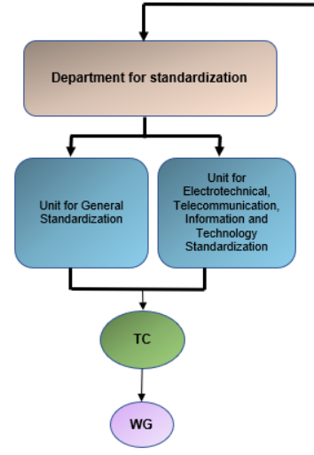
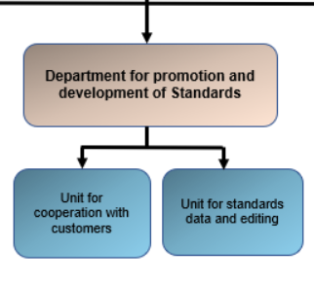
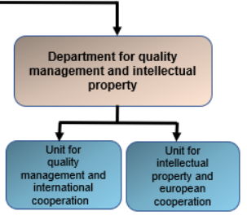
Internal organization of ISRSM

Slide 15
Sale of standards, electronic sale of standards through online sale and My Profile registration
ISRSM also provides education on standardization to interested parties through various thematic presentations, trainings and seminars.
ISRSM is a certified body according to ISO 9001
ISRSM is within the Quality of infrastructure together with Metrology, Accreditation, Legal metrology, Efficient trade system and conformity assessment

Slide 16
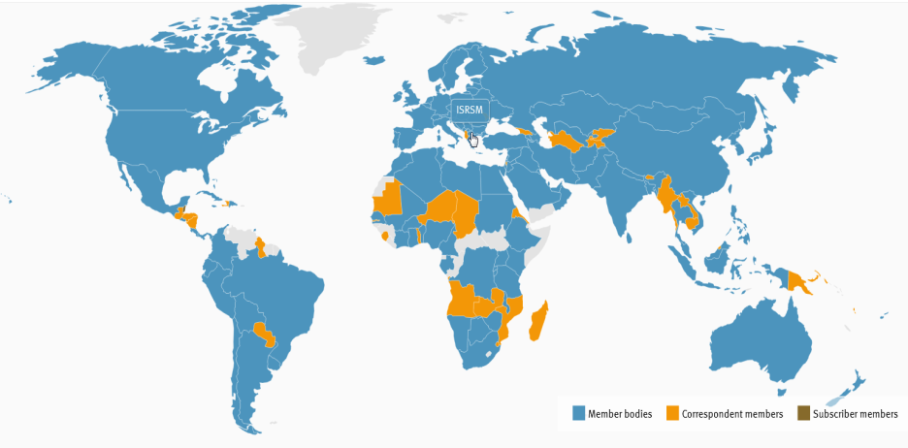



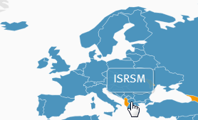


Membership in international and European standard organizations
INTERNATIONAL ORGANIZATION FOR STANDARDIZATION
Меѓународна организација за стандардизација www.iso.org
Full member, since 1995
INTERNATIONAL ELECTROTECHNICAL COMMISSION
Меѓународна електротехничка комисија www.iec.ch
Associate Member, since January 2005
EUROPEAN COMMITTEE FOR STANDARDIZATION
Европски комитет за стандардизација www.cen.eu
Full member, since, July 2012.
EUROPEAN COMMITTEE FOR ELECTRORECHNICAL STANDARDIZATION
Европски комитет за електротехничка стандардизација
www.cenelec.eu
Full member, since, July 2012.
EUROPEAN TELECOMMUNICATIONS STANDARDS INSTITUTE
Европски институт за телекомуникациски стандарди www.etsi.org
National standards body, since December 2006.

Slide 17
COPYRIGHT
The copyright of the standards and standardization documents belongs to ISRM and their duplication, distribution and resale without the consent of ISRM is prohibited and is subject to punishment sanctions in accordance with the Law on Copyright and Related Rights.
17

Slide 18
INTERESTED PARTIES
Consumer Associations
Certification and consulting bodies
Chambers of Commerce
Standardization
Manufacturers
The business community
State authorities
Educational
institutions
Non-governmental
organizations

Slide 19
Participation of ISRM TC in the work of European and international TC’s and WG’s
ISRM
TECHNICAL
COMMITTEES
DELEGATION
EXPERT
Plennary meetings
Development of an standard
CEN/CENELEC/ETSI/ISO/IEC
Technical committees
Working groups
19

Slide 20
Benefits of participating in the work of ISRSM TC
Discounts for various events (conferences, workshops) or materials
20% Discounts when purchasing standards from the scope of work of the relevant ISRSM TC
Access to the latest information on standards and legislation and thus the opportunity to identify the latest trends
Opportunity to influence and participate in the creation of new standards at the European, international and national level
Opportunity to establish relationships and contacts with experts and companies from the same industry in the country and abroad
Increased corporate image as a leader in the relevant industry

Slide 21
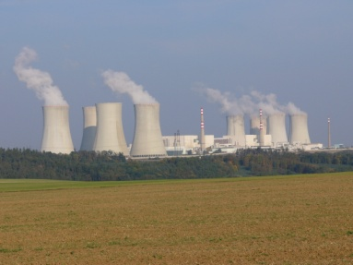
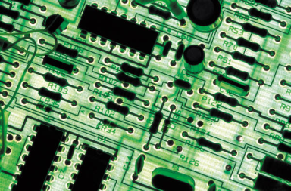


ISRSM HAS BEEN ESTABLISHED TOTALLY 36 ACTIVE TECHNICAL COMMITTEES, OF WHICH 6 ACTIVE TECHNICAL COMMITTEES IN THE ELECTROTECHNICAL AREA AND AREA OF ELECTRONIC COMMUNICATIONS AND ICT:
https://isrsm.gov.mk/en/committee
ISRSM TC 1- Electrical apparatus for explosive atmospheres
ISRSM TC 2 – Electronic communications
ISRSM TC 21– Low voltage equipment and electric cables
ISRSM TC 31– Electrical lighting
ISRSM TC 32 – Electric power and installations
ISRSM TC 34 – Information and communication technologies

Slide 22
ISRSM TC 2 – Electronic communications
The Technical Committee was established on 18.09.2008
35 sessions held so far
Chairman of TC 31 – Prof. Dr. Venceslav Kafedziski
Technical Secretary – M.Sc. Liljana Hadzjevska - Antovska
Number of members with their nominated representatives - 12
Total number of standards covered – 1102 (ISRSM/ETSI database in progress)
Number of projects currently being worked on – continuously
Total number of published (adopted) standards – 891
Total number of withdrawn standards - 211

Slide 23
isrsm tc 2 – scope of work (etsi)
ATTM - Access, Terminals, Transmission and Multiplexing
BRAN - Broadband Radio Access Networks
BROADCAST - EBU/CENELEC/ETSI on Broadcasting
CABLE - Integrated broadband cable telecommunication networks
CYBER - Cyber Security
DATA – Data Solutions
DECT - Digital Enhanced Cordless Telecommunications (DECT)
EE - Environmental Engineering
eHEALTH - eHEALTH
EMTEL - Emergency Communications
ERM - EMC and Radio Spectrum Matters
ESI - Electronic Signatures and Trust Infrastructures
HF - Human Factors
INT - Core Network and Interoperability Testing
ITS - Intelligent Transport Systems
LI - Lawful Interception
MSG - Mobile Standards Group
https://isrsm.gov.mk/en/committee/show/9241

Slide 24
isrsm tc 2 – scope of work (etsi)
MTS - Methods for Testing & Specification
QT – Quantum Technologies
RRS - Reconfigurable Radio Systems
RT - Railway telecommunications
SAFETY - Safety
SAI - Securing Artificial Intelligence
SES - Satellite Earth Stations & Systems
SET - Secure Element Technologies
SmartBAN - Smart Body Area Network
SmartM2M - Smart M2M
STQ - Speech and Multimedia Transmission Quality
TCCE - TETRA and Critical Communications Evolution
USER - User Group
3GPP RAN - Technical Specification Group - Radio Access Network
3GPP SA - Technical Specification Group - Services and System Aspects
3GPP CT - Technical Specification Group - Core Network & Terminals
oneM2M - oneM2M
https://isrsm.gov.mk/en/committee/show/9241

Slide 25
ISRSM TC 34 – Information and communication technologies
The Technical Committee was established on 21.12.2009
35 sessions held so far
Chairman of TC 34 – Prof. Dr. Ljupcho Antovski
Technical Secretary – M.Sc. Liljana Hadzjevska - Antovska
Number of members with their nominated representatives - 15
Total number of standards covered – 1325
Number of projects currently being worked on – 85
Total number of published (adopted) standards – 629
Total number of withdrawn standards - 611

Slide 26
isrsm tc 34 – scope of work (CEN, CENELEC, ISO, IEC)
https://isrsm.gov.mk/en/committee/show/9248
CLC/TC 57 | Power systems management and associated information exchange | ISO JTC 1/SC 2 | Coded character sets
CEN/SS F12 | Information Processing Systems | ISO JTC 1/SC 6 | Telecommunications and information exchange between systems
CEN/TC 224 | Personal identification and related personal devices with secure element, systems, operations and privacy in a multi sectorial environment | ISO JTC 1/SC 7 | Software and systems engineering
CEN/TC 225 | AIDC technologies | ISO JTC 1/SC 17 | Cards and security devices for personal identification
CEN/TC 251 | Health informatics | ISO JTC 1/SC 22 | Programming languages, their environments and system software interfaces
CEN/TC 287 | Geographic information | ISO JTC 1/SC 23 | Digitally Recorded Media for Information Interchange and Storage
CEN/TC 294 | Communication systems for meters | ISO JTC 1/SC 24 | Computer graphics, image processing and environmental data representation
CEN/TC 310 | Advanced automation technologies and their applications | ISO JTC 1/SC 25 | Interconnection of information technology equipment
CEN/TC 365 | Internet Filtering | ISO JTC JTC 1/SC 27 | IT Security techniques

Slide 27
isrsm tc 34 – scope of work (CEN, CENELEC, ISO, IEC)
https://isrsm.gov.mk/en/committee/show/9248
CEN/WS ICT | ICT/SKILLS Workshop (IT profiles and curricula) | ISO JTC 1/SC 29 | Coding of audio, picture, multimedia and hypermedia information
CEN/WS JXF | XFS for the Java Platform | ISO JTC 1/SC 31 | Automatic identification and data capture techniques
CEN/WS LTS | Learning Technologies | ISO JTC 1/SC 32 | Data management and interchange
CEN/CLC/JTC 13 | Cybersecurity and Data Protection | ISO JTC 1/SC 34 | Document description and processing languages
CLC/TC 215 | Electrotechnical aspects of telecommunication equipment | ISO JTC 1/SC 35 | User interfaces
CEN/CLC/JTC 21 | Artificial Intelligence | ISO JTC 1/SC 36 | Information technology for learning, education and training
 |  | ISO/IEC JTC 1/SC 42 | Artificial Intelligence
 |  | ISO JTC 1/SC 37 | Biometrics
 |  | ISO TC 215 | Health informatics
 |  | IEC TC 57 | Power systems management and associated information exchange

Slide 28
Useful links
https://isrsm.gov.mk/en/ - ISRSM web site
https://isrsm.gov.mk/en/committee - ISRSM TC
https://isrsm.gov.mk/en/announcement-paper_c123 – ISRSM announcement paper
https://isrsm.gov.mk/en/chlenstvo-vo-isrsm-isrsm-tk_p20.html - How to become a member
https://isrsm.gov.mk/en/small-and-medium-size-enterprises_p1117.html - SME’s portal
https://isrsm.gov.mk/en/sales-of-standards_p10.html – Sale of standards
https://isrsm.gov.mk/en/overview-of-trainings_p10012.html - Trainings
https://isrsm.gov.mk/en/contact_p10001.html - Contact

Slide 29
THANK YOU FOR YOUR ATTENTION
Contact:
Standardization Institute of the Republic of North Macedonia
Str. Jurij Gagarin No. 15, 3rd floor, Skopje
(Building of the Ministry of Economy and Labor)
tel: +359 2 32 47 150
web site: https://isrsm.gov.mk
e-mail: hadzievska.Liljana@isrsm.gov.mk

Slide 30
ISRSM TC 2 and ETSI Standardization Activities
Prof. Venceslav Kafedziski
University Ss Cyril and Methodius in Skopje
5/18/2026

Slide 31
TK 2-Technical Committee for Electronic Communications
TK2 was founded in 2008.
Current members of TK2 are AEC (Macedonian telecommunications regulator), Ministry of digital transformation, three telecommunication operators, three economic chambers, FEEIT/UKIM, MANU and ETAI Society.
The TK2 is a mirror of ETSI and covers all the standards published by ETSI, including technical specifications.
ETSI was set up in 1988 by the European Conference of Postal and Telecommunications Administrations (CEPT) following a proposal from the European Commission (EC).
ETSI is the officially recognized body with a responsibility for the standardization of information and communication technologies (ICT). It is one of the three bodies officially recognized by the European Union as a European Standards Organisation (ESO), the others being CEN and CENELEC. The role of the ESOs is to support EU regulation and policies through the production of Harmonised European Standards (ENs) and other deliverables.
ETSI unites more than 900 member organizations in and outside Europe, including manufacturers, network operators, administrations, service providers, research bodies and users – all key players in the ICT sector.
Notes:
31

Slide 32
ETSI Technical Committees
ATTM (Access, Terminals, Transmission and Multiplexing)
BRAN (Broadband Radio Access Networks): Wireless broadband technologies.
Broadcasting (EBU/CENELEC/ETSI): Joint committee for broadcasting technologies.
CYBER (Cyber Security): Focuses on securing ICT products, services.
EE (Environmental Engineering): Responsible for sustainability, energy efficiency, and environmental impact of ICT equipment.
EMTEL (Emergency Communications): Defining the requirements, architecture, and standards for public safety and emergency communications.
ERM (EMC and Radio Spectrum Matters): Handles electromagnetic compatibility and radio spectrum regulatory matters.
ESI (Electronic Signatures and Trust Infrastructures): Focuses on security standards for electronic signatures and trust services.
ITS (Intelligent Transport Systems): Standards for cooperative ITS and road safety, including communication between vehicles and infrastructure.
LI (Lawful Interception): Standards for secure, authorized access to communications.
MSG (Mobile Standards Group): Mobile network standards.
MTS (Methods for Testing and Specification): Testing methodology.
QT (Quantum Technologies): Quantum communications and networking and quantum security.
RRS (Reconfigurable Radio Systems): Flexible radio technologies.
RT (Railway Telecommunications): Focuses on GSM-R, FRMCS, and railway interoperability.
SAI (Securing Artificial Intelligence): Establishes global cybersecurity rules and standards to protect AI models and systems.
SES (Satellite Earth Stations and Systems): Satellite communications.
TCCE (TETRA and Critical Communications Evolution): Develops standards for mission-critical communication, voice, and data services.
Notes:
32

Slide 33
Industry Specification Groups and Collaborative Projects
Industry Specification Groups
NFV (Network Functions Virtualisation): An ISG that pioneered the virtualization of network functions.
MEC (Multi-access Edge Computing): Standardizes open frameworks that run applications and process data at the network edge.
ENI (Experiential Networked Intelligence): Focuses on using AI/ML for network management.
F5G (Fifth Generation Fixed Network): Addresses the evolution of pure fiber-to-the-home/office broadband.
ARF (Augmented Reality Framework): Develops standards for AR components.
ZSM (Zero touch network and Service Management): Focuses on end-to-end automation of network and service management.
RIS (Reconfigurable Intelligent Surfaces): Focuses on new types of smart radio surfaces for 6G.
ISAC (Integrated Sensing And Communications): Coordinates pre-standards research on merging sensing with communication (6G).
THz (Terahertz): Develops technical foundations for communication systems in the 0.1 THz to 10 THz range.
MAT (Multiple Access Techniques): Researches new access techniques for 6G.
CIM (Context Information Management): Standardizes data exchange for smart cities
OEU (Operational energy Efficiency for Users): Addresses power consumption and greenhouse gas emissions in ICT infrastructure.
Collaborative Projects:
3GPP (3rd Generation Partnership Project): While technically a partnership, 3GPP is largely hosted and managed within ETSI, defining global standards for 4G, 5G, and 6G.
oneM2M: A global initiative for IoT, which ETSI is a founding member of. Its specifications provide a framework to support a wide range of applications and services such as smart cities, smart grid, connected car, home automation, public safety and health.
Notes:
33

Slide 34
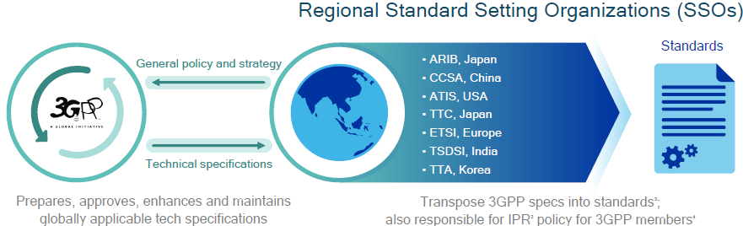
What is 3GPP?
3GPP drives global standards for cellular technology
Develops global technical specifications for 2G, 3G, 4G, 5G and 6G mobile devices
3GPP is a partnership of seven regional Standard Setting Organizations (SSOs)
Formed to create and maintain global wireless communication standards

Slide 35
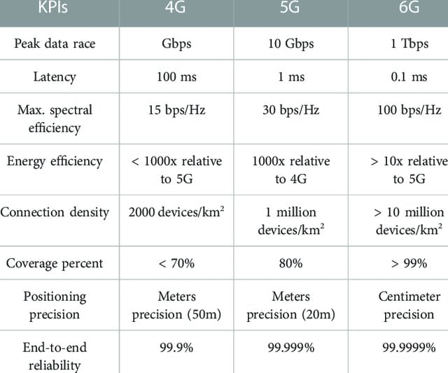
KPI Comparison of 4G, 5G and 6G
Notes:
35

Slide 36
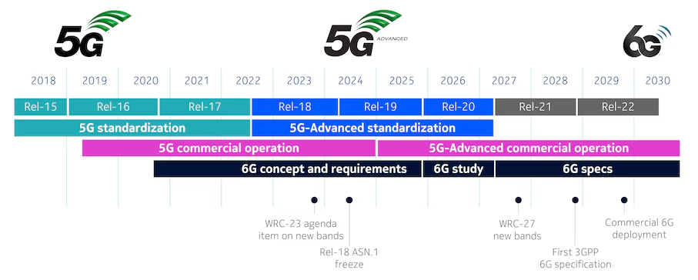
3GPP 5G Evolution
Notes:
36

Slide 37
ETSI Mobile Communications Standards
While 3GPP handles the global, highly technical engineering specifications for mobile networks (4G LTE, 5G NR, and 6G), the ETSI TC Mobile Standards Group (TC MSG) serves a distinct, vital role: bridging those global blueprints with European law, regulatory spectrum limits, and market access.
The ETSI TC MSG performs several key functions that 3GPP does not handle directly:
  1. Enforcing Regulatory Compliance (with RED)
  To sell cellular equipment inside the European Union, manufacturers must prove their devices comply with the Radio Equipment Directive (RED). TC MSG drafts and maintains Harmonised European Standards (such as the EN 301 908 series for IMT cellular networks). These standards explicitly convert 3GPP parameters into legally binding rules regarding electromagnetic compatibility (EMC), radio spectrum efficiency (Article 3.2 of the RED), and human health/safety limits.
  2. Funneling European Demands Into 3GPP
  TC MSG acts as a primary filter and regional representative. It monitors upcoming European Union regulatory changes or spectrum shifts and formally submits them as "European Regulatory Requirements" directly into the 3GPP technical working groups.
  3. Overseeing European Emergency Systems (eCall)
  4. Holding Legacy and Local Specifications

Slide 38
ETSI 5G Standards
Key 5G EN Standards (Harmonised). These standards are essential for manufacturers to demonstrate that their 5G equipment complies with the EU Radio Equipment Directive (RED):
ETSI EN 301 908-1: The "common requirements" part of the IMT cellular network series that applies to 5G as well as earlier generations. Adopted version is МКС EN 301 908-1 V15.2.1 from 2024, which is the latest version in 2026 as well).
TK2 is in the process of adopting the following 5G standards:
ETSI EN 301 908-23: Harmonised Standard for Active Antenna System (AAS) base stations, focusing on IMT cellular network radio spectrum access and including Advanced beamforming and Massive MIMO. It defines technical requirements for transmitter/receiver performance, including radiated measurements (OTA) and undesired emissions, ensuring conformity with RED.
ETSI EN 301 908-24: Refers to 5G New Radio (NR) Base Stations.
ETSI EN 301 908-25: Refers to 5G New Radio (NR) User Equipment (phones, tablets, IoT devices) and covers essential requirements for spectrum use.
TK2 is in the process of updating the following standards to include 5G:
ETSI EN 301 908-18 (V17.1.1): For Multi-Standard Radio (MSR) Base Stations that include 5G NR. (adopted version is V15.1.1, required version is V17.1.1).
ETSI EN 301 489-52: Specifically deals with Electromagnetic Compatibility (EMC) for 5G mobile terminals. (adopted version is V1.2.1, required version is V1.3.1).
Notes:
38

Slide 39
ETSI Cybersecurity Work
ETSI has become one of the most influential organizations in European cybersecurity standardization. Its work spans:
IoT security,
critical infrastructure protection,
digital identity,
trust services,
AI security,
quantum-safe cryptography
ETSI Technical Committees (TC) that cover security
TC CYBER (Cyber Security): The primary ETSI committee for cybersecurity. It develops baseline standards for consumer IoT, cybersecurity for critical infrastructures, and quantum-safe cryptography. It also coordinates standards supporting EU legislation like the Cyber Resilience Act (CRA).
TC ESI (Electronic Signatures and Trust Infrastructures): Develops standards for trust infrastructures and trust services that enable secure electronic signatures, digital identities, authentication, timestamping, and legally trusted electronic transactions under frameworks such as eIDAS.
TC SAI (Securing Artificial Intelligence): Focuses on developing safeguards to mitigate vulnerabilities in AI algorithms, data, and machine learning systems against adversarial threats and manipulation.
Notes:
39

Slide 40
ETSI Standards for IoT Security
ETSI Standard | ETSI Committee | Main Purpose
ETSI EN 303 645 | ETSI TC CYBER | Baseline cybersecurity requirements for consumer IoT devices
ETSI TS 103 701 | ETSI TC CYBER | IoT cybersecurity assessment and testing methodology
ETSI TR 103 621 | ETSI TC CYBER | Provides practical guidance, best practices, and execution steps
Notes:
40

Slide 41
ETSI EN 303 645
Item | Description
Standard | ETSI EN 303 645
ETSI Committee | ETSI TC CYBER
Main Topic | Cybersecurity requirements for consumer IoT devices
Scope | Smart home devices, household appliances, wearables, cameras, consumer routers, smart TVs, consumer IoT appliances
Main Objective | Improve baseline security of connected consumer devices
Importance | One of the world’s most influential IoT cybersecurity standards

Slide 42
ETSI EN 303 645
Main Security Requirements
  No universal default passwords
  Secure software and firmware updates
  Vulnerability disclosure mechanisms
  Secure storage of credentials and sensitive data
  Secure communications
  Minimize attack surface (unused physical ports and unnecessary network ports/protocols must be disabled by default).
  Ensure software integrity
  Make it easy for consumers to delete personal data
  Make installation and maintenance easy
  Validate input data

Slide 43
EN 18031 (CEN/CENELEC)
CEN/CENELEC EN 18031 is a European harmonized cybersecurity standard family for connected/radio products, supporting the EU Radio Equipment Directive (RED) compliance. Adopted by ISRSM TK34 as MKS standard.
It defines cybersecurity requirements for:
  internet-connected radio equipment (including smartphones, laptops, and routers),
  IoT devices,
  wireless consumer products,
  smart devices.
Standard | Main Scope
EN 18031-1 | Common cybersecurity requirements for internet-connected radio equipment
EN 18031-2 | Security for devices processing personal/location data
EN 18031-3 | Security for devices handling monetary value or virtual currency

Slide 44
Digital Trust
Digital trust represents confidence that digital systems and services are:
secure,
authentic,
reliable,
private,
operating as intended.
It enables trusted:
electronic transactions,
digital communications,
online services,
digital identities.
Digital trust is essential for:
e-government,
online banking,
e-commerce,
secure telecommunications,
AI-enabled services,
trusted digital infrastructures.
Notes:
44

Slide 45
Components of Digital Trust
Component Purpose
Electronic Signatures Authentication and non-repudiation
Digital Certificates Identity verification
Trusted Timestamping Proof of integrity and existence
Cryptography Confidentiality and secure communications
Authentication Verify users/devices/services
Trustworthy AI Reliable and safe AI behavior
Public Key Infrastructure (PKI) is the foundational cybersecurity architecture that manages, distributes, and verifies digital identities and encrypted communications across the internet
Notes:
45

Slide 46
ETSI Digital Trust Standards
ETSI Standard | ETSI Committee | Main Purpose
ETSI EN 319 401 | ETSI ESI | General requirements for trust service providers (TSPs)
ETSI EN 319 411 | ETSI ESI | Security requirements for TSPs issuing digital certificates for identities, web servers, or digital signatures
ETSI EN 319 421 | ETSI ESI | Trusted timestamping services
ETSI TS 119 312 | ETSI ESI | Approved cryptographic algorithms and suites
Notes:
46

Slide 47
Quantum-Safe vs Quantum-Secure Communications
Quantum-Safe (Post-Quantum) Cryptography
Uses classical cryptographic algorithms resistant to quantum attacks
Runs on conventional computers and networks
Intended to replace RSA (Rivest-Shamir-Adleman) which relies on the difficulty of factoring massive prime numbers and ECC (Elliptic Curve Cryptography), which relies on the algebraic structure of elliptic curves over finite fields.
Examples:
lattice-based cryptography
hash-based signatures
code-based cryptography
Quantum-Secure Communications
Uses principles of quantum mechanics directly
Usually based on Quantum Key Distribution (QKD)
Eavesdropping can be physically detected
Requires specialized quantum communication hardware
Notes:
47

Slide 48
ETSI Standards for Quantum-Safe and Quantum-Secure Communications
Standard | Committee / Group | Purpose
ETSI TS 103 744 V1.2.1 (2025-03) | ETSI TC CYBER WG QSC | Quantum-safe Hybrid Key Establishment
ETSI GS QKD Series | ETSI ISG QKD | Quantum-secure communication using QKD
ETSI TR 104 171 (2026-03) | ETSI TC CYBER WG QSC | Quantum Random Number Generators (QRNG)
ETSI TR 104 239-1 (2026-03) | ETSI TC CYBER WG QSC | Quantum-safe framework and threat analysis
The ISG for Quantum-safe cryptography (QSC) is now Working Group (WG) of TC Cyber
There exists ISG for Quantum Key Distribution (QKD)
Notes:
48

Slide 49
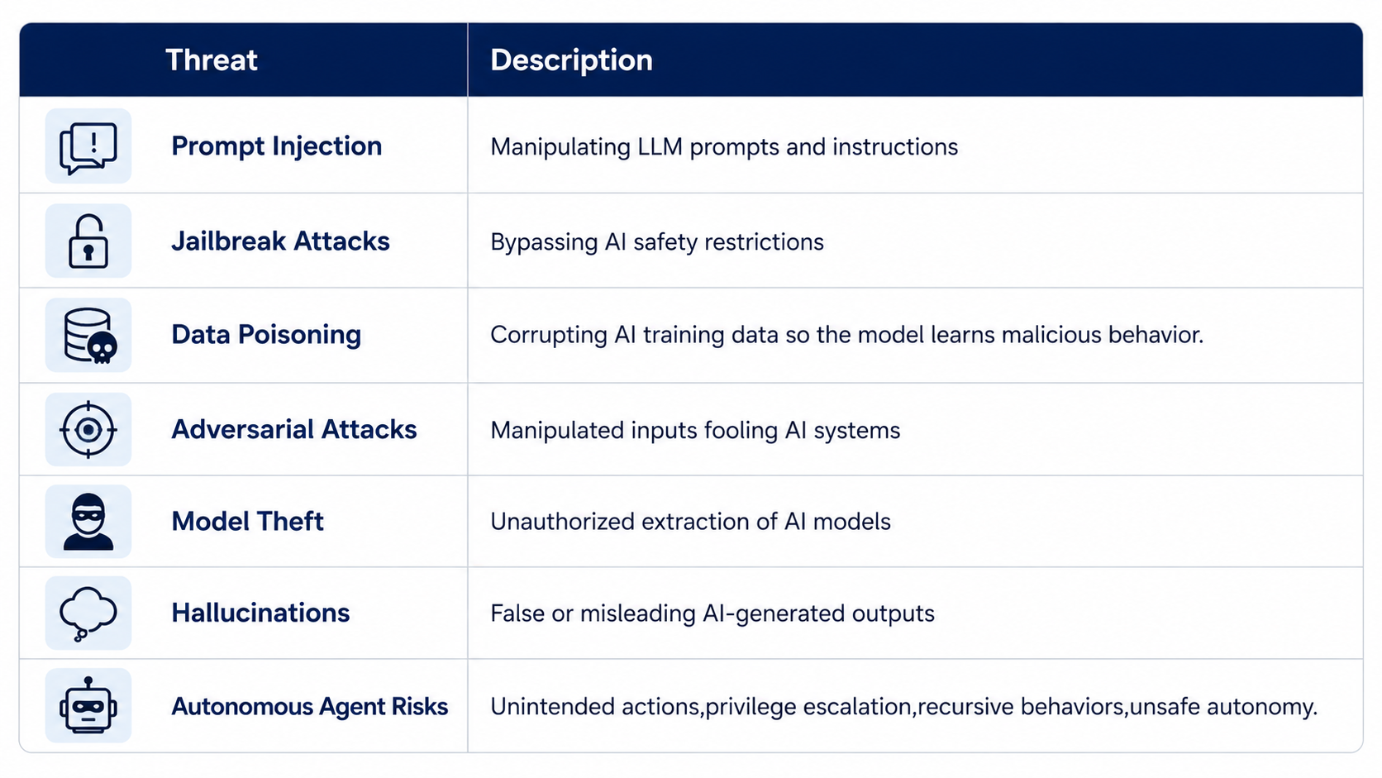
Security of AI
Security of AI focuses on protecting AI systems against attacks, manipulation, misuse, unsafe behavior, malicious inputs.
Notes:
49

Slide 50
ETSI EN 304 223: Cybersecurity for AI Systems
  Publication Date: January 15, 2026.
  Draft Approval: Late 2025.
  Announcement of Existence (doa): By March 31, 2026, NSOs must formally announce the standard.
  National Adoption/Endorsement (dop/e): By September 30, 2026, NSOs must publish or endorse the standard as a national standard.
Item | Description
ETSI Committee | ETSI TC SAI
Main Topic | Baseline cybersecurity requirements for AI models and systems
Scope | Covers AI systems including generative AI and deep neural networks
Main Threats Addressed | Data poisoning, prompt injection, model manipulation, adversarial attacks
Lifecycle Phases | Secure design, development, deployment, maintenance and end-of-life
Main Objective | Secure and trustworthy AI systems across the entire AI supply chain
Relation to EU AI Act | Supports implementation of cybersecurity requirements of the EU AI Act
Notes:
50

Slide 51
ETSI EN 304 223: Cybersecurity for AI Systems
Key Security Principles
  Secure AI system design
  Risk assessment and threat management
  Secure infrastructure and supply chain
  Protection of AI models, prompts and training data
  Continuous monitoring, patching and maintenance
  Human oversight and accountability
  Importance
  ETSI EN 304 223 is considered one of the first major international standards specifically adopting a whole life-cycle approach.
  ETSI EN 304 223 defines 13 principles and requirements across five phases: secure design, secure development, secure deployment, secure maintenance, and secure end of life.
Notes:
51

Slide 52
EU AI Act
The EU AI Act is the world's first comprehensive legal framework on artificial intelligence. Officially entering into force in August 2024, the regulation establishes harmonized rules for developing, marketing, and using AI technology within the European Union. The AI Act is mostly about making AI trustworthy, safe, controllable, transparent, and secure.
EU AI Act mainly refers to:
  regulation of AI systems themselves,
  safety and trustworthiness of AI,
  governance of AI risks,
  security of AI systems and their societal impact.
The EU AI Act uses a risk-based approach, dividing AI systems into four categories according to the level of risk they pose to safety, fundamental rights, privacy and society:
  Unacceptable Risk
  High Risk
  Limited Risk
  Minimal Risk
Notes:
52

Slide 53
EU AI Act Timeline
Feb. 2025
Prohibited Practices – Strict bans on social scoring, behavioral manipulation, and public biometric tracking.
Aug. 2025
General AI Rules – Enforceable copyright compliance and risk governance for foundational GPAI models.
Aug. 2026
High-Risk Software – Mandatory conformity audits for standalone tools (e.g., HR, recruitment, education tech).
Aug. 2026
Basic Transparency – Compulsory user notification when individuals interact with basic AI chatbots.
Dec. 2026
Deepfake Labeling – Enforceable watermarking mandates for AI-generated text, audio, and visual media.
Aug. 2027
Embedded High-Risk – Mandatory safety compliance for AI embedded in hardware (e.g., medical devices, aviation).

Slide 54
ISRSM TC 2 – Electronic communications
MSc. Igor Bojadjiev
Agency for electronic communications (AEK)

Slide 55
Connection with ETSI
ETSI (European Telecommunications Standards Institute) standards (electronic communications, intelligent transport systems and medical electronic)
AEC represents Macedonia in ETSI since 2006 (full member on the 48th General Assembly in Nice)
AEC and TK 2 are competent and in continuous contact with relevant European institutions
Standardization enables a greater degree of interoperability, encourages innovation, helps companies and opens up new markets, creates trusted products, expands the market, reduces prices and increases competitiveness
Standardization is the basic requirement for open information exchange, without which the network society simply would not function
ETSI unites more than 900 member organizations in and outside of Europe, including manufacturers, network operators, administrations, service providers, research bodies and users – all key players in the information and communication technologies sector

Slide 56
Obligations according to the Law on Electronic Communications
Encouraging the development of public electronic communication networks and services in Macedonia, in order to ensure economic and social development
Encouraging the use and development of broadband
Protection of the rights of users, including end-users with disabilities and end-users with special social needs
Efficient use of radio frequency spectrum and numbering
Promoting the development and encouraging investments in public electronic communications networks by introducing new technologies and services, and in particular by introducing next generations of public electronic communications networks

Slide 57
Construction of Electronic Communication Networks
Besides Macedonian norms for construction of public electronic communications networks are applied standards or technical specifications of ETSI, CEN (European Committee for Standardization), CENELEC (The European Committee for Electrotechnical Standardization), ITU, ISO (the International Organization for Standardization), IEC (International Electrotechnical Commission) and CEPT (European Conference of Postal and Telecommunications Administrations)

Slide 58
AEC’s Jurisdiction
Performs supervision and control and monitors the operations of operators in accordance with the Law on Electronic Communications and the regulations adopted on its basis;
Performs control and monitoring of the radio frequency spectrum, as well as examination and detection of harmful interference;
Issues permits for the use of radio frequencies;
Coordinates radio frequencies with the regulatory bodies of neighboring and other countries;
Adopts bylaws necessary for the implementation of the Law on Electronic Communications;
Implements the application of national and international standards and technical regulations in the field of electronic communications;
Participates in the work of international organizations and associations of national regulatory bodies in the field of electronic communications
Controls and measures the quality parameters of public electronic communication services;
Controls and measures non-ionizing radiation caused by the use of public electronic communication networks

Slide 59
NFAT-National Frequency Allocation Table
CIVIL | GOVERNMENT | APPLICATIONS | Ibternational Decisions and Recommendations | Standards
470 - 694 MHz
BROADCASTING М18 |  | TV broadcasting: Genevа 2006 |  | MKC EN 302 296
Land mobile |  |  |  | MKC EN 303 340
 |  | Radio microphones and hearing aids: 470-789 MHz | ERC/REC 70-03 | MKC EN 300 422
 |  | PMSE | ERC/REC 25-10 | MKC EN 300 454
 |  | RA: 608-614 MHz (VLBI)
М14
694 - 790 MHz
BROADCASTING М18A
LAND MOBILE M36A |  | MFCN | ECC/DEC/(15)01 | MKC EN 301 908
 |  |  | ECC/DEC/(22)07
 |  |  | ECC/REC/(15)01
 |  | Radio microphones and hearing aids: 470-703 MHz, 733-757.5 MHz | ERC/REC 70-03 | MKC EN 300 422
 |  | PMSE | ERC/REC 25-10 | MKC EN 300 454
 |  | PPDR: 698-703/753-758 MHz and 733-736/788-791 MHz | ECC/REC/(16)03
 |  |  | ECC/DEC/(16)02
790 - 862 MHz
FIXED
LAND MOBILE M36Б |  | Radio microphones and hearing aids: 821.5-832 MHz | ERC/REC 70-03 | MKC EN 300 422
 |  |  | ERC/REC 25-10
 |  | MFCN | ECC/DEC/(09)03 | MKC EN 301 908
 |  |  | ECC/DEC/(22)07
 |  |  | ECC/REC/(11)04
 |  | PPDR: 698-703/753-758 MHz and 733-736/788-791 MHz | ECC/REC/(16)03
 |  |  | ECC/DEC/(16)02

Slide 60
MKC EN/EN
MKC EN 302 296-EMC and DVB-T
MKC EN 303 340-Digital Terrestrial TV Broadcast Receivers
MKC EN 300 422-Radio Microphones
MKC EN 300 454-Wide Band Audio Links
MKC EN 301 908-BS and UE for IMT-2000

Slide 61
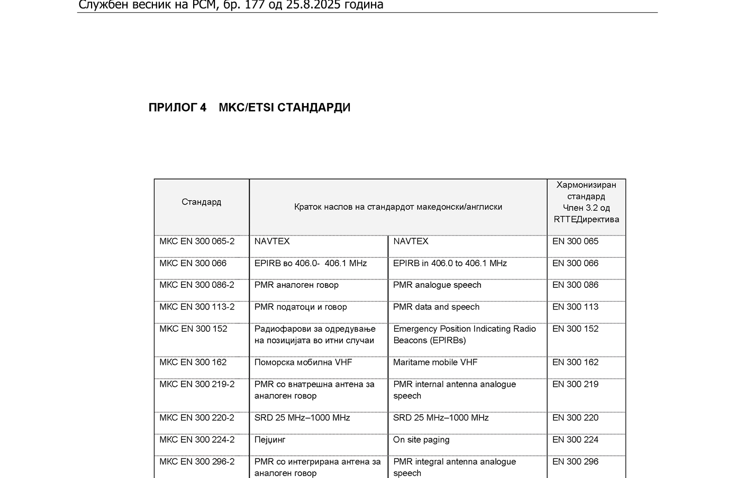
Harmonization of ETSI in MKC EN

Slide 62
Measurements of QoS
Implemented documents of: ITU, CEPT, ETSI and BEREC
Monitoring methodology for assessing the performance of GSM networks (ЕСС Report 118)
Measurements for UMTS coverage (ЕСС Report 103)
LTE coverage measurements (ECC Report 256)
Coverage availability and performance aspects for 5G NR (ECC Report 341)
LTE; Reception from base stations (ETSI TS 136 104)
5G; NR; Base Station (BS) radio transmission and reception (ETSI TS 138 104)
The measurements and measurement equipment meet the technical requirements defined in ETSI TS 102 250

Slide 63
ISRSM TC 34 – ICT Standards
Prof. Ljupcho Antovski, FINKI
ljupcho.antovski@finki.ukim.mk

Slide 64
Ljupcho Antovski
Professor at FINKI
Chair of TK 34 - ICT Standards
Member of ISO / TC 307 - Blockchain and distributed ledger technologies

Slide 65
TK 34 In a Nutshell
National ICT standardization committee.
Scope: software, computer networks, data, IT security, digital services, e‑government, AI, Blockchain and DLT.
Mirror of key ISO/IEC JTC 1 and CEN/CENELEC/IEC groups (software engineering, data management, cybersecurity, AI, health informatics, etc.)

Slide 66
TK 34 Contributions
Adopts ISO/IEC, CEN/CENELEC and IEC ICT standards into the MK corpus.
Supports harmonization with European practice (ETSI..), reducing fragmentation and compliance costs.
Offers a neutral table where operators, vendors and academia can agree which ICT standards really matter for the country.

Slide 67
TK 34 “Modern” Topics
Cybersecurity: following ISO/IEC JTC 1/SC 27 and CEN‑CENELEC JTC 13 standards on information security, data protection and cybersecurity management.
AI: monitoring ISO/IEC JTC 1/SC 42 and CEN‑CENELEC JTC 21 work on trustworthy AI, governance, risk and transparency.
Blockchain/DLT: tracking ISO/TC 307 standards on identity, smart contracts and interoperable ledgers.

Slide 68
TK 34 Impact and Invitation
ICT Standards turn buzzwords like AI, cybersecurity, blockchain, cloud – into concrete, testable requirements.
Using standards in regulation, licenses and public procurement increases trust, interoperability and safety.
Through TK 34, the country can influence ISO/IEC and CEN/CENELEC work, not only copy it.
Invitation for operators, vendors and public institutions to nominate experts and propose topics where ICT standards can solve real regulatory or market problems.

Slide 69
Data center standards and challenges
Presenter: Jane Antov, Neocom
ISRSM TC 34 - ICT

Slide 70
Data center standards
МКС EN 50600 – (ISRSM Council) - Information technology - Data center facilities and infrastructures
ISO/IEC 22237 - Information technology — Data center facilities and infrastructures
Uptime Institute - Telecommunications Infrastructure Standard for Data Centers
TIA 942 - Telecommunications Infrastructure Standard for Data Centers
ASHRAE (American Society of Heating, Refrigerating and Air-Conditioning Engineers)

Slide 71
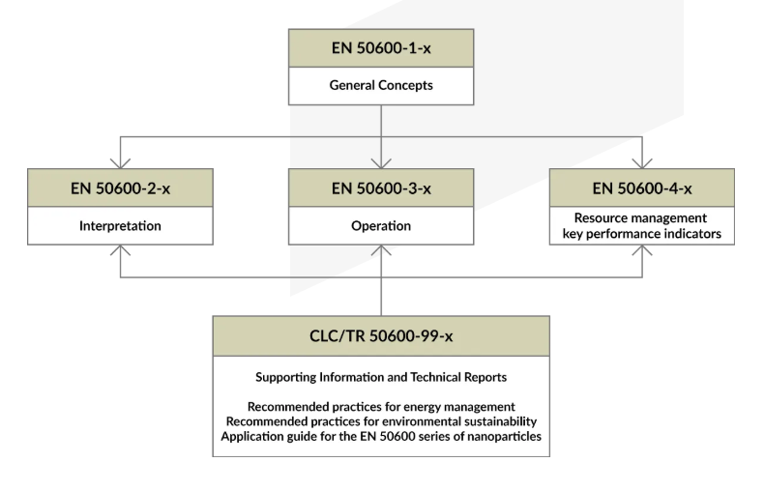
Data center standard EN 50600
Availability Class 1 (Basic): Single, non-redundant distribution path with no redundancy, offering low tolerance for disruption.
Availability Class 2 (Redundant Components): Includes redundant capacity components (e.g., N+1) but operates on a single distribution path.
Availability Class 3 (Concurrently Maintainable): Features multiple independent, active distribution paths, allowing for maintenance without interrupting service.
Availability Class 4 (Fault Tolerant): Designed to withstand a single fault or failure without impacting operations, utilizing fully redundant, active paths

Slide 72
Key parameters, KPIs and challenges
PUE – Power Usage Efficiency
WUE – Water Usage Efficiency
REF – Renewable Energy Factor
Carbon footprint
Reporting

Slide 73
Local market challenges
Energy
Location
Interconnectivity (telecommunication links and capacity)
Design challenges
Civil engineering
Building materials
Competition

Slide 74
THANK YOU FOR YOUR ATTENTION
Contact: Jane Antov, Member of ISRSM TC 34; NEOCOM Skopje
Director of System Integration and Advanced Technologies
jane.antov@neocom.com.mk

Slide 75
THANK YOU FOR YOUR ATTENTION
MODERATOR:
MSc. Liljana Hadjievska – Antovska, ISRSM
PANELISTS:
Prof. Venceslav Kafedziski, FEIT
Msc. Igor Bojadjiev, AEK
Prof. Ljupcho Antovski, FINKI
Jane Antov, Neocom

